Slide 1
Entertainment Streaming Opportunities

Slide 2
Entertainment Streaming Opportunities Download the Recorded Video Presentation or the Native PowerPoint Slides, here: • http://dusil.com/

Slide 3
Agenda - COBS
Opportunities
Behaviors
Challenges
Strategies

Slide 4
Challenge – USA Cinema
Revenue decline in USA cinema is offset by increased ticket prices
Sources – http://www.the-numbers.com/, http://www.boxofficemojo.com/

Slide 5
Opportunity – International Cinema
32.2% CAGR
2.1% CAGR
Sources – http://www.the-numbers.com/, http://www.boxofficemojo.com/

Slide 6
Opportunity – Int’l Cinema Forecast
# | Country | ’13 Revenue
1 | USA | 10.9b US$
2 | China | 3.6b US$
3 | Japan | 2.4b US$
4 | UK | 1.7b US$
5 | France | 1.6b US$
6 | India | 1.5b US$
8 | South Korea | 1.4b US$
9 | Russia | 1.4b US$
7 | Germany | 1.3b US$
10 | Australia | 1.1b US$
3.8% CAGR
billion US$
http://www.statista.com/statistics/259987/global-box-office-revenue/

Slide 7
Opportunity - Film Production
Worldwide film production has grown by over 4% year over year
4.3% CAGR
http://data.uis.unesco.org/index.aspx?queryname=51
Notes:
Interestingly, the USA is not the largest producer of feature-length films and has not held that title for many years. (The US film industry is still the largest in terms of box office revenues, however.) India’s Bollywood produces well over a thousand 1 films per year, making it the most prolific film-making nation. (India comes in at third with box office revenues of $2.2 billion in 2010 behind the US’s $10 billion and Japan’s $2.5 billion, and China has only recently surpassed the $2 billion threshold.) Next on the production list, Nigeria’s Nollywood has taken second place in the race to produce movies, churning out nearly a thousand films per year aimed at a thriving home theater market. (Nigeria actually produced more films than India circa 2007, but India has since re-claimed its number one spot.) Obviously, the US movie industry has many more well-known films than any other country, but it comes in third on the list of movie-making nations with roughly 700 feature-length movies made each year.

Slide 8
Cloud • Digital Entertainment
Video Editing
Video Entertainment
Metadata Databases
Social Networking
Video Delivery
Video Hosting
Video Conferencing
Notes:
Let’s look deeper into cloud service, specifically for digital video. Adobe entered the cloud business model with their Adobe®Anywhere for video, announced at NAB, in April 2013 (http://www.adobe.com/aboutadobe/pressroom/pressreleases/201304/040413AdobeAnywhere.html). Avid also announced at NAB’14 (http://mandetech.com/2014/06/23/avid-everywhere-launches-at-nab2014/), their own cloud based video editing service called Avid Everywhere. Next are entertainment platforms such as Netflix and Hulu, which are fundamentally cloud based services. Metadata databases, social networks, also focus on consolidating and delivering video assets. In terms of Infrastructure as a service, aka. Content Delivery Networks or CDN’s connect to video hosting services such as from Amazon or Microsoft. Video conferencing services are examples of IaaS.

Slide 9
Opportunity – Gaming
The global game industry has performed extremely well over the last decade
PWC, Gartner, iDate
10.1% CAGR
Sources: PWC, Gartner, Digi-Capital

Slide 10
Opportunity – Music Industry
Eggs are no longer in one basket
Steady growth in these top 5 categories:
Radio advertising music
Recorded music sales
Musical instrument sales
Live performance revenues
Portable digital music players
+ other income categories
IFPI (International Federation of the Phonographic Industry)
Floor 64 - Sky Is Rising (12.Jan)

Slide 11
Cloud • Computing & Communications
CRM
Storage
Gaming
Music
Messaging
Productivity
Social Networking
Notes:
Let’s look at a few services that are all considered quite mainstream, when discussing cloud services. Salesforce.com was founded in 1999, and has since become a SaaS powerhouse with 2014 revenues of 4billion US$ and a market cap of around 33billion US$. In the last decade several companies have grown their brand presence in Storage, Gaming, Music, and Messaging. Even Microsoft finally gave in and launched their Office 365 service in June 2011.

Slide 12
Opportunity – Growth in TV & VoD
iDate - DigiWorld Yearbook '13, Next Gen TV

Slide 13
Opportunity – Global Entertainment
5.7% CAGR
pwc - Global Entertainment & Media Outlook '11-'15
Notes:
“In other words, for all the reports that people just want stu" for free, and are not willing to spend on entertainment, the actual data shows that they’re spending noticeably more on entertainment today than they did ten years ago.”

Slide 14
‘‘
’’
Global revenues from TV & video will reach €483 billion by 2017,
up from €392 billion in 2012, according to new research.
iDate - IDATE’s World TV & New Video Services Market
iDate - IDATE’s World TV & New Video Services Market

Slide 15
Opportunity – Global Entertainment
5.6% CAGR
pwc - Global Entertainment & Media Outlook '11-'15
Notes:
“In other words, for all the reports that people just want stu" for free, and are not willing to spend on entertainment, the actual data shows that they’re spending noticeably more on entertainment today than they did ten years ago.”

Slide 16
‘‘
’’
By 2017, linear TV will continue to generate 91% of income, while VoD will represent 7% of the total video market.
iDate - IDATE’s World TV & New Video Services Market
iDate - IDATE’s World TV & New Video Services Market

Slide 17
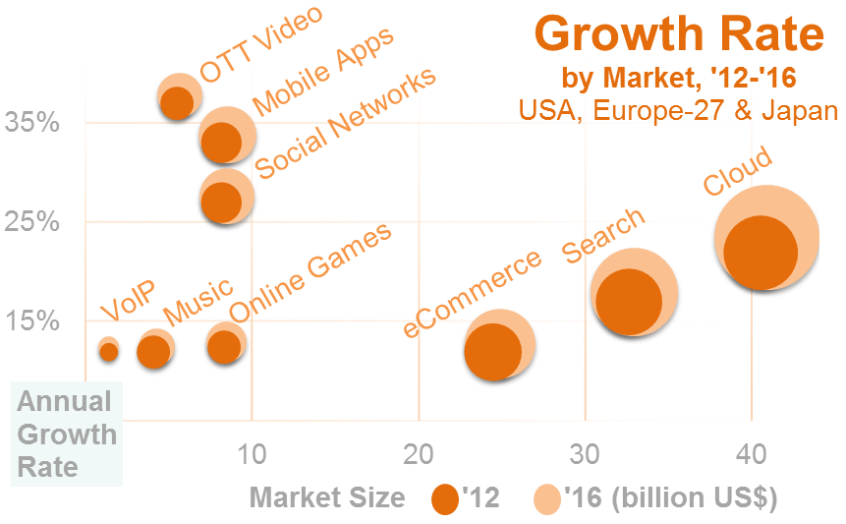
Opportunity – Market by Industry
iDate - DigiWorld Yearbook ‘13

Slide 19
Synopsis – Entertainment Streaming Opportunities
Check out other white papers, video presentations, and opinion pieces from my blog “Digital Video for a Digital Generation": dusil.com
Building a new Video Streaming service starts from understanding the market landscape. We’re all familiar with the SWOT analysis: Strengths, Weaknesses, Opportunities & Threats. But dissecting the challenges in the Video streaming industry is about understanding problems, before a solution can be formulated. Creating a gap-analysis is the next step in recognizing opportunities in this rapidly changing market space. Then, examining subscriber behavior ensures that we look through the lens of the consumer. Once those steps are completed, we can formulate a strategy to build an innovative and competitive video streaming service. This presentation takes a modern market approach for video streaming through an assessment of Challenges, Opportunities, Behaviors, & Strategies (or COBS)

Slide 20
Tags – Entertainment Streaming Opportunities
2nd Screen, Broadcast, COBS, Connected TV, Digital Rights, Digital Video, DRM, dusil.com, Entertainment Streaming Behaviors, Entertainment Streaming Challenges, Entertainment Streaming Opportunities, Entertainment Streaming Strategies, Gabriel Dusil, Internet Video, Linear TV, Multi-screen, Multiscreen, Online Video Platform, OTT, Over the Top Content, OVP, Recommendation Engine, Return On Investment, ROI, Search & Discovery, second screen, Smart TV, TCO, Television, total cost of ownership, TV Anywhere, TV Everywhere, Video Streaming

