Slide 1
Entertainment Streaming Behaviors

Slide 2
Entertainment Streaming Behaviors Download the Recorded Video Presentation or the Native PowerPoint Slides, here: • http://dusil.com/

Slide 3
Agenda - COBS
Opportunities
Behaviors
Challenges
Strategies

Slide 4
Behavior – Cutting the Cord
Ericsson - TV & Video, Changing the Game ('12)

Slide 5
Behavior – Pay-TV vs. the Internet
Cord cutters
Cord shavers
Cord-nevers

Slide 6
Behavior – Average Time Spent per Device
Ericsson - TV & Media (13.Aug) – Average viewing in 12 Markets: US, UK, China, Spain, Sweden, Brazil, Taiwan, South Korea, Germany, Mexico, Chile, Italy

Slide 7
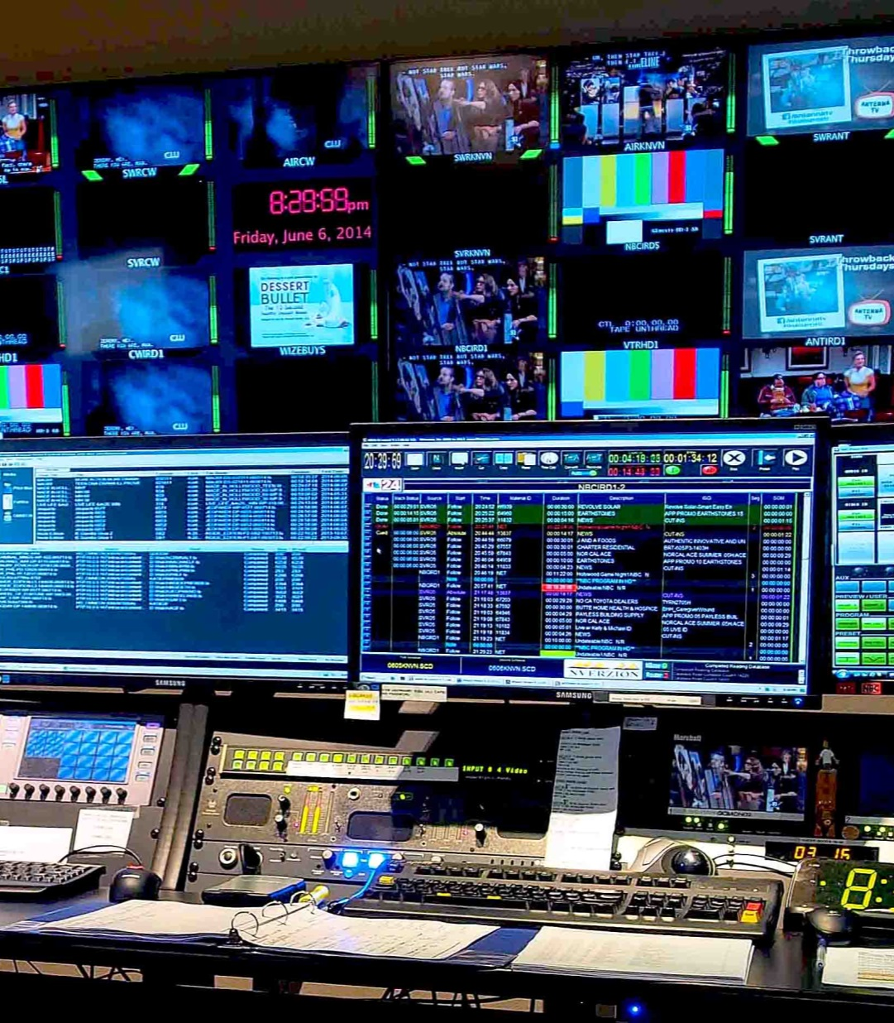
Broadcast TV Over the Top
Notes:
To begin with, let’s look at the differences between Broadcast TV (linear television), and Over the Top services that use the internet to deliver video. TV viewing is inherently passive. You turn on the TV, go to your favorite channel and generally leave it alone. In OTT the subscriber needs to actively pursue what they want to watch - they search for something (which means that they need to know what they want to watch in advance), or allow the recommendation engine or social media to guide them to undiscovered content.
Broadcast TV is generally restricted by geography. Whether it be the reach of cable, satellite, or over the air (OTA) antenna. OTT is on the internet so it has global reach. Although content can still be restricted by region by having blackout screens or alternate content, if the provider doesn’t have rights to that country.
TV generally has a lean back experience, and follows from the passive experience mentioned earlier. OTT on the other hand, is first a lean-forward experience (search, discover, recommend, etc). Then once content is found, it turns to a lean-back experience.
Television audiences are general and anonymous in nature. Their channels are broad in scope to address the interests of a wide audience. The broadcaster has a general idea who is watching their content, but they don’t know the exact demographics of their audience. In OTT there is a 1:1 connection to each subscriber.
OTT is very granular in nature, knowing in many cases the age, gender, location, status, and buying behavior – just to name a few. The analytics associated with correlating all of that data is at the center stage of advertisers and marketers. It’s one of the reasons why BIG data has so much attention these days.
Broadcast is typically restricted to the living room, despite technologies that have tried to break away from this restriction. OTT is by default multiscreen.
Finally, TV features are quite restricted. The red button was an attempt to bring some dynamic content to the TV, but has had limited success. Hindsight has taught us that viewers didn’t like the red button, because it took them away from the main broadcast they were enjoying. Multiscreen solves the “red button issue” because the second screen can be used to view complementary content. OTT features are an open door of to millions of applications.

Slide 8
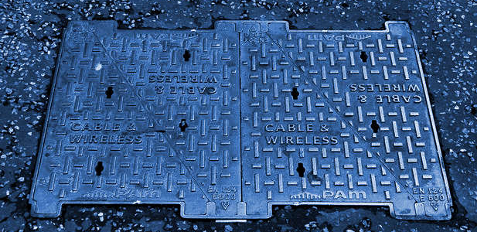
Broadcast TV
Broadcast TV
Notes:
Let’s begin this part of the presentation by looking at what we mean by Broadcast.
Broadcast TV is an infrastructure – consisting of a TV station where content is sourced.
This entertainment is then delivered through satellite, cable or over the air transmissions as the main three delivery mechanisms
Consumption at the consumer level is enjoyed typically on a living room TV

Slide 9
Over the Top
CDN
Transit Providers
Aggregators
Access Providers
Notes:
On the other hand, Over the Top, or OTT content is typically sourced from data centers. This is where Video On Demand services begin – or VoD. In other words, video resides on hard drives, and is then served to the subscriber at their request. Live television is starting to be supported in OTT as well. In this case the source would be a web connected camera, somewhere in the field.
Content for OTT is delivered through the internet. This slide shows an overly simplified model. In reality, there are several interconnections involved in getting from the data center to the subscriber. Namely, the OTT provider typically is connected to their own CDN, or a third party CDN (content delivery network) provider. The CDN’s goal is to get the content to the subscriber in the best quality possible, and as close as they can geographically. This is important since most CDN’s don’t have a direct connection to the end user, and rely on ISPs or an incumbent service provider to send the video to the consumer. This involves a complex network of regional operators that have a peering agreement with the CDN provider – these may be Aggregators or Transit providers. These intermediaries then connect to the “Access Provider”, otherwise known as the network service providers that owns the “last mile”.

Slide 10
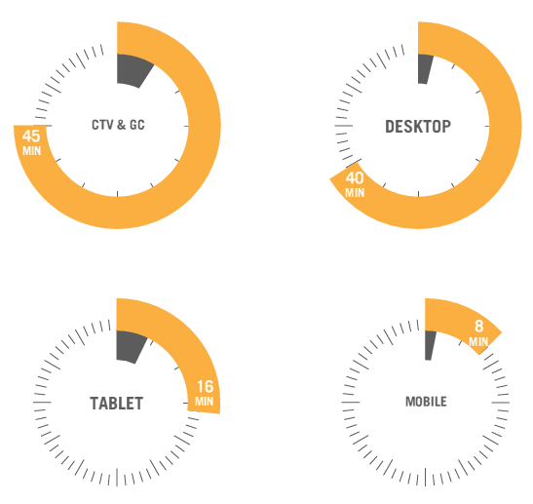
Behavior – Live vs. VOD by device
Live content is mainly on TVs or Desktop PC’s
Tablets & mobiles are reserved for shorter content
Ooyala - Video Index Report (13.Q1)
CTV = connected TVs, GC = Game consoles

Slide 11
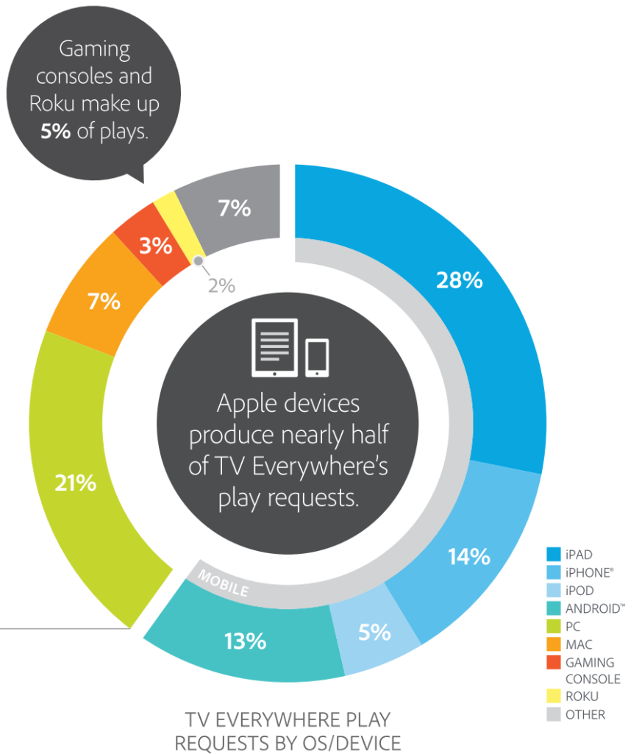
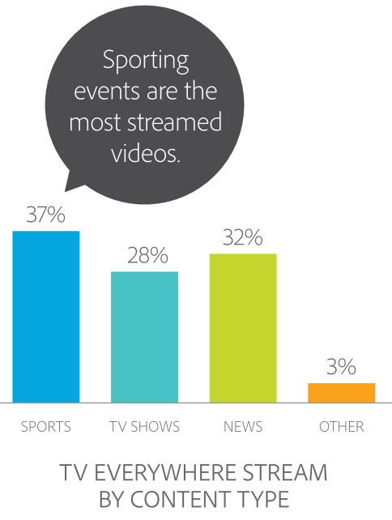
Behavior – Entertainment by Device
Apple Devices produce nearly half of TV play requests
Adobe - U.S. Digital Video Benchmark (13.Q4)

Slide 12
Behavior – 2nd Screen Opportunities
Movies, reality TV, drama, comedy, etc. have the biggest engagement for 2nd screen
Informia - Future of TV, Strategies for Becoming Connected (12.Mar)

Slide 13
Behavior – Popular Activities on 2nd Screen
Read email while watching TV 63%
Using Apps or browse the Internet to kill time 56%
Using Apps or browse the Internet to find Info 49%
Use Social forums while watching TV 40%
Discuss content online
29%
Watch 2 or more programs
25%
14%
Compete with others watching the same show
14%
Watch show from two camera angles
13%
Interact with show through voting or sports betting

Slide 14
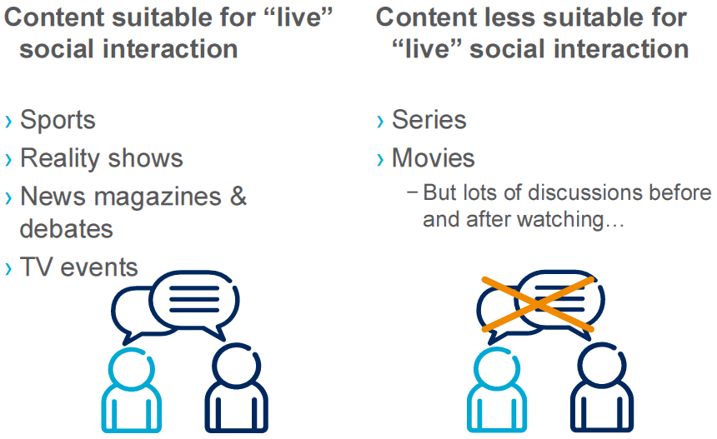
Behavior – Social Networking
Ericsson - TV & Video '11 (Consumer trends, Global, Nov '11)

Slide 15
Behavior - Video Recommendations
Ericsson - TV & Video '11 (Consumer trends, Global, Nov '11)

Slide 16
Behavior – Services Most Worthwhile Purchasing

Slide 17
Behavior – Enterprise Video Content
% respondents preferring to view video content for specific kinds of information:
Content | Response | Duration
Product demos | 89% | 3- 5 minutes
Case studies | 84% | 9 minutes
Video white papers | 84% | 10-19 minutes
Conference preso | 82% | 10-19 minutes
Testimonials | 73% | 3 min. or less
http://www.idgconnect.com/video

Slide 19
Synopsis – Entertainment Streaming Behaviors
Check out other white papers, video presentations, and opinion pieces from my blog “Digital Video for a Digital Generation": dusil.com
Building a new Video Streaming service starts from understanding the market landscape. We’re all familiar with the SWOT analysis: Strengths, Weaknesses, Opportunities & Threats. But dissecting the challenges in the Video streaming industry is about understanding problems, before a solution can be formulated. Creating a gap-analysis is the next step in recognizing opportunities in this rapidly changing market space. Then, examining subscriber behavior ensures that we look through the lens of the consumer. Once those steps are completed, we can formulate a strategy to build an innovative and competitive video streaming service. This presentation takes a modern market approach for video streaming through an assessment of Challenges, Opportunities, Behaviors, & Strategies (or COBS)

Slide 20
Tags – Entertainment Streaming Behaviors
2nd Screen, Broadcast, COBS, Connected TV, Digital Rights, Digital Video, DRM, dusil.com, Entertainment Streaming Behaviors, Entertainment Streaming Challenges, Entertainment Streaming Opportunities, Entertainment Streaming Strategies, Gabriel Dusil, Internet Video, Linear TV, Multi-screen, Multiscreen, Online Video Platform, OTT, Over the Top Content, OVP, Recommendation Engine, Return On Investment, ROI, Search & Discovery, second screen, Smart TV, TCO, Television, total cost of ownership, TV Anywhere, TV Everywhere, Video Streaming

