Slide 1
Getting Your ROI From Video Streaming

Slide 2
Getting Your ROI From Video Streaming Download the Recorded Video Presentation or the Native PowerPoint Slides, here: • http://dusil.com/

Slide 3
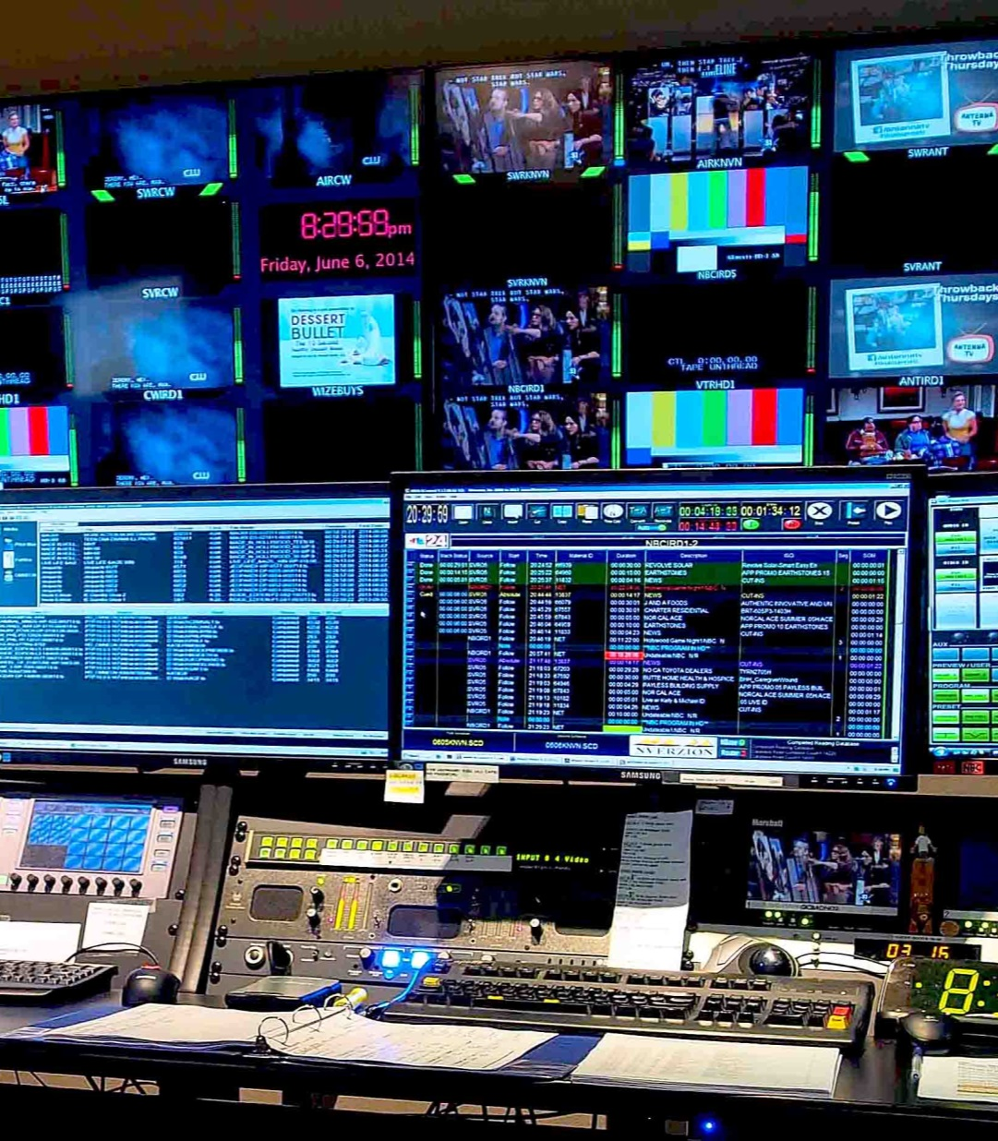
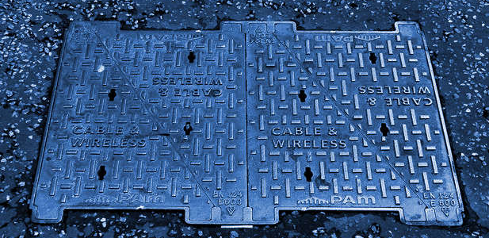
Broadcast TV
Broadcast TV
Notes:
Let’s begin this part of the presentation by looking at what we mean by Broadcast.
Broadcast TV is an infrastructure – consisting of a TV station where content is sourced.
This entertainment is then delivered through satellite, cable or over the air transmissions as the main three delivery mechanisms
Consumption at the consumer level is enjoyed typically on a living room TV

Slide 4
Over the Top
CDN
Transit Providers
Aggregators
Access Providers
Notes:
On the other hand, Over the Top, or OTT content is typically sourced from data centers. This is where Video On Demand services begin – or VoD. In other words, video resides on hard drives, and is then served to the subscriber at their request. Live television is starting to be supported in OTT as well. In this case the source would be a web connected camera, somewhere in the field.
Content for OTT is delivered through the internet. This slide shows an overly simplified model. In reality, there are several interconnections involved in getting from the data center to the subscriber. Namely, the OTT provider typically is connected to their own CDN, or a third party CDN (content delivery network) provider. The CDN’s goal is to get the content to the subscriber in the best quality possible, and as close as they can geographically. This is important since most CDN’s don’t have a direct connection to the end user, and rely on ISPs or an incumbent service provider to send the video to the consumer. This involves a complex network of regional operators that have a peering agreement with the CDN provider – these may be Aggregators or Transit providers. These intermediaries then connect to the “Access Provider”, otherwise known as the network service providers that owns the “last mile”.

Slide 5
Broadcast TV Over the Top
Broadcast TV Over the Top
Engagement • Passive
Reach • Regional
Experience • Lean-back
100’s of Channels few useful
Audience • General
Viewing • Living Room
Features • Limited
EPG, red button, PiP, TV Guide
Feedback • Delayed
Engagement • Active
Reach • Global
Experience • Lean-forward ⇨ back
Create Your Own Channel
Audience • Personal
Viewing • Multiscreen
Features • Interactive
1+ million apps
Feedback • Immediate
Notes:
To begin with, let’s look at the differences between Broadcast TV (linear television), and Over the Top services that use the internet to deliver video. TV viewing is inherently passive. You turn on the TV, go to your favorite channel and generally leave it alone. In OTT the subscriber needs to actively pursue what they want to watch - they search for something (which means that they need to know what they want to watch in advance), or allow the recommendation engine or social media to guide them to undiscovered content.
Broadcast TV is generally restricted by geography. Whether it be the reach of cable, satellite, or over the air (OTA) antenna. OTT is on the internet so it has global reach. Although content can still be restricted by region by having blackout screens or alternate content, if the provider doesn’t have rights to that country.
TV generally has a lean back experience, and follows from the passive experience mentioned earlier. OTT on the other hand, is first a lean-forward experience (search, discover, recommend, etc). Then once content is found, it turns to a lean-back experience.
Television audiences are general and anonymous in nature. Their channels are broad in scope to address the interests of a wide audience. The broadcaster has a general idea who is watching their content, but they don’t know the exact demographics of their audience. In OTT there is a 1:1 connection to each subscriber.
OTT is very granular in nature, knowing in many cases the age, gender, location, status, and buying behavior – just to name a few. The analytics associated with correlating all of that data is at the center stage of advertisers and marketers. It’s one of the reasons why BIG data has so much attention these days.
Broadcast is typically restricted to the living room, despite technologies that have tried to break away from this restriction. OTT is by default multiscreen.
Finally, TV features are quite restricted. The red button was an attempt to bring some dynamic content to the TV, but has had limited success. Hindsight has taught us that viewers didn’t like the red button, because it took them away from the main broadcast they were enjoying. Multiscreen solves the “red button issue” because the second screen can be used to view complementary content. OTT features are an open door of to millions of applications.

Slide 6
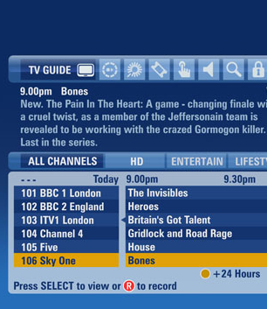
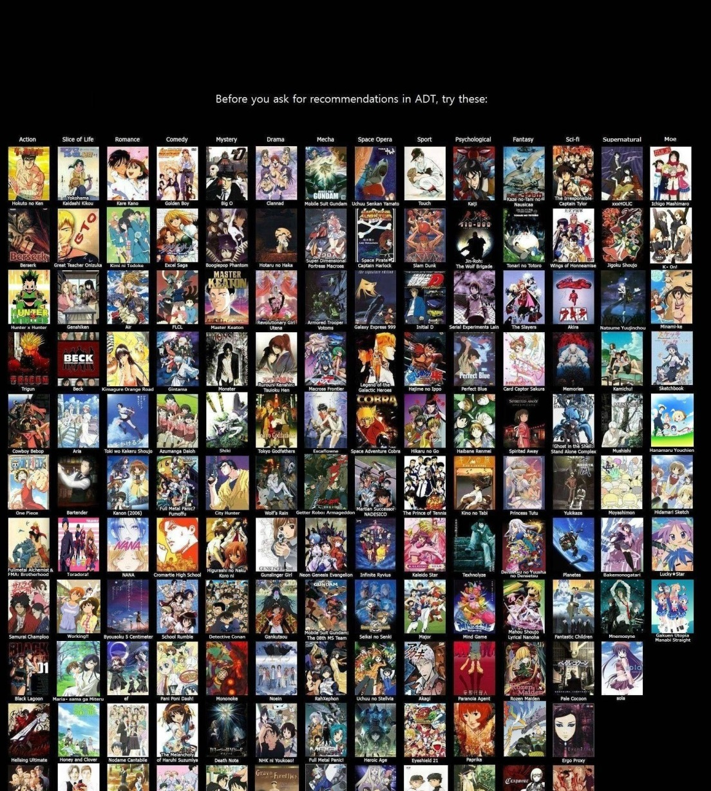
Appliance • TV Cloud • Service
Appliance • TV Cloud • Service
Subscriber Advantages
Local Storage
Skip Ads
Subscriber Disadvantages
No portability
Expensive STB
Provider Advantages
App Control
“Locked” clients
Provider Disadvantages
Expensive STB
Subscriber Advantages
∞ Storage
∞ Apps
Subscriber Disadvantages
Internet Speed & Reliability
Provider Advantages
Central control
1:1 Relationship
Relevant ads
Provider Disadvantages
“Losing control”
Notes:
Another way to explore the ROI of cloud-based video streaming is to look at the features of TV’s set-top-box (STB) and compare that to a cloud-service offering.
In terms of advantages, we can split these into subscriber advantages and service provider advantages. When a subscriber has an STB, and it can be used to record shows, then the subscriber has the ability to fast forward through advertising. Something of a thorn in the side of advertisers. Also, with an STB the provider has control over the subscriber “ they’re locked in because they have our box” – so to speak. This allows the subscriber to control the apps allowed on the STB, and overall digital rights control as well. On the other hand, a cloud service has next to unlimited storage capabilities. But not because the provider is saving a copy for each subscriber, but because all they need to do is save the “in” and “out” points of the content they want – essentially a few bytes of text data. In other words, the provider needs only one copy of the content, and millions of subscribers just have to save a simple text based “pointer” to the content. This is the power of a network based Personal Video Recorder “PVR” or Digital Video Recorder “DVR”. Also the cloud provider can always serve a better version to the subscriber whenever they want, because the content is in the cloud. So when better compression, better resolution, better color depth becomes available, the master can be replaced for the benefit of all subscribers simultaneously. Cloud provider advantages are also more robust centralized control – compared to STB’s that may have issues with connectivity during service issues. They also have a more personal 1:1 relationship with subscribers. This allows the provider to serve more targeted advertising – by demographic, region, and context.
To complete this picture lets look at some disadvantages. STB disadvantages for the subscriber starts from the fact that content is not portable to multiple screens if it sits on an STB. If it resides in the cloud, the subscriber has the flexibility to begin watching on their tablet, then pause, and watch on their mobile, and finish watching on their TV. Expense is another issue - STB’s are essentially computers with motherboards and hard drives. They dramatically increase the cost of a pay-TV service, since the price of the box needs to be amortized a portion of the service term, including delivery, and the burden on service departments. As years pass these STB’s become outdated, and become a burden for upgrading, and servicing. I met a department manager at Comcast at the last NAB’14 in Las Vegas, and she told me that Comcast have over 23 million STB’s deployed that are essentially outdated.

Slide 7
Cloud ROI – Monetizing the Long-Tail
News Sports
Movies & TV Series
Head -end
Long-tail
Long-tail
Most Effective
for Advertising
Most Effective for Recommendation Engines
Popularity • Revenue
Cult-classic
Ideal in Broadcast • Live Content • Sports • News
Ideal for OTT • Movies • TV • Stock Footage
# of Titles
Age of content
Notes:
Another important distinction between Broadcast TV and OTT is in the legacy of content over time. Generally speaking brand new content is most valuable when it is first delivered or launched to an audience. It doesn’t matter if this is live news, sports or premium content such as movies and television series.
In live news and sports, the head-end spike is much more pronounced. Once the live broadcast has finished, then it’s value takes a nose-dive. Any sustained value in news and sports is established through sound-bites and highlight clips, and possibly inclusion into future documentaries, for example.
Premium content, on the other hand, has a much more gradual decay in value. The success of a movie for example is gauged in the revenue generated from it’s opening weekend. After that there is a decay in revenue and overall popularity. Each movie follows a different curve. Those that have a more gradual decline over years can enjoy catalog success titles, or graduate to “cult classic” status (http://en.wikipedia.org/wiki/Cult_classic). Head-end content works very well for broadcasters that utilize advertising as their main means of generating revenue and awareness of up-in-coming live broadcasts.
This pricing decay has it’s advantages as well – mainly to those that are licensing the content for future use, or syndicating it. In other words, the faster the content value decays, the cheaper it becomes for syndication partners, at an earlier stage. Although this may be a bad thing, as a decay implies a failure box-office revenue.
Generally speaking, all content eventually migrates to the long-tail. Over a long period, the long tail library accumulates, and much of the content is “lost” or undiscoverable through traditional means. Long tail content works well with OTT services because recommendation engines, social media, and other discovery methods allow subscribers to experience titles they would never discover on their own. For example, a subscriber may watch the 2014 movie “Maleficent” with Angelina Jolie. The recommendation engine may then suggest the 1987 musical production of “sleeping beauty”, or the 1959 animated Disney production, “Sleeping Beauty”

Slide 8
ROI • • Content Discovery
Requires a Proactive Subscriber to search for what they want
Need to Ask Google the right question
Subscriber Reacts to Recommended Content
Collaborative Behavior
User Ratings
Stats • Plays
Testimonials • Reviews
Likes • Dislikes
Buying • Viewing Behavior
Notes:
Lets look a little deeper into Recommendation engines. Content discovery is a push-pull application. In other words, when a user wants to find content, they need to use Google, Bing or other search engines to find what they want. It’s all about asking the right question, so that you get to the correct answer. This activity is about the user “pushing” themselves towards the direction of the content they are trying to find.
On the other hand, getting someone to recommend content is all about “pull”. More traditional methods of recommendation discovery was through Word of Mouth from Friends or Family, Ads, Critic reviews, Trailers & Teasers, or participation in groups with similar interests
For example a recommendation engine pulls the subscriber to that content. More traditional “Pull” methods have been Word-of-mouth, advertising, Reviews, Trailers, etc. But with internet applications, this “pull” has been much more powerful with social networking, recommendation engines, and correlating the viewing and buying behavior of subscribers.

Slide 9
Revenue Cost
32:1
ROI
Informia – OTT Video Revenue Forecast
AccuStream Research - Integrated Video Platforms
Notes:
Let’s now look at some concrete figures from industry analysts. These figures are from Accustream that did a study on the revenue of online video platforms – in red. We took these figures and mapped them to Informa, who reported on the revenue generated from OTT services, and split them across Transaction, Subscription and Advertising revenue.
This comparison determines that the cost to create an OTT platform to the revenue it could generate has a 32:1 ratio. In other words, the platform should generate over 30 times the cost of the platform itself.
As we discussed throughout this presentation, this does not give us a total cost of ownership assessment, but it’s an interesting comparison to make, nonetheless.

Slide 11
Synopsis – Getting Your ROI From Video Streaming
Check out other white papers, video presentations, and opinion pieces from my blog “Digital Video for a Digital Generation": www.dusil.com
Investing in video streaming services requires a solid understanding of the Return on Investment (ROI) for such a platform. In this presentation we breakdown the value proposition of Over the Top content (OTT) platforms, used to generate new revenue streams from entertainment assets. Understanding ROI, requires a breakdown of cost savings, new revenue streams, feature enhancements, and other intangible benefits. This web seminar looks into various aspects of content management, delivery and consumption, and how cloud-based services such as OTT not only generates new revenue streams, but also opens new doors to monetize entertainment libraries.

Slide 12
Tags – Getting Your ROI From Video Streaming
Fear Uncertainty Doubt, 2nd Screen, Broadcast, Connected TV, Digital Rights, Digital Video, DRM, Gabriel Dusil, Internet Video, Linear Broadcast, Linear TV, Multi + screen, Multiscreen, Online Video Platform, OTT, Over the Top Content, OVP, Recommendation Engine, Search + Discovery, second screen, Smart TV, Social TV, Television, TV Everywhere, Video Streaming, Visual Unity Global, Return On Investment, ROI, Total Cost of Ownership, TCO,

