Slide 1
Defining ROI & TCO for Video Streaming

Slide 2
Defining ROI & TCO for Video Streaming Download the Recorded Video Presentation or the Native PowerPoint Slides, here: • http://dusil.com/

Slide 3
AGENDA
technology
Process
People
New Revenue
Cost Savings
Features & Benefits
Notes:
This presentation is split into two parts. In this part we would like to set the stage, by defining what we mean by Return on Investment. But, in order to discuss ROI, we need to also discuss Total Cost of Ownership, as the two are intertwined. In the second part of the presentation we will then look at the ROI of cloud-based video services in general, and more specifically; video streaming, and Over the top services.

Slide 4
Entertainment • OTT Enterprise • OVP
Entertainment Enterprise
Video is used to attract new subscribers
Maintain loyalty through Enhanced Features & User Experience (UX)
Large & relevant content libraries justify subscription price
Video is used to sell retail products
Sell more product with Demos, Ads, Testimonials, Employee Content
Training Conferencing, Corporate & CEO Announcements
‘‘
’’
‘‘
’’
ROI is a balance between Subscriber revenue & Total Cost of Ownership
ROI is a balance between platform cost & new revenue from vMarketing
Notes:
Let’s begin by first defining the difference between the ROI generated from Entertainment and the Enterprise market. Getting a return on investment can mean different things to different people. Especially when viewed from the industry they come from, and more specifically, the role they play in that company. When we talk about Enterprise, we’re referring here to Online Retails, Corporations, that are not necessarily selling video content to users, but rather, using that content to sell other products.

Slide 5
ROI • Money ROI • Time
ROI • Money ROI • Time
Increased Profit
Increased Revenue
Launching New Services
Streamline Workflow
Higher Client Satisfaction
Efficient Supply Chain
‘‘
’’
‘‘
’’
Focus is on revenue opportunities that advance the corporate strategy
Focus is on opportunities that improve efficiency & competitive advantages
Notes:
In our pursuit of defining “Return on Investment”, we need to look at ROI in the context of not only how a company makes money from their investment, but also how they save money as well. In addition, we can look at ROI in how a company can save time, in the investment that they have made. This time savings can be achieved, for example, through new features and functionality, that improves workflow and streamlines processes. So in the past, time may have been wasted in a broken workflow process, or no workflow existed at all, and a process needed to be established from scratch. A new investment in infrastructure, allows staff to streamline their operations. So an ROI is achieved not only in financial gain, but also in efficiency. An ROI in the context of time would allow the company to focus on more strategic initiatives, an improvement in new features, and enhance their competitive position, for example.

Slide 6
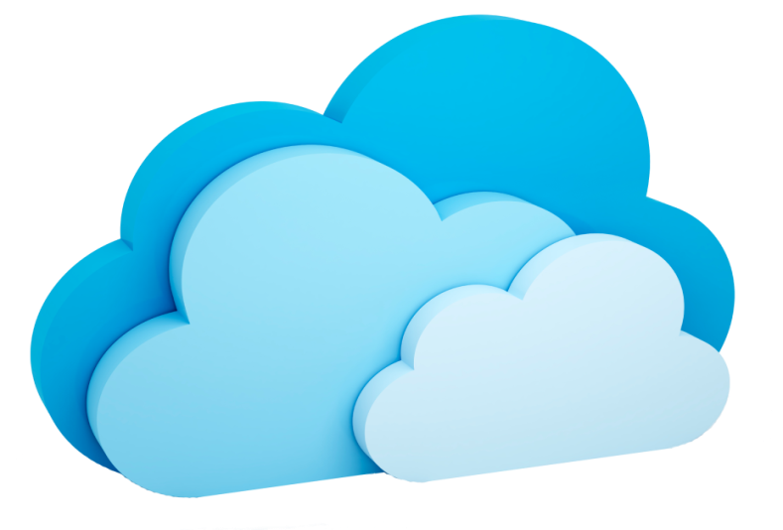
Build It Yourself Cloud Services
Build It Yourself Cloud Services
Hardware • Software
Purchase • Integrate • Operate
Service Level Agreement
Purchase • Integrate • Operate
Operations
Technical
Staffing
Notes:
The two models we would like to look at is the “Build it Yourself” model, and “Utilizing a Cloud-based service”. This slide speaks to the direct link between ROI and Total Cost of Ownership. In both cases the effort is still in purchasing, integrating and operating the new investment, but how this is accomplished is radically different between these two models. When you build it yourself, then typically this is an investment in hardware and software. But a cloud-based service is essentially purchasing a service level agreement. On the HW & SW side, you’re buying something you can touch. But on the SLA side, you’re not necessarily going to get a package in the post, once you make your purchase.

Slide 7
Examining Total Cost of Ownership
Create
Contribute
Manage
Deliver
Consume
Live
Ingest
Dashboard
SW
Staff
Process
CDN
Multiscreen
Management
HW
Services
Analog
HW
SW
SW
Maintain
Process
CRM
HW
MAM
HW
Digital
Transcode
Legend
App
Maintenance
Payment
Legal
SW
HW
Development
SW
Gateway
SW
People
Digitize
Staff
HW
SW
Recommend
Process
HW
Storage
Process
Protection
SW
Technology
© 2014 • gabriel@dusil.com • www.dusil.com
• 7
Notes:
This brings us to the next slide, in looking at the Total Cost of Ownership aspect of a video streaming service.
To better understand TCO we can look at video streaming in these five pillars: Creating content, contributing that content to the platform we are using. Then we manage that content. In this management pillar there are several modules: One is for the dashboard, which gives us a window into the activities of the service we are running. We also need to manage our clients: CRM – or client relationship management. We need to manage our assets – MAM – or Media asset management. In the IT industry we refer to this as our CMS, or content management system. In the media and entertainment world we call it our media asset manager. Next we have our payment platform. Here we manage our advertising activities, and any other asset monetization models such as Transaction video on demand (TVoD), Subscription VoD, or Advertising (AVoD). We also have to have a separate module responsible for content protection. Here sits not just DRM – digital rights management – but we need to protect our content through authentication of users, encryption of content while at rest, vs. in motion (i.e. when we send the video over the internet to the subscriber). Last but not least we have a recommendation engine. These are feature enhancements which serve to generate a higher Average Revenue Per User (APRU), and enhance the client experience by making it more personal. In the delivery pillar we have our content delivery network, which connects the back-end hosting to the subscriber residing somewhere on the internet. The subscriber sits in our fifth pillar which we call “Consumption”. Here sits many multiscreens – TV, Computers, Mobiles, Tablets. But also consists of gaming consoles, set top boxes, and connected devices such as Blu-ray players.
Each of these pillars have a combination of people, process and technology, which represent the total cost of ownership of the platform – whether it is in-house, or in the cloud. Part of a client’s decision process is to decide if they want to have everything reside in their premises. Or if they want it to reside in the cloud. Or to have a hybrid approach, and choose some modules to sit in their premises, while others would be managed in the cloud.

Slide 8
Considerations • Infrastructure Protection
Brand • Image • Credibility
How important is Trust to your subscribers?
Disaster Recovery
Data Loss • Is content quickly restorable?
Down Time
How fast can you recover? • Backup
Redundancy • Repairs
Security • Content at Rest • Content in Motion
• Digital Rights Management • URL link protection • Authentication
Legal Liabilities
• How liable are you if media is lost or stolen? • Subscriber Agreements • Content Rights
Notes:
In the spirit of hidden costs, we can take this discussion to the next level. Here we want to discuss the overhead associated with protecting the companies brand, data, and liability. It leads into the “what if?” scenarios, in protecting the infrastructure. Such as “In the event of a disaster, how will our brand be effected? How will our data be affected? How liable are you in the case of a breach?”
Next is content resilience. In other words, maintaining the stability of the service through redundancy, high availability, and disaster recovery. This leads to security – making sure that while the data is sitting in the database, it is being protected from disaster, or theft, or hackers. And while the data is in motion – i.e. being delivered to the subscriber, that it is protected from theft, piracy, and that the quality of video experience is maintained through features such as adaptive bitrate (ABR).
Finally, a relatively minor component, but still worth mentioning is legal. One is in the negotiation of the content rights, and ensuring they are enforced through the contractual use of the content, as well as subscriber agreements – and this leads to liability as well.

Slide 9
Cloud • Computing & Communications
CRM
Storage
Gaming
Music
Messaging
Productivity
Social Networking
Notes:
Let’s look at a few services that are all considered quite mainstream, when discussing cloud services. Salesforce.com was founded in 1999, and has since become a SaaS powerhouse with 2014 revenues of 4billion US$ and a market cap of around 33billion US$. In the last decade several companies have grown their brand presence in Storage, Gaming, Music, and Messaging. Even Microsoft finally gave in and launched their Office 365 service in June 2011.

Slide 10
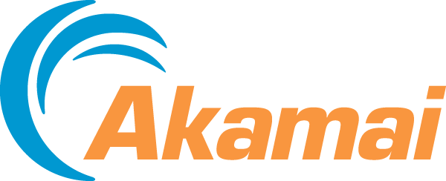
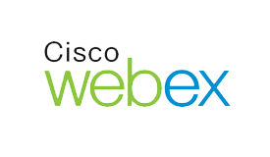
Cloud • Digital Entertainment
Video Editing
Video Entertainment
Metadata Databases
Social Networking
Video Delivery
Video Hosting
Video Conferencing
Notes:
Let’s look deeper into cloud service, specifically for digital video. Adobe entered the cloud business model with their Adobe®Anywhere for video, announced at NAB, in April 2013 (http://www.adobe.com/aboutadobe/pressroom/pressreleases/201304/040413AdobeAnywhere.html). Avid also announced at NAB’14 (http://mandetech.com/2014/06/23/avid-everywhere-launches-at-nab2014/), their own cloud based video editing service called Avid Everywhere. Next are entertainment platforms such as Netflix and Hulu, which are fundamentally cloud based services. Metadata databases, social networks, also focus on consolidating and delivering video assets. In terms of Infrastructure as a service, aka. Content Delivery Networks or CDN’s connect to video hosting services such as from Amazon or Microsoft. Video conferencing services are examples of IaaS.

Slide 11
Fear
Uncertainty
Doubt
Notes:
Fifteen years ago we used to call cloud-services, “Outsourcing”. And in the IT world, outsourcing was somewhat of a four letter word. Only a few companies wanted to outsource. The “outsourcing” term migrated to “Software as a Service”, and eventually expanded to Platform as a service, and Infrastructure as a service as the top three aaS markets. Now there are many more “aaS-as a service” business models (Data Center aaS, ITaaS (http://newtech.about.com/od/cloudcomputing/tp/Top-10-As-A-Service-Cloud-Solutions.htm). In any case, they all reside under the umbrella of cloud-services. Needless to say, there is an outdated stigma associated with outsourcing.
We could speculate that the Fear Uncertainty and Doubt, or FUD associated with cloud-services is in the past, but this is still an concern that lingers in the circles of IT outsourcing sales.

Slide 12
Considerations • Lingering Concerns
Reliability Concerns
Internet Bottlenecks
Upload vs. download
Single point of failure
Latency • Up-time
Control Concerns
“Ownership”
Disconnected from assets
Cost Allocation
Capital vs. Operating
Ego
“Their goal is to Increase their personal power & stature by amassing departments, info & head count”*
* Entrepreneur.com, “Is Your Managerial Ego Too Big?” by Joe Robinson, 11th April 2014, http://www.entrepreneur.com/author/joe-robinson
Notes:
Regardless of the global acceptance of cloud-services, and those cloud services related to streaming video, there continues to be concerns. To begin with there are concerns with Internet reliability. And in this context we are referring to the companies ability to access the cloud-service to manage their video assets. Internet reliability also is greatly effected depending on the geographic region where the company resides, and is largely the result of the internet bandwidth and resilience of the company’s “last mile (last kilometer)” connection to their facilities. Reliability is a combination of “up-time, latency, and overall bandwidth capabilities”, but also is a concern if only a single ISP is used, since the provider ultimately becomes a single point of failure.
Next is the perceived loss of control. It is the perception that if the hardware does not reside under their feet, that there is a loss of control. This was a major issue ten years ago, and much less so, now that companies are accustomed to cloud-services. But it is still a concern.
Next are the cost comparisons between building your own vs. cloud based services. On the surface it looks like buying the software and hardware may be cheaper than paying for a service. But there are many examples now showing that when viewed from the total cost of ownership perspective, that a cloud service is much cheaper. Also, purchasing software is perceived as one time capital cost but many of us know that is simply not true – there are upgrade costs to the software, and to the deployment and integration of that software upgrade.
Finally, this is one aspect to cloud-based selling principles that is not typically discussed. And that is one of “ego” on the side of the decision maker. In other words, there are business owners, or departmental owners that have no interest in buying a service, because it takes away from their plans to building their own personal empire. Their goals center around building large departments of staff, and responsibility. It comes down to what I refer to as the three motivators of man: Power, Wealth, and Fame. This helps to build their empire (the power), and leverage within the organization, and this leads to fame and wealth. A cloud-based service takes away from these goals, because it means less people in the department, and a perceived loss of control, as we discussed earlier. A very good article recently released by Joe Robinson in the footer discusses this quite well. Identifying and navigating around managers that has the ambition to build their own empire is very difficult.

Slide 14
Synopsis – Defining ROI & TCO for Video Streaming
Check out other white papers, video presentations, and opinion pieces from my blog “Digital Video for a Digital Generation": www.dusil.com
Investing in video streaming services requires a solid understanding of the Return on Investment (ROI) for such a platform. In this presentation we breakdown the value proposition of Over the Top content (OTT) platforms, used to generate new revenue streams from entertainment assets. Understanding ROI, requires a breakdown of cost savings, new revenue streams, feature enhancements, and other intangible benefits. This web seminar looks into various aspects of content management, delivery and consumption, and how cloud-based services such as OTT not only generates new revenue streams, but also opens new doors to monetize entertainment libraries.

Slide 15
Tags – Defining ROI & TCO for Video Streaming
Fear Uncertainty Doubt, 2nd Screen, Broadcast, Connected TV, Digital Rights, Digital Video, DRM, Gabriel Dusil, Internet Video, Linear Broadcast, Linear TV, Multi + screen, Multiscreen, Online Video Platform, OTT, Over the Top Content, OVP, Recommendation Engine, Search + Discovery, second screen, Smart TV, Social TV, Television, TV Everywhere, Video Streaming, Visual Unity Global, Return On Investment, ROI, Total Cost of Ownership, TCO,

