Slide 1
Visual Unity Global Corporate Overview
Gabriel Dusil
Chief Marketing & Corporate Strategy Officer
www.linkedin.com/in/gabrieldusil
www.dusil.com
gabriel.dusil@visualunity.com

Slide 2
Visual Unity Global Corporate Overview
Download the Recorded Video Presentation or the Native PowerPoint Slides, here:
• http://dusil.com/

Slide 3
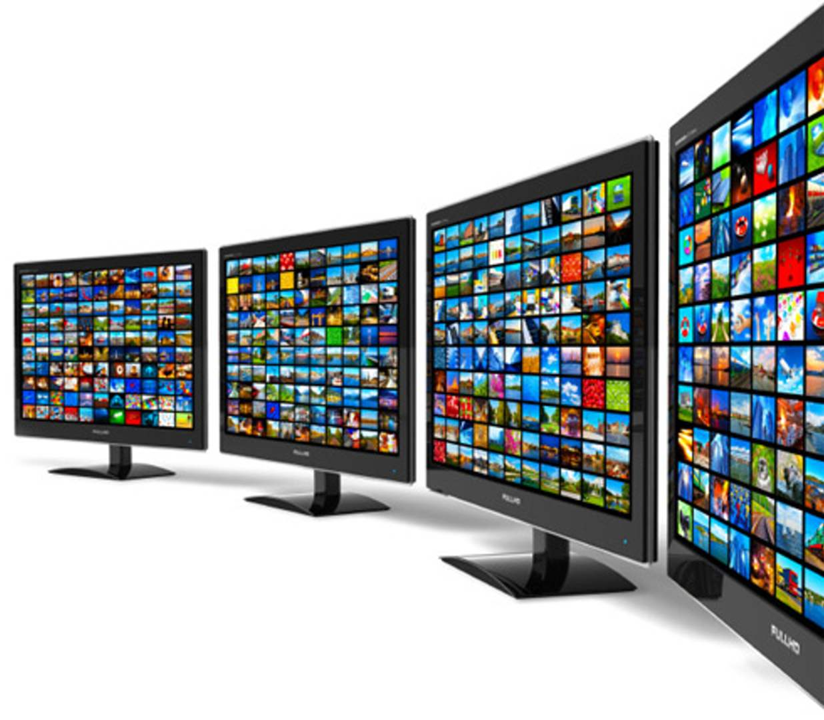

  OTT & Broadcast
  Products
  Services
End-to-end OTT Platform
& Multiscreen Solution Provider

Slide 4



Slide 5






Entertainment
Communication
Computing

Slide 6
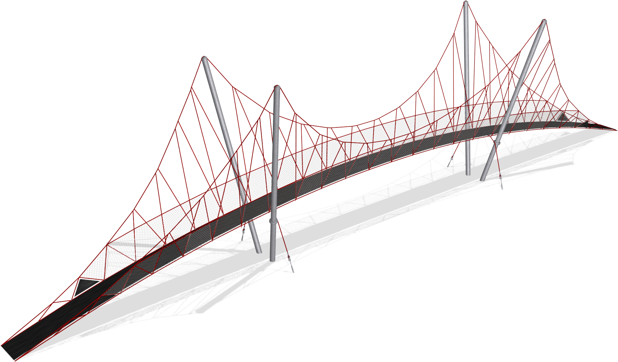
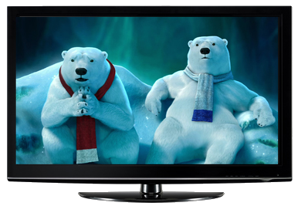
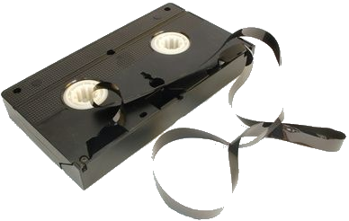



Bridging Broadcast to Multiscreen Solutions
Broadcast Services
TV ⇨ Multiscreen
OTT Platform
Multiscreen Development
‘‘
’’
‘‘
’’
‘‘
’’
We Service Traditional Broadcasters
We Bridge Content
to the Internet
We Enable Multiscreen Delivery

Slide 7









Awards & Achievements

Slide 8


Technical & Market Positioning
Technical Positioning
Market Positioning
22+ years Broadcast
& 15+ years Internet Video experience
Award winning mobile delivery technology
True end-to-end, & modular video platform
Flexible Deliverables: In-house, cloud, or hybrid
Thought leadership in online video services
Multi-cultural & Multi-lingual solutions
Big Enough to Deliver, Small Enough to Listen
Successful reference accounts

Slide 9

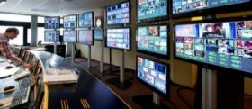





OTT &
Multiscreen
Solutions
Platform Solutions
Cloud Services
• PaaS
• SaaS
Professional Services
  • Design, Build & Support • Project Management
  • Consulting • System Integration

Slide 10
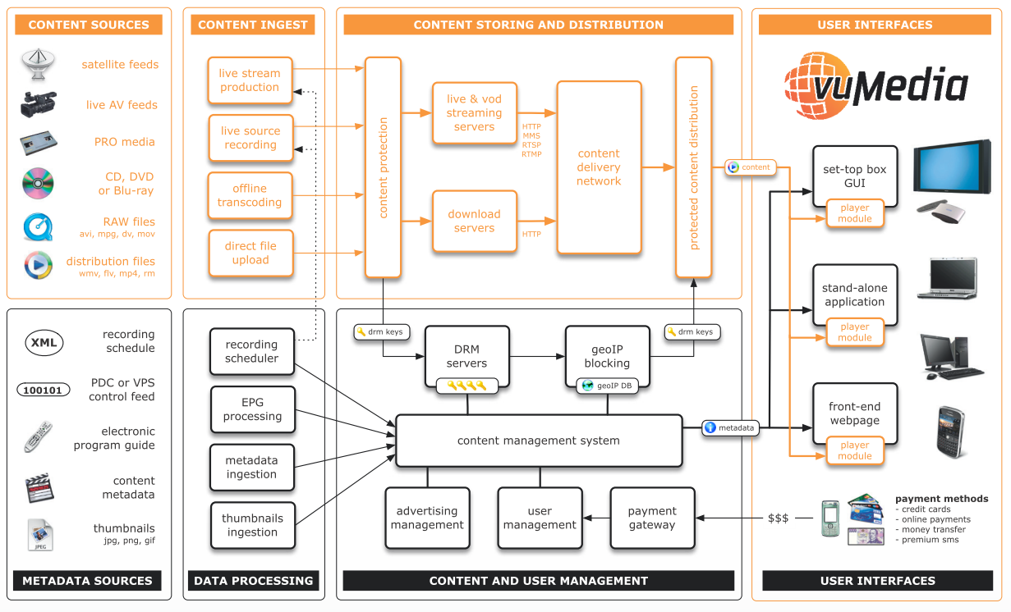

Slide 11






Create
Contribute
Manage
Deliver
Consume
  CDN Agnostic
• SaaS • PaaS •

Slide 12
Create
Contribute
Manage
Deliver
Consume
Contracts
Rights
Analytics
Report
Syndication
Dashboard
Broadcast
Web
Scheduler
Adaptive
Portal
Player
Live
VoD
Optimized
Metadata
Live Streaming
Apps
eShop
Film
Video
Relationship
Management
Tiered Storage
Search
Rate
Responsive
STB
Recommendation
Image
DB
Transcode
Social
Secure
Profiles
Bitrate
GeoIP
DRM
Audio
Disc
Frame Rate
LinkShield
Library
Search
Payment
Ads
Gateway
• SaaS • PaaS •

Slide 13
Professional Services
  Consulting
  Design, Build & Support
  Project Management
  System Integration
OTT architecture
End-to-End Implementation
Project Planning
Best-in-class Partners
Broadcast Design
Monitoring
Best Practices
Interfaces Standardization
Media Management
Service Level Agreements
Troubleshooting
Optimization
Compliance
Software Development
Risk Management
Installation
Advisory Services
Software Maintenance
Severity Management
Training

Slide 14






















Clients

Slide 15





















Partners
Notes:
MJO Note: his graphic was taken from the website - logos should be available on the shared drive. The list needs to be reviewed and updated, eg Omneon is now Harmonic.

Slide 16
Corporate Overview
22+
Award-winning Platform & Solutions
  Turnkey Broadcasting ⇨ OTT & Multiscreen
Multiscreen Solution Provider
  60+ staff
  30% in-house developers
OTT & Internet Video
Expertise
  Media & Broadcast
  Products & Services
Years Broadcast Experience
11
Global
Offices
6.4
Million USD
‘13 Revenue
15+
Years of Internet video experience
OTT = Over the top content. These are services that use an internet connected device to an existing ISP service to deliver content
Notes:
The Visual Unity team has over 20 years of tradition as a Broadcast Systems Integrator principally serving the Central European Broadcast market, including over 15 years as a Multiscreen Systems Integrator (MSI) – bringing Internet, cloud and mobile technology to video broadcasting.
With expected core revenues of $7.2M (2012), and years of demonstrable history of delivering innovative solutions to its clients across the region, the Visual Unity team has been tried and validated. Visual Unity’s expertise as a Multiscreen Systems Integrator with an understanding of traditional broadcast systems gives it a unique competitive advantage – ideally positioned to meet the increasing demand for online and Multiscreen (computer, mobile phone, tablet, smartTV, game console etc…) content distribution by TV networks (broadcasters), movie and production studios (content owners), cable companies (aggregators) and corporate users of video – both internal and external (enterprises)
The team has invested significant resources to develop vuMedia™--an integrated, proprietary, content management & delivery platform that helps broadcasters control, manage & monetized their video content in the Multiscreen environment.
The investor will access the opportunity to participate in and capitalize on the explosive need for Multiscreen broadcast platforms backed by traditional linear broadcast expertise – a near unique proposition on the market – by backing an experienced group of professionals with a validated value proposition for clients

Slide 18
Who is Visual Unity?
Visual Unity bridges the gap between linear broadcast, IT and IPTV to help clients reach and engage audiences on any screen. Since 1991, the team has been designing and delivering turnkey broadcast and complex multiscreen solutions worldwide – from HD outside Broadcast (OB) vehicles and major playout facilities to live internet streaming and Video on Demand services. Visual Unity’s award-winning vuMediaTM platform helps broadcasters and content owners control how their brand and assets are managed and monetized in the multiscreen environment. Highly scalable and flexible, vuMediaTM delivers a cutting-edge live viewing experience on the web or any mobile or connected device – all of which can be deployed into existing workflows and business processes.
Visual Unity is an OTT Platform and Multiscreen Service Provider, enabling global clients to deliver premium quality video content. Our clients can measure, analyze and optimize their libraries over time and achieve optimal business success. Our vuMedia™ platform inspire clients to deploy their content across multiple devices, screens, and platforms. Visual Unity helps clients manage, deliver and monetize their digital assets.
www.visualunity.com
Na Hrebenech II 1718/8, Prague 4, 147 00, Czech Republic
Tel: +420 271 742 111
Fax: +420 271 742 112
info@visualunity.com
Notes:
430 characters (with spaces), 61 words

