Slide 1
The Future of Over the Top Content Services

Slide 2
Download the Original Video & Presentation - The Future of Over the Top Content Services
View the recorded video presentation, or download the native PowerPoint slides here:
http://dusil.com/

Slide 3
Lowering Operating Costs & Increasing Efficiency
H.265
SD 1.6Mbps
H.264
½HD 2.4 Mbps
MPEG2
HD, 5.6Mbps
4K, 22Mbps

Slide 4
SD
⇨ HD
⇨ 4K
3840x2160
1920x1080
1024x576
Notes:
4

Slide 5
H.264 vs. H.265 - Encoding Times
H.264
2160p
2160p
10bit
t
4t
8-16t
H.265
1080p
8bit
2160p
8bit
2160p
10bit
10t
40t
80-160t

Slide 6
4K Digital Video - Minimizing the Consumer Bottleneck
30Mbps or more
100Mbps or more
Up to 18Gbps uncompressed 4K
WiFi 802.11ac
Set Top Box
Smart TV
Game Console
4K UHD TV
Quad Full High Definition (QFHD @ 3840x2160)
HDMI v2.0+
Display Port 1.2+
Router
Wired 100BaseT+
Internet
CPU capable to decode 4K

Slide 7
Audio-Video Adoption in USA Households
Recession
Recession
Recession
Recession
• Nielsen Media Research's - “Penetration of Media Devices in U.S. Homes” • Television Bureau of Advertising - “TV Basics”, Jun ‘12 • Visual Unity Research
Notes:
July 1981 – November 1982: 14 months
July 1990 – March 1991: 8 months
March 2001 – November 2001: 8 months
December 2007 – June 2009: 18 months^{[49][50]}
Wikipedia: http://en.wikipedia.org/wiki/Recession#Global

Slide 8
OTT Evolution - Content Discovery
Viewing Stats
Buying Behavior
Preference “Your Likes & Dislikes”
Reviews, News, & Ads
Collaborate “viewers liked”
Social Media
“Friend’s liked”
Search
A Recommendation Engine is not just about Content Suggestions…
It’s about a Meaningful & Personal Engagement
‘‘
’’
Discovery

Slide 9
Most Useful Recommendations
Ericsson - TV & Video '11 (Consumer trends, Global, Nov '11)

Slide 10
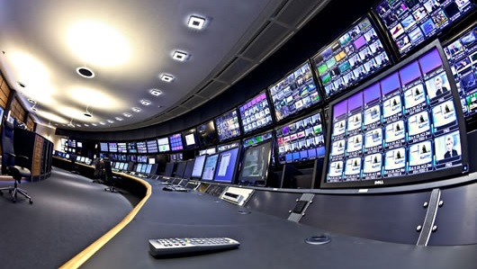
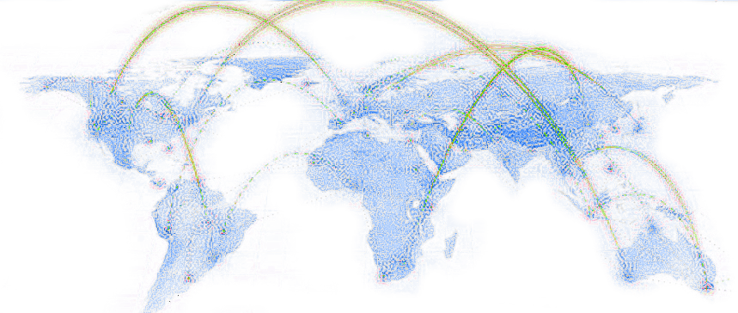
OTT is all about Infrastructure

Slide 11
OTT • Barriers to Entry
Time • Long Development Cycle
36 month to develop a robust platform
Money • Delivery is Expensive
Build CDN infrastructure
Experience • Television & Video
22 years speaking with broadcasters
Building & managing CDNs
15 yrs building end-to-end OTT

Slide 12
The Future of Content Delivery
Product
Select
Consume
4K Video Master
4K Video Master
Theatrical Alternative, Director’s & Extended
Languages
Transcode
Subtitles
Deleted Scenes
Behind the Scenes
Trailer
Deliver
Metadata – Structural & Contextual
Thumbnails Screenshots
Posters Cover Art

Slide 13
OTT Evolution
Coms
Music
Gaming
Storage
Productivity
Video
Social Media
‘‘
’’
OTT will bring Digital Video & Entertainment to tomorrow’s Digital Society

