Slide 1
The Rise, Fall… and Rise of the Entertainment Industry

Slide 2
Download the Original Presentation - The Rise, Fall… & Rise of the Entertainment Industry
View the recorded video presentation from IBC ‘13 at:
http://gdusil.wordpress.com/2013/09/24/the-rise-fall-and-rise-of-the-entertainment-industry
This session was presented by Gabriel Dusil, Senior VP of Marketing & Corporate Strategy at Visual Unity, and was broadcasted live at IBC '13, in Amsterdam on the 14th of September 2013, via the Broadcast Show (http://www.broadcastshow.com/), and powered by TV Bay.
Or, download the native PowerPoint slides, from my blog:
http://gdusil.wordpress.com/2013/09/24/the-rise-fall-and-rise-of-the-entertainment-industry

Slide 3
This is not Multiscreen …

Slide 4
This is … Multiscreen
Computers
Televisions
Smartphones
Tablets
Cinema

Slide 5
Connected TV Devices
Informa Telecoms & Media - Global Installed Base of Connected TV Devices '11-16

Slide 6
Consumer Entertainment Spending
Source: Rentrak & Digital Entertainment Group

Slide 7
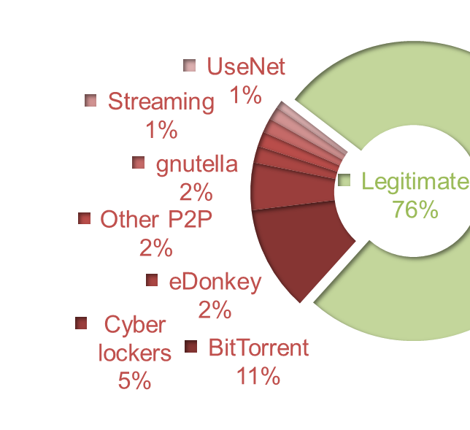
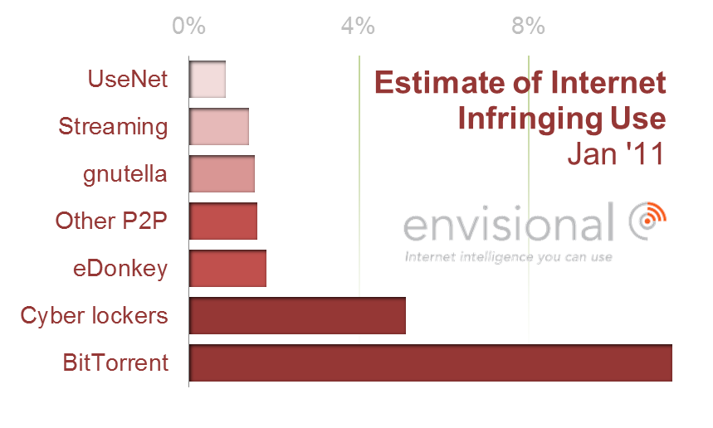
Nearly ¼ of Internet Traffic is pirated content
Envisional - An Estimate of Infringing Use of the Internet (11.Jan)
Notes:
“Unlike bittorrent, eDonkey, and cyberlocker usage, experience indicates that most usage of video streaming is benign and poses no threat to copyright”
Envisional

Slide 8
Torrents by Type

Slide 9
Illegal Inhibitors Legal Drivers
Poor quality & corrupt files
Incomplete bundles
Content management
Security
It’s illegal!
Lack of Content Availability
DRM Complexities & Portability
Access to all_{(most)} content
It’s Free!
Personable & Interactive
User Interface & User Experience
High Quality Content
Piece of Mind “I’m a good citizen”
Lack of Content Availability
Attractive Price
Content Upgradability
Illegal Drivers Legal Inhibitors

Slide 10
Entertainment
Global Entertainment grew from $449b to $745b from ‘98 & ‘10
“That’s quite a leap for a market supposedly being decimated by technological change.”
“Actual data shows that they’re spending noticeably more on entertainment today than they did ten years ago.”
Floor 64 - Sky Is Rising (12.Jan)
Notes:
“In other words, for all the reports that people just want stu" for free, and are not willing to spend on entertainment, the actual data shows that they’re spending noticeably more on entertainment today than they did ten years ago.”

Slide 11
Entertainment Spending
US Household spending went from 4.9% in ‘00 to 5.6% in ‘08 for entertainment.
“[Consumers are] spending noticeably more on entertainment today than they did ten years ago”
Bureau of Labor Statistics
Floor 64 - Sky Is Rising (12.Jan)
Notes:
“In other words, for all the reports that people just want stu" for free, and are not willing to spend on entertainment, the actual data shows that they’re spending noticeably more on entertainment today than they did ten years ago.”

Slide 12
Cinema - USA
Revenue decline in U.S. cinema attendance is offset by a corresponding increase in ticket prices
Net effect is near-flat revenue for the past 10 years in the USA
MPAA - Theatrical Market Statistics '12

Slide 13
Cinema – Int’l Upside
# | Country | ’12 Cinema Revenue
1 | USA | 10.5b US$
2 | China | 2.7b US$
3 | Japan | 2.4b US$
4 | UK | 1.7b US$
5 | France | 1.7b US$
6 | India | 1.4b US$
7 | Germany | 1.3b US$
8 | South Korea | 1.3b US$
9 | Russia | 1.2b US$
10 | Australia | 1.2b US$
MPAA - Theatrical Market Statistics '12, IHS Screen Digest

Slide 14
Cinema
Worldwide box office ticket revenues increased by 25%, from $25b in ‘06 to $32b in ‘10
According to the MPAA
Floor 64 - Sky Is Rising (12.Jan)
Notes:
Interestingly, the USA is not the largest producer of feature-length films and has not held that title for many years. (The US film industry is still the largest in terms of
box office revenues, however.) India’s Bollywood produces well over a thousand 1 films per year, making it the most prolific film-making nation. (India comes in at third with
box office revenues of $2.2 billion in 2010 behind the US’s $10 billion and Japan’s $2.5 billion, and China has only recently surpassed the $2 billion threshold.) Next on the production list, Nigeria’s Nollywood has taken second place in the race to produce movies, churning out nearly a thousand films per year aimed at a thriving home
theater market. (Nigeria actually produced more films than India circa 2007, but India has since re-claimed its number one spot.) Obviously, the US movie industry has many more well-known films than any other country, but it comes in third on the list of movie-making nations with roughly 700 feature-length movies made each year.

Slide 15
Film Production
The film industry has grown worldwide by almost 6% over the 5-year period from 2005 to 2010
Exceeding approximately $82 billion in value
According to PwC
Floor 64 - Sky Is Rising (12.Jan)
Notes:
Interestingly, the USA is not the largest producer of feature-length films and has not held that title for many years. (The US film industry is still the largest in terms of
box o#ce revenues, however.) India’s Bollywood produces well over a thousand !lms per year, making it the most proli!c !lm-making nation. (India comes in at third with
box o#ce revenues of $2.2 billion in 2010 behind the US’s $10 billion and Japan’s $2.5 billion, and China has only recently surpassed the $2 billion threshold.) Next on the production list, Nigeria’s Nollywood has taken second place in the race to produce movies, churning out nearly a thousand !lms per year aimed at a thriving home
theater market. (Nigeria actually produced more !lms than India circa 2007, but India has since re-claimed its
number one spot.) Obviously, the US movie industry has many more well-known !lms than any other country,
but it comes in third on the list of movie-making nations with roughly 700 feature-length movies made each
year.

Slide 16
Music
Online have not offset the decline in disc sales
“Digital single sales growth is slowing: we almost reached 1.4b in ‘12 but it is unlikely that they will reach 1.5b in ’16 before they begin to decline” - Billboard
http://www.billboard.com/biz/articles/news/digital-and-mobile/1521562/building-the-100-billion-music-business-guest-post-by

Slide 17
Music Industry
Enjoying steady growth:
Radio advertising music
Recorded music sales
Musical instrument sales
Live performance revenues
Portable digital music players
+ a few other income categories
IFPI (International Federation of the Phonographic Industry)
Floor 64 - Sky Is Rising (12.Jan)

Slide 18
Gaming
The global game industry has performed extremely well over the last decade
PWC, Gartner, iDate
ESA reports that the average age of American gamers is 37 years old
Floor 64 - Sky Is Rising (12.Jan)

Slide 19
Conclusions
Broadcast landscape is changing thanks to the Internet
Consumer Choice is growing by orders of magnitude
Regardless: Entertainment industry continues with healthy growth
Despite reports of rampant piracy
Gaming, Music, Movies, Video are all growing – some in double digits.
Physical media sales are continuing their nose-dive
Consumers no longer want the “album” when they just need the single
Ownership is being replaced by Accessibility

Slide 21
Synopsis – The Rise, Fall… & Rise of the Entertainment Industry
The Internet has truly changed the playing field of entertainment. With each company that shuts its doors, many more have opened to capitalize on this ever-evolving eMarketplace. The net effect has been certainly disruptive across the music, movie, broadcast, and gaming industries. Disruption can be discussed in a positive and negative context. Some industry proponents blame copyright infringement for their revenue decline. Others thank the unabated proliferation of their content through the Internet, in reaching an untapped global audience. Is the sky falling on the entertainment industry, or is it thriving? Should we be thanking the internet, or blame it. Is this a failure of legacy business models or is it just the evolution of technology? This presentation explores the effect that the Internet has had on the entertainment industry, and looks towards how subscriber behavior is advancing their consumption of entertainment.

Slide 22
Tags - The Rise, Fall & Rise of the Entertainment Industry
Connected TV, Digital Video, Gabriel Dusil, Internet Video, Linear Broadcast, Linear TV, Multi-screen, Multiscreen, New Media, Online Video Platform, OTT, Over the Top Content, OVP, Search & Discovery, Search and Discovery, second screen, Smart TV, Social TV, Visual Unity, TV Everywhere, Broadcast Show, TV Bay

