Slide 1
OTT & New Media Market Opportunities
Gabriel Dusil
SVP Marketing & Corporate Strategy
www.facebook.com/gdusil
cz.linkedin.com/in/gabrieldusil
gdusil.wordpress.com
gabriel.dusil@visualunity.com

Slide 2
Download the Original Presentation
Download the native PowerPoint slides here:
http://gdusil.wordpress.com/2013/06/17/ott-and-new-media-market-opportunities
Or, check out other articles on my blog:
http://gdusil.wordpress.com

Slide 3
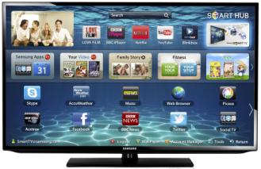
What is “Connected TV”
“There will be over 551 million smart TVs connected to the Net by 2016, about 20% of all TVs in the world”
Digital TV Research
Over the Top (OTT)
IPTV, HTPC
STB, Game Console
Web⇨TV
TV⇨Web
Video On Demand •
Live Streaming & Catch-up •
Time, Place & Device shift •
OTT Goes Global - Worldwide Survey of OTT Services

Slide 4
What is Multiscreen?
Multiscreen
Aspect
Experience
Interaction
Cinema
2.39:1
Lean Back
100 min.
Television | PC, Laptop | Tablet | Mobile
16:9 | 16:9 | 4:3 & 3:4 | 3:2 & 2:3
Lean Back | Lean Forward | Forward & Back | Forward & Back
43 min. | 39 min. | 30 min. | 17 min.
¹
¹ Google - New Multiscreen World (12.Aug)
Figures for TV, PC, Tablet & Mobile

Slide 5
What is OTT?
OTT = Over the Top content
Services that use an internet connected device to an existing ISP service to receive (video) content
❖ eg. Roku, Blu-ray player, Nintendo Wii, Smart TV, Xbox, PlayStation, Tablet, etc.
OTT (Internet Video) will grow 12x from 2012 to 2020
Alcatel-Lucent Bell Labs - “How the tablet generation is pushing networks to the edge”, 13th Dec. 2012

Slide 6
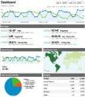
What is OVP?
vuEasy
Monetize
OVP = Online Video Platform
A cloud-based content management solution (CMS) for managing and delivering multimedia (namely video) to subscribers
A solution to manage, publish, measure, and monetize high quality video content on the web.
Manage
Analytics
DRM
Live stream
Adverts
Video
on
Demand
Admin
CMS
Pay
CRM

Slide 7
Multiscreen Solution Provider
What
We Do
Network Operators • Media Companies • Enterprise
Platform Solutions
Service Provider
Software Development
Professional Services
What
We Deliver
Broadcast Design Consulting Project Management Transcoding System Integration
vuMedia
vuNet
vuMultiscreen
vuMobile
vuEasy
For Whom We Deliver

Slide 8
Online will Surpass Broadcast by 2020
By the end of this decade, more people will be watching Internet video than television
SocialTimes.com - http://socialtimes.com/online-video-to-surpass-us-broadcast-tv-by-end-of-decade_b13470

Slide 9
Cloud-based Opportunities
PaaS & SaaS cloud-based services expect strong double digit growth
Visual Unity has offerings in IaaS, PaaS, & SaaS
Cloud Computing - ‘11-’16 | CAGR
Infrastructure as a Service (IaaS) | 41.7%
Platform as a Service (PaaS) | 26.6%
Software as a Service (SaaS) | 17.4%
Gartner – Public Cloud Service Forecast (12.Q2 Update)
CAGR – Compounded Annual Growth Rate
Notes:
In an IaaS model, the vendor only provides the underlying infrastructure, including network, storage, compute resources and virtualization technology. In this model, your developers still have a whole lot of operational work. They may get an operating system, but they still have to manually configure, manage and update numerous components.
In a PaaS model, the vendor not only provides the underlying infrastructure resources but also the application development platform. This platform includes the automation to deploy, test and iterate applications. Operating systems, databases, middleware and up-to-date tools and services are all provided by the PaaS vendor, so time-consuming operational tasks such as configuring, optimizing and continuously updating your environment are handled on your behalf.
With the Engine Yard PaaS, everything is set up and maintained on your behalf, but you still have complete control of your environment. You can focus on developing code that delivers value to your business – not managing underlying infrastructure and middleware.
Source: EngineYard, “PaaS not IaaS”, http://www.engineyard.com/paas-vs-iaas

Slide 10
Market - Broadcast & OTT
Broadcast market estimated at $430b globally, by 2017
OTT will be 37b US$ by 2017
Average annual growth of 29%
CAGR = Compounded Annual Growth Rate
Notes:
New enterprise market for video delivery growing
Continues to have very strong growth and demand for IP-based video products and services.
Viewing is no longer passive; Multiscreen social engagement is key
Opportunity for new revenue models & monetization
IT suppliers lack real IPTV and Multiscreen expertise
According to the latest forecasts from Informa Telecoms & Media, the global online-video market will be worth $37 billion in 2017, driven by the popularity of services like Netflix and YouTube.
This figure is made up of the three key video-revenue streams of advertising, subscriptions and transactions. Despite the market maturing, advertising will continue to be a larger revenue generator than subscriptions in 2017, as it is in 2012.
Broadcasters, content owners, publishers and others must migrate to Multiscreen delivery to survive. OTT services (media distribution over third party infrastructure) will grow significantly.
“$2 Billion Video Delivery Platforms Market Set to Double by 2017”, Says ABI Research
“According to Brightcove (Nasdaq:BCOV), there is a large and growing market opportunity for OVPs and it estimates the total addressable market to be approximately $2.3 billion in 2011, growing to approximately $5.8 billion in 2015.” Larry Kless
Visual Unity is ideally positioned to take advantage of the growing need for broadcaster's move Multiscreen.
“Video Infrastructure Market Reaches $13.2B Worldwide. The impact by OTT video and Multiscreen viewing is still slight but threatening” ACG Research
“In 2012, revenues for video platforms distributing video on behalf of media & entertainment companies (including cable & satellite distributors) worldwide will reach $2.1 billion, and will grow to over $4 billion in 2017. In particular, Multiscreen video—“TV Everywhere” to some—is gaining momentum across all pay-TV operator types (cable, satellite, and IPTV) in all regions: 83% of the operators we interviewed plan to offer some type of Multiscreen viewing—PC, smartphone, tablet—by 2013.” says Jeff Heynen, directing analyst for broadband access and video at Infonetics Research.

Slide 11
Online Video by Region

Slide 12
We Offer 3 Cloud Services
vuMedia
Platform as a Service
SaaS
OVP • vuEasy™ Software-based Cloud service
IaaS
CDN = Content Delivery • vuNet™
PaaS
OTT platform
vuMedia™
Build & Test
Consultation
Design & Architect
Management
Configuration
Development
Maintenance
Middleware
Infrastructure
Custom Integration
vuNet
Software
vuEasy
Content Delivery
Database
SLA
Virtualization
Software
Software
Multi-tenancy
Integration
Hardware
Storage
Customize
Monetization
OTT = Over the Top Content
OVP = Online Video Platform
Notes:
IaaS, PaaS, and SaaS stand for Infrastructure as a Service, Platform as a Service, and Software as a Service respectively. But what exactly is the context & definition of each of these acronyms? The simple definitions I have included below.
IaaS – A service provided by a company, group, community, or government that provides basic computer networking, load balancing, content delivery networks, routing, commodity data storage, and virtualized operating system hosting.
PaaS – A service provided by a company, group, community, or government that provides a platform in which to develop software applications, usually web based, with immediate abstractions of the underlying infrastructure.
SaaS – A service provided by a company, group, community, or government that provides a software solution to the system clients. The software may be internal to a business, delivered by other means, or most commonly delivered over the Internet.
cloudave.com - “Confusions of IaaS, PaaS, and SaaS”
http://www.cloudave.com/9239/the-confusions-of-iaas-paas-and-saas/

Slide 13
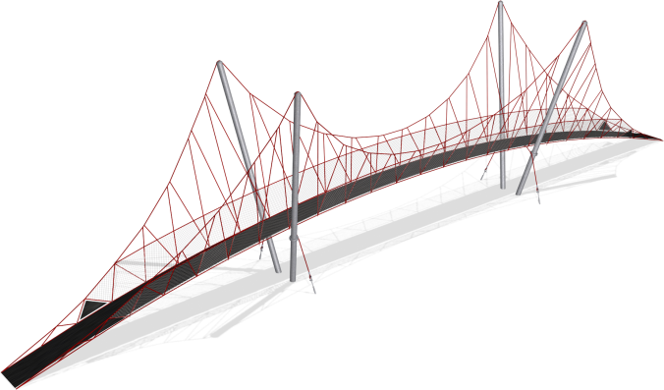
Multiscreen Solutions, Servicing…
Traditional Broadcasters
1950+ Broadcast
TV ⇨ Multiscreen OTT Solutions
Multiscreen Providers
1997+ Online Video
‘‘
’’
‘‘
’’
‘‘
’’
We Provide products & services to existing broadcasters
We offer a platform solutions for companies wanting to bridge content to the Internet
We service clients wanting content delivered onto many devices

Slide 14
Offering A Full Range of Video Services
Broadcast Solutions
⇩ vuEasy™ OVP Services
Entry Level Video platform in-the-cloud (SaaS)
⇩ vuMedia™ OTT Solutions
Bridge between Broadcast & Multiscreen (PaaS)
⇩ vuNet™ Content Delivery
CDN Services, Guarantees quality of video delivery (IaaS)
Multiscreen Services
vuMedia™ OTT (PaaS Platform)
Broadcast Solutions
(Products & Services)
Solution Cost
Multiscreen Services
(Software Dev.)
vuNet™ CDN (IaaS Service)
vuEasy™ OVP Service
(SaaS)
Project
Size

Slide 15
Create
Ingest
Manage
Deliver
Consume
vuManagement
image
vuIngest
Dashboard
Servers Storage
Portal
Search
Discovery
Player
live
Live & VoD
Analysis
Stats
Reports
OTT STB
Scheduler
CRM
CMS
db
Recorder
Client Relationship
Management
Content Management
System
Web App
Metadata
Adaptive
audio
Optimized
App
Store
Transcode
Content Protection
Live Stream
film
Profiles
LinkShield
DRM
GeoIP
Social Networking
Frame size
VoD
Storage
cam
Bitrate
Monetization
Gateway
Auditing
Payment
Advertising
disc
vuMedia v2.0
DB = Database
AV = Audio Visual
4K = up to 4096×3072
OTT = Over the Top Content
STB = Set Top Box
VoD = Video On Demand

Slide 16
vuMedia™ - Features & Benefits
Modular, Scalable & Redundant Architecture
Complete Brand & Content Rights Control
VoD & Live Streaming End-to-end Workflow
Statistics, Reporting & Analytics Engines
Superior Viewing on Any Device or Screen
Monetization of Digital Video & Audio
Content & Client Relationship Management
Global CDNs Integration

Slide 17
Clients

Slide 18
Partners
Notes:
MJO Note: his graphic was taken from the website - logos should be available on the shared drive. The list needs to be reviewed and updated, eg Omneon is now Harmonic.

Slide 19
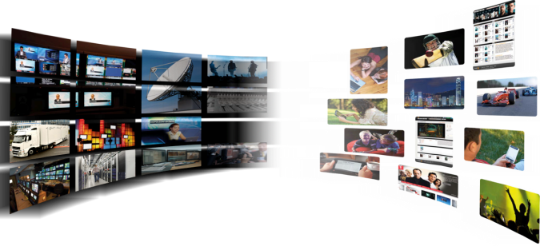
Visual Unity - Differentiators
Advanced Features: 4K video, 3D, DRM,…
End2End Solutions to Manage, Deliver & Monetize
Expertise in Broadcast workflow ⇨ Online Video
Multi-language & Multi-culture support
Big Enough to Deliver, Small Enough to Listen
Successful History of Reference Accounts
Very cost effective Software Development
Flexibility: Both custom or off-the shelf offering

Slide 21
Synopsis - OTT & New Media Market Opportunities
The era of multiscreen video has begun. Portability and connectivity are changing the video landscape. TV everywhere and other multiscreen initiatives are fundamentally changing the entertainment business model, with apps streaming live to TVs, computers, tablets, and mobile phones. According to the latest forecasts from Informa, the global online-video market will be worth $37 billion in 2017, driven by the popularity of OTT (Over the Top services). Broadcasters, content owners, and distributors must engage multiscreen delivery to survive. This presentation explores these market trends, and integrated solutions that bridge the gap between the broadcast world and multiscreen consumption.

Slide 22
Tags - OTT & New Media Market Opportunities
4K, Connected TV, Digital Video, Online Video, Gabriel Dusil, Internet Video, Broadcast, Linear Broadcast, Multi-screen, Multiscreen, New Media, Online Video Platform, OTT, Over the Top Content, OVP, Smart TV, Social TV, Visual Unity, PaaS, Platform as a Service, SaaS, Software as a Service, CDN, Linear Television, Linear TV, System Integration, Television

