Slide 1
Presentation Skills - What They Never Teach You

Slide 2
Download the Original Presentation
Download the native PowerPoint slides, from my blog:
http://gdusil.wordpress.com/2013/05/20/presentation-skills-what-they-never-teach-you
Or, check out other articles on my blog:
http://gdusil.wordpress.com

Slide 3
Agenda
Content & Story
Engaging the Audience
Timing, Mood & Flow
PowerPoint
Presenting like Steve Jobs
Preparation
Do’s & Don’ts

Slide 4
Content & Story
The Foundation of a good presentation Is content & story
Without good content, the audience will not be engage
If the story does not flow, then the message will be lost
‘‘
’’
If Content is King, then Story is the Kingdom

Slide 5
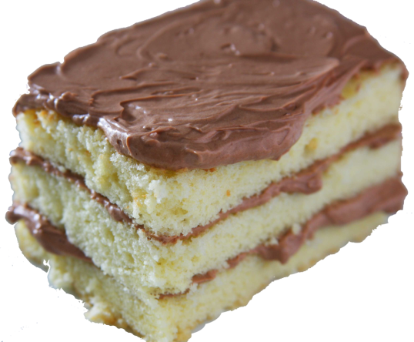
Content & Story
A good presenter…
…Can present the same content without slides
…Captivates an audience
…Sparks the audience’s imagination
Presentation
‘‘
’’
Slides don’t make a good presentation – The presenter does.
Content & Story

Slide 6
Preparation - Considerations
Layout
Use color & animation sparingly
Where it helps to tell the story
Use only one type of animation
Fade is inconspicuous
Graphics
Ensure they are relevant to the content
Ensure you have content rights to all images
Avoid repeating graphics or text
Slides
…should each give a different perspective on your story
…should progress the story
…should be unique
‘‘
’’
Each slide should give a different perspective on your message, but don’t repeat yourself

Slide 7
Preparation – The 360º View
Present your topic from different angles
Everyone looks at the world from their own experience
Explain from their vantage point
Telling a story from different perspectives builds a more complete picture
Effective for complex subject matters
Top ⇨ down vs. Bottom ⇨ up
How do the experts vs. end-users view it?

Slide 8
Preparation - Before You Show Up
Ensure that the organizers have the proper technology
Audio recording
Audio connection to PC
Computer
Projector
Microphone
Head-mount, lapel, or hand-held
Handheld Mouse
To advance slides
Laser Pointer?
Too ‘90’s? - Use the mouse pointer instead
Production Considerations
Audio recording should taken from a lapel or handheld mic
Two camera angles are more dynamic
Ensure all slides work on the organizer’s PC
(if you are not using your own)
Varying PowerPoint versions may behave differently

Slide 9
Preparation - Before You Present
Some audiences or cultures don’t like PowerPoint slides
Viewed as a lazy method to communicate
Technical Considerations
Ensure all technology is working
Ensure the presentation flows from start to finish
Review & practice your in “slide show” mode
An improper slide build may catch you off guard or ruin your flow
It’s OK to be nervous
Ensures that you are alert
If you’re too relaxed, you may loose your train of thought
‘‘
’’
Look in the mirror & make sure you are presentable

Slide 10
Preparation - Level vs. Knowledge
Content should be slightly above the audience’s knowledge
Audience Will Be Lost
‘‘
’’
Presenting slightly above the knowledge level of the audience is easier said than done
Audience Will Be Engaged
Audience Knowledge
Audience Won’t Learn Anything New
Presentation Level
Audience Will Be Bored

Slide 11
Preparation – Starting your Presentation
Start a dialog with the audience
eg. for small venues or training
Establish Credibility
Introduce yourself & your credentials ⇨ generates Respect
Establish a relaxed atmosphere
Gauge…
…Language competency
…Expectations
…Knowledge of topic
‘‘
’’
A good presenter can modify their presentation based on a 5 minute dialog with their audience.
If possible
Foreign venues
Establishes at which level to present

Slide 12
Engage with Your Audience - PEER
Passion
Present as if it is your life-long project
Emotion
Love your work
Respect
If they respect you, they will listen to you
Empathy
If they like you, they will listen to you
Introduce Yourself
Who are you & where you come from
How you have the authority on the topic
How you got to be in front of them
Find Common Ground
Geography
Cultural & Language
Experiences & Expertise

Slide 13
Engage with Your Audience
Embrace your audience
Maintain eye Contact
Speak as if you are having a one-to-one conversation with each audience member
Connect with the audience
Ask questions
Prepare workshops
Q&A session
Speak with Confidence
The first five minutes will set the stage for the whole presentation
If it starts well, then it will go well
Metaphorically
‘‘
’’
If the story is the foundation, then PowerPoint is just the pages & letters
Good for Training sessions

Slide 14
Timing, Mood & Flow
Practice Your Timing
Ask the organiser to show a countdown timer, or signs for
“10 minutes to go”
“Time’s up”
“5 minutes over”
Consider 2-4 min. per slide
Practice which slides take longer
Assume that you will talk faster during the actual presentation
Know Your Timing
If you typically spend 4 minutes per slides, and you have 30 minutes, then only prepare 7 slides (+title & +Q&A)
‘‘
’’
Respect the organizers & other presenters by speaking within your time slot

Slide 15
Timing, Mood & Flow
Establish the mood at the beginning of the presentation
If the mood is light, people will be relaxed
If you are nervous, the audience will feel uncomfortable
If you are confident, the audience will listen to your story
Charisma
If you have it, then use it
Humor
Not for everyone
Use it if you are confident with your delivery
Enthusiasm
The audience will feed off your excitement – if it’s genuine

Slide 16
Timing, Mood & Flow
Intro ⇨ Body ⇨ Climax
The story should flow from beginning to end
Start strong, Finish strong
If you make a mistake, maintain the flow
Build on the story
Make sure you know what is your next slide
Story
Climax
Exciting
Intro
Body
time
Boring

Slide 17
Do’s
Define all your acronyms
Reference all sources
Turn off your mobile
Turn off any pop-up notices on your computer
Thank the organizers
Use 16:9 slide ratio
Movie viewing experience
Have backup content ready
Have any anticipated files already opened
Or hyperlink to files
Stick to the PowerPoint template structure
Speak slowly & clearly
International venues

Slide 18
Don’ts
International
audiences
Don’t use jargon
“We knocked it out of the Park” – baseball reference: means we did a great job
“Bang for the buck” - means: getting the most for your money
Don’t turn your back to the audience
Don’t Insult anyone
Don’t assume everyone understands your accent
Don’t let them see you sweat
Don’t be guarded, Open your
Don’t be afraid of feeling vulnerable

Slide 19
Distribution Social Networking
Distribute slides in PDF*
Review before sending
Protects your publication
Camtasia can be used to record PowerPoint
http://www.techsmith.com/camtasia.html
Recorded presentations & video can be combined in a NLE editor
CamStudio is a good open source alterative
http://camstudio.org/
Post onto slideshare
Link to your LinkedIn profile
Link to your blog
Link to Facebook
* For company presentations, check your corporate policy
NLE = Non Linear Editor – eg. Adobe Premier Pro, Apple Final Cut

Slide 20
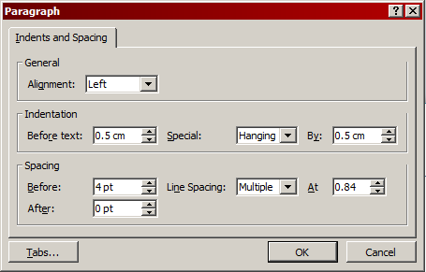
PowerPoint - Slides
34 points
24 points
First Bullet
Second Bullet
Third Bullet
22 points, with contrast color
20 points, grey
No need for more than three levels
Don’t use less than 18 points
The First line does not need to be bulleted
Larger text can have line spacing as low as 0.6

Slide 21
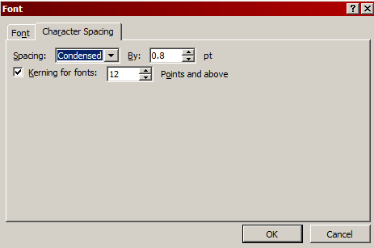
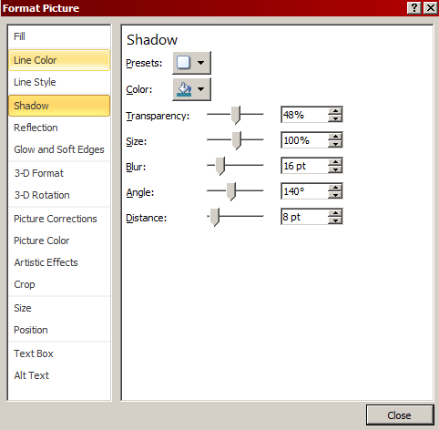
PowerPoint - Slides
First Bullet
Font spacing can be condensed to .6 of normal spacing, or higher for larger fonts
Fonts can be condensed to save sentence spacing
Shadow on Graphics for emphasis

Slide 22
PowerPoint - Structure
Layouts should have distinct titles
When merging two presentations, then slides with the same title will adopt the new layout
Five Layouts are all that is needed
Minimum Structure needed for a PowerPoint Template
Q&A layout can be part of template.
Prevents needless repeating graphics
Use at the end of each section
Title Slide
Title & Content
Two Columns
Title Only
Blank
Q&A

Slide 23
Presenting like Steve Jobs
"Plan in analog”
Play with ideas on whiteboards. Don’t get stuck in PowerPoint
"Answer the most important question”
Why should I care?
"Develop a sense of purpose”
Convey your passion for your content
"Create Twitter-like Headlines”
People don’t want to read, they want to hear a story
"Draw a road map: Beginning, middle & end”
Use a structure so the audience feels the presenter is organized
“Introduce the Antagonist”
What is the problem that needs to be solved or the enemy to overcome?
1
2
3
4
5
6
“How to Be Insanely Great in Front of Any Audience”, by Carmine Gallo
http://feedproxy.google.com/~r/bakadesuyo/~3/jaDYUNlsvpk/#ixzz2AlZf7IP7

Slide 24
Presenting like Steve Jobs
“Reveal the conquering hero”
What is the solution? What will lead to victory?
"Channel their inner Zen”
Keep everything simple. To the point & minimalist
“Dress up your numbers”
Present stats in a context that is relevant to your audience
“Use ‘amazingly zippy’ words”
Review your copy closely, and edit, edit, edit
“Share the stage”
It’s not a one-man show. Rotate in other presenters
“Stage your presentation with props”
Add life and break up stretches of talk by giving demos
7
8
9
10
11
12
“How to Be Insanely Great in Front of Any Audience”, by Carmine Gallo
http://feedproxy.google.com/~r/bakadesuyo/~3/jaDYUNlsvpk/#ixzz2AlZf7IP7

Slide 25
Presenting like Steve Jobs
“Reveal a Holy Shit moment”
There’s always a surprise at the end - a scripted one
“Master stage presence”
Manage your body language & delivery
“Make it look effortless”
Rehearse, rehearse, rehearse
"Wear the appropriate costume”
Dress like the leader you want to become
“Toss the script”
Once you’ve rehearsed, make it relaxed & natural
“Have fun”
Even if things go sideways, roll with it
13
14
15
16
17
18
“How to Be Insanely Great in Front of Any Audience”, by Carmine Gallo
http://feedproxy.google.com/~r/bakadesuyo/~3/jaDYUNlsvpk/#ixzz2AlZf7IP7

Slide 27
Synopsis - Presentation Skills, What They Never Teach You
With twenty years of experience delivering and watching presentations, I have learned a lot with regards to what works and what doesn’t. Presentation training that I have experienced often focused only on content, and making sure the presenter learns to say the right things. But good presentations are about passion, empathy, emotions, and respect. Good presenters tell an engaging story, regardless of what is projected behind them. It’s about the delivery. In a world that is bombarded by PowerPoint, slide presentations are sometimes frowned upon. But that’s like saying there are too many books in the world. It’s not about presenting slides, or how good the animations look. PowerPoint is just a book and the letters it contains. It’s what’s inside that book that makes it special. It’s all about the story, and how it is delivered. If Content is still King, then Story is the Kingdom.

Slide 28
Tags - Presentation Skills - What They Never Teach You
Gabriel Dusil, Presentation Skills, Presentation Techniques, Presentation Training, PowerPoint, PowerPoint training, Presentations, Presenting, Management Skills, Management Training, Training Skills, Presenting like Steve Jobs, Content is King, Story is the Kingdom, , Passion Empathy Emotion Respect

