Slide 1
Successful Negotiation Skills

Slide 2
Download the Original Presentation
Download the native PowerPoint slides, from my blog:
http://gdusil.wordpress.com/2013/04/25/successful-negotiation-skills/
Or, check out other articles on my blog:
http://gdusil.wordpress.com

Slide 3
Agenda
Definition
Mandate
Phases
Roles
Golden Rules
Avoiding Negotiation
Principles

Slide 4
Definitions
‘‘
’’
Don’t negotiate, unless you have to.
“Resolution of conflict by mutual compromise”
The 10 Rules of Negotiation, Alan McCarthy, Catalyst
“A dialogue intended to resolve disputes”
Wikipedia
“…Involved parties resolve dispute by holding discussions and coming to an agreement”
www.legal-explanations.com
“Bargaining (give and take) process between two or more parties (each with its own aims, needs and viewpoints) seeking to discover a common ground and reach an agreement”
www.businessdictionary.com

Slide 5
Principles
Both sides can win without the need for Negotiation but not on the same terms
If there is no Conflict to resolve, then there is no need to Negotiate
If there is no possibility of a Resolution, then there is nothing to Negotiate
If there is no willingness to Compromise, hen there is nothing to Negotiate

Slide 6
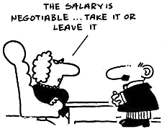
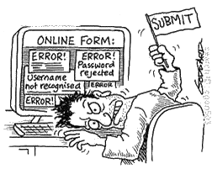
Avoiding Negotiation
Win:Lose – Dictating Terms
“Take it or leave it”
Lose:Win – Surrender
Used a controlled manner so as not to set a precedent (i.e. give in with conditions)

Slide 7
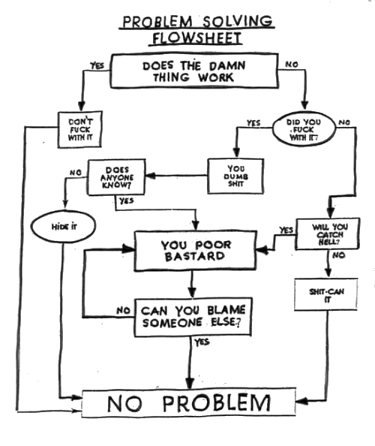
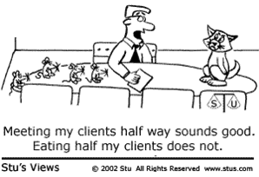
Avoiding Negotiation
Win:Win - Problem Solving
Both parties seek a resolution
Lose:Lose - Arbitration
Unwilling to have a direct dialog? Then an Arbitrator is required

Slide 8
What is a Negotiation?
Position Orientated
Need a mandate before starting
Follow the 5 Negotiation Stages
Need to understand both parties objectives from the negotiation
It helps to understand what are their motivations as well
Amicable negotiations seek a Win:Win
Identify if the other party is trying to do the same
‘‘
’’
Shared interests or Shared risk can result in a win:win
‘‘
’’
Be prepared for some Creative Thinking

Slide 9
Negotiation Mandate
Separate & Understand the difference between…
Your Corporate goals
Your Departmental or Regional goals
Your Personal goals
Understand your leverage
Your Strengths & Weaknesses
The other party’s Strengths & Weaknesses
Scenario Planning
Know what is your bottom line (worst case scenario)
What is your “Walk-away” price
Agree on your top line (best case scenario)
‘‘
’’
Plan your goals & contingencies…

Slide 10
Negotiation Is…
…Co-operative not Competitive
…Pragmatic not Emotional
…Where Concessions start small & conditions start large
…where Behaviour breeds Behaviour

Slide 11
Negotiation Stages
1. Plan
4. Agree
2. Discuss
3. Propose
5. Trade
‘‘
’’
If Conflict Occurs
Understand Why There is Conflict &
What Can Be Done About it

Slide 12
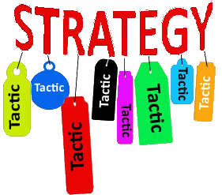
1. Planning – Tactics & Strategy
Tactics
Agenda
Concessions
Roles
Venue
Authority
Disclosures
Timing
Strategies
Soft, Hard or Honorable?
Keep it simple & flexible
Remember – It’s about…
Interests not positions
Problems not personalities

Slide 13
1. Planning - Soft, Hard or Honorable
Soft | Hard | Honorable
Participants are friendly | Participants are enemies | Participants are problem solvers
Goal is to reach an agreement | Goal is conquest | Goal is an amicable outcome
Make concessions Cultivate the relationship | Make Demands as a condition of the agreement | Separate negotiators from the problem
Soft on the issues & people | Hard on the issues & people | Soft on people & hard on issues
Easily change position | Dig into your position | Focus on common interests
Make offers | Make threats | Explore common interests
Disclose your bottom line | Push for revealing their bottom line | Avoid need to reach a bottom line
Accept a one-sided compromise | Demand one-sided gain as the price of the agreement | Explore scenarios with a double-sided gain
Insist on mutual agreement | Insist on maintaining your position | Develop multiple options
Avoid a contest of wills & egos | Win a contest of wills & egos | Insist on objective criteria
Yield to pressure | Apply pressure | Result on common principles

Slide 14
1. Planning – Team Roles
‘‘
’’
Every team should have 3 roles. If not, then roles need to be shared
Lead | Recap | Observe
Chairman over the agenda | Maintains integrity of leader | Maintains integrity of company
Acts as a traffic cop | Summarizes each session | Watches body language
Not always the most senior, not always the same person | Anyone trusted by the leader, with good listening skills | Keeps quiet. Has excellent listening skills
Give final approval | Eyes & ears of the leader | Takes notes
Person that introduces new topics | Looks for traps | Looks for traps
Can call for an adjournment | Can call for an adjournment | Can call an adjournment
Only one to agree without a break | Takes the heat off the leader | Aware of tone of proceedings

Slide 15
2. Discussion
Remember
Respond positively
Listen more - Talk less
Read body language
Always question & explore
Never assume
Flags & Signals
Identify willingness/unwillingness
Understand their conditions, objections, & motivations
Explore & question
Avoid interrupting
Always reconfirm
Beware of being manipulated

Slide 16
3. Propose
‘‘
’’
Do…
Propose & provide alternatives
Take the initiative
Advance the discussions
Be realistic
Adjourn during disagreement
Realise their needs & limitations
Don’t…
Complain (propose alternatives)
Interrupt proposals
Use emotion as a bully technique
Be bullied by emotion
Start with specific conditions and follow through with tentative proposals
Conditions Start Large, Concessions Start Small
Always summarize to ensure both sides are on the same page

Slide 17
3. Propose
Bundle your Offer
Consider your Options
React to the Discussion
Plan your Tradeables
Recognise your Limitations
Understand your Leverage

Slide 18
4. Trade – Do’s
Do…
Continually review objectives
Plan your tradeables in advance
Plan your receivables in advance
Recognise your limitations
Ensure that no one leaves until the terms of the agreement are confirmed
‘‘
’’
Today’s gift is tomorrow's starting-point
Tomorrow’s starting-point is lower than today.

Slide 19
4. Trade - Don’t’s
Don’t…
Give away free gifts
Concede your low cost tradeables too soon
Give an inch - Trade it instead
Trade items that you don’t have the authority
Bluff on ultimatums
Salami the deal
‘‘
’’
What is it worth to you vs. the other party?
What does it cost you?
What do you get in return?
What is in it for you?

Slide 20
4. Trade
Tradable | Items
Time | Duration of the contract or individual items
Goods | Quantities, Quality, Features & Substitutes
Services | SLA terms, sigma 6, 24x7, Response
Staff | Personnel, Management, Regional offices
Guarantees | Guarantors, Insurance, Liabilities, Bonds
Money | SRP, Discounts, Financing, Investment
Warranty | Liability, Coverage, Duration & Extent
Risk | Who carries it? Who shares it?
‘‘
’’
Do You Have The Authority?
SRP – Suggested Retail Price

Slide 21
4. Trade
Negotiable
Payment terms
Support
References
Staff & Executives
Terms & Conditions
Timescale
Financing
Resources
Careful Negotiating
Intellectual Property Rights (IPR)
Futures (Products or Services)
Legal or Regulatory Compliance
Principles
Ethics & Morals
Company Policy
Price contingencies

Slide 22
5. Agreement - Checklist
Did you address, agree, or conclude on all objectives?
Did you decide when to stop trading in the agreement?
Did you Summarise agreed positions on both sides?
Did you outline the terms of the agreement in detail?
Did you confirm in writing all items verbally agreed?
‘‘
’’
Listen more, Talk less

Slide 23
5. Agreement - Never…
Never Compromise your ethics
Never negotiate with yourself
Never accept their first offer
Never take their first offer
Never give away free gifts
Never unbundle (salami) the deal
Never reveal your bottom line
Never take the quick deal

Slide 25
Synopsis – Successful Negotiation Skills
Effective negotiation skills are essential to many corporate disciplines including sales, marketing, legal, technical roles. But this also plays into interpersonal relationships such as marriage, parenting and personnel management. Preparation is essential to a successful negotiation, even as far as identifying if or when it is necessary to negotiate. Amicable negotiations seek a win-win scenario - a solution that is acceptable to both parties. But not all negotiations are fair - It is important to identify whether the other party is pursuing a win:lose or win:win outcome, so that appropriate tactics can be taken. This presentation explores some basic skills, techniques, and planning methodologies for a successful negotiation.

Slide 26
Tags
Gabriel Dusil, Negotiation, Negotiation Techniques, Successful Negotiation, Negotiation Skills, Negotiation Mandate, Negotiation Strategy, Negotiation Tactics, Negotiation Stages

