Slide 1
Telco & Mobile Security
Strategies

Slide 2


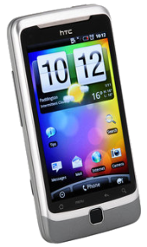

Mobile Device Security - State-of-Play
Android
Permissions
  Limited access to approved data/systems
Access Control
  Password & Idle screen locking
Isolation
  Limits an apps ability to access
  data or other system resources
Encryption
  Conceal data at rest on the device
Provenance
  Apps are stamped to identity the
  author for tamper resistance
Apple iOS
Symantec - A Window Into Mobile Device Security (11.Jun)

Slide 3
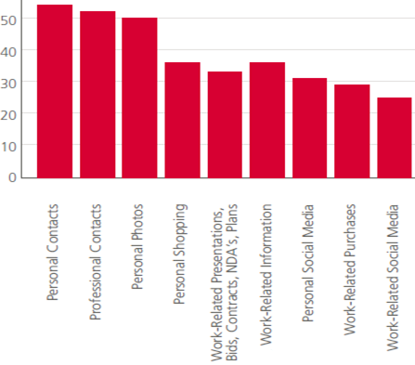

Mobile – Current & Future Threats
Mobile devices hold a rich
set of personal information:
  Location details
  browsing & call history
  contact lists & phone #’s
  SMS, email & Facebook
  Calendar details
  Passwords in clear text
  Premium-rate calling
Internet Access remains
a large vulnerability hole
Up-In-Coming Threats
  Micro-payment vulnerabilities
  Access to corporate server
  “LikeJacking”
McAfee - Mobility and Security Dazzling Opportunities, Profound Challenges (11.May)
LookOut - Mobile Threat Report (11.Aug)

Slide 4

Mobile Security – Market Challenges
Recent Issues…
  iPhone “Root-kitting”
    Bypassing device security
  Theft of smartphones, & tablets
    sensitive records compromised
  Spoofed ActiveSync policy apps
    Reporting higher security than what is actually available
  “Co-mingling”
    Mixing private & corporate data
  Malware
    Stealing data & bandwidth
    Uncertified apps with malware
    Capturing info & forwarding
Device Management Checklist
Description | Cur-rent | Next Gen
Device Upgrade Flexibility |  | 
Threat Analysis |  | 
Location-Aware usage |  | 
User Device Switching |  | 
Device Policy Capabilities |  | 
Network Security |  | 
Dynamic Corporate Policies |  | 
Scalability Expandability |  | 
App & Data Security |  | 
J. Gold - A Heuristic Approach to Mobile Security, ‘11

Slide 5
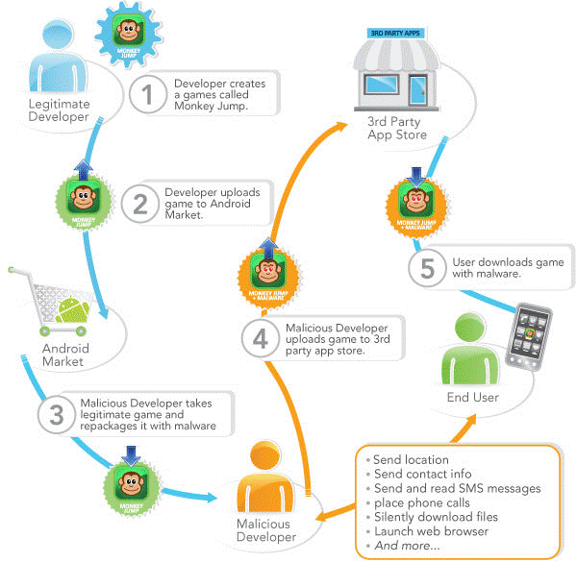
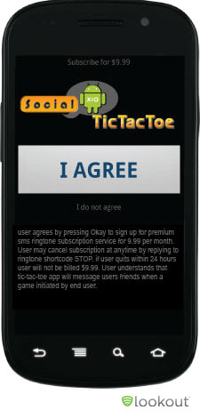
Malware Threat Example - Repackaging
LookOut - Mobile Threat Report (11.Aug)

Slide 6
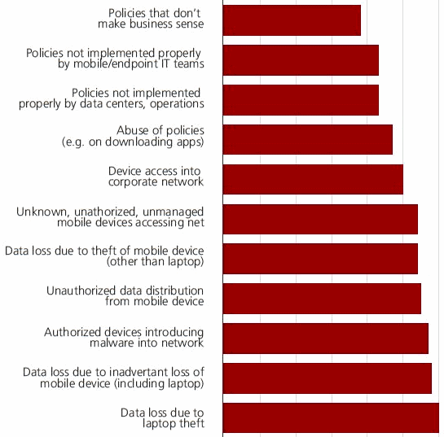
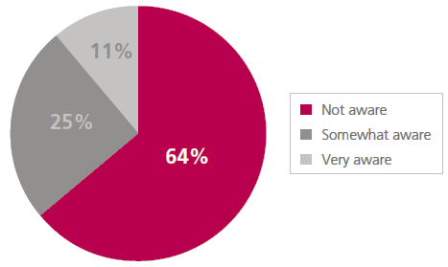
Mobile Security – Lacking Awareness
Awareness of Company Security and Data Protection Policies for Mobile Devices:
Greatest Security Concerns for
Mobile Devices
McAfee - Mobility and Security Dazzling Opportunities, Profound Challenges (11.May)

Slide 7


Telco Security – Market Drivers
Subscribers
  Mobile users are in early stages of facing significant mobile threats.
  Handsets hold sensitive data
    Access to sensitive data (online banking, micro payments)
  Subscriber are unaware of mobile security threats and mitigation is largely ignored.
Operators
  Lacking visibility to subscriber network activity & threats
    mobile, land-line, & internet
  ⇧ protection for subscribers
  Providing additional service value
  Preparing for future mobile threats

Slide 8
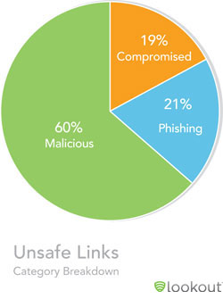
Malware Mitigation – Hidden Costs
Maintenance and Repair
  Managing signature updates
  Cost of paying to fix systems infected by malware
Hardware Overhead
  Most anti-malware consume large amounts processing power, memory and storage space.
Lost Productivity
  Lost Productivity per employee
  Differing mobile Operating Systems to manage infections
Company Costs
  Due to stolen Mbytes of bandwidth from Malware
LookOut - Mobile Threat Report (11.Aug)
http://www.networksecurityjournal.com/features/malware-burden-012208/

Slide 9
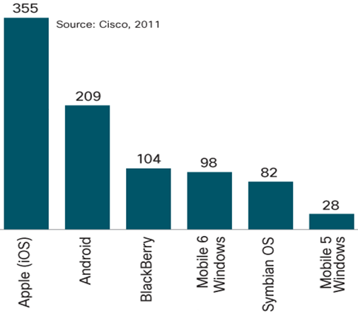
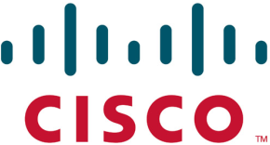
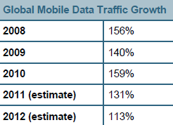
Mobile Data - Smartphone Trends
Subscribers used 79 MB per month in ‘10,  125% from ‘09
  Expect a 16-fold increase (1.3 GB per month) by ‘15
Average mobile speed in ‘10 was 215 kbps,  2.2Mbps by ‘15.
Cisco - Visual Networking Index Global Mobile Data '11

Slide 10


Mobile Data – Increasing Costs & Usage
Evolving Usage by App – (Allot)
Monthly Data Usage – (Nielson)
Allot – Mobile Trends, Global Mobile Broadband Traffic Report 11.H1
Average U.S. Smartphone Data Usage Up 89% as Cost per MB Goes Down 46%
http://blog.nielsen.com/nielsenwire/online_mobile/
http://www.wired.com/wiredscience/2011/06/how-much-does-your-data-cost/

Slide 11





Malware is Stealing Bandwidth
39%
Video
Streaming
12% Web
Browsing
3% VoIP
& IM
44% File
Sharing
2% Malware
& Other
GPRS
UMTS
TCP/IP
Internet
16.8%
Viruses
Switching
Network
7.8%
Worms
2.3%
Adware
70%
Trojans
1.9%
Backdoor
0.1%
Spyware
Panda Security - Malware Statics, 11.Mar.16
Allot – Mobile Trends, Global Mobile Broadband Traffic Report 11.H1

Slide 12
Mobile Malware Usage - Vampire Data
Malware bandwidth stolen
  From €15 to €60 per year⁰
Accelerators
  Roaming will accelerate malware cost by over 30x¹
  Multiple Malware instances 
  Power Users are 25x more exposed to malware costs²
A Provider with 1m subscribers - Vampire Costs would exceed €30m per year³
Smartphones Data Cost
  ⁰ Based on 500 bytes/min typical = 21.6 MB per month @ €0.06 per MB, & up to 4 Malware per handset
  ¹Based on Roaming costs in Europe between € 1.2 and € 12 Euros per MB, ²Based on 2GB monthly usage
³Average two malware instances across the subscriber base
  - http://ec.europa.eu/information_society/activities/roaming/data/index_en.htm
- Average U.S. Smartphone Data Usage Up 89% as Cost per MB Goes Down 46%
http://blog.nielsen.com/nielsenwire/online_mobile/

Slide 13
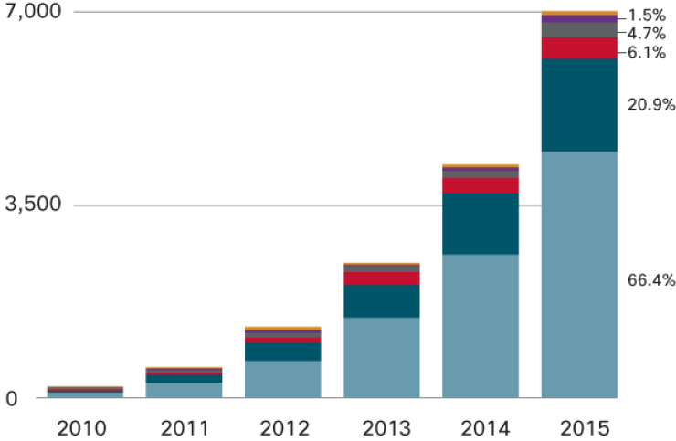
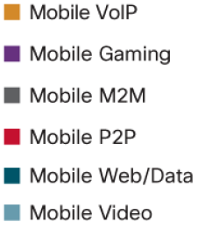

Mobile Security – Emerging Patterns
Malware acting as a botnet will exploit many vulnerabilities
  Abuse of premium-rate text messages
  Attacks gather sensitive data for commercial or political purposes
  Financial fraud as more mobile finance and payment apps emerge
LookOut - Mobile Threat Report (11.Aug)
Cisco - Visual Networking Index Global Mobile Data '11

Slide 14
Telco Security - Objectives
End-point protection achieved by app suites
  Firewalls & VPN
  Disk Encryption
  Remote wiping
  Location-based services
  Anti-Malware
Infrastructure Security utilizes
  Managed Security
  Flow statistics
  Policy compliance
  Intrusion detection
  Network Behavior Analysis
    Separating normal behavior from anomalous behavior
End-Point Protection
Infrastructure Security
Subscriber Security Strategy

Slide 15




Mobile & ISP Infrastructure Security
Mobile
Network
Subscribers
GPRS
UMTS
TCP/IP
Internet
Gbps
NetFlow
Switching
Network
Cognitive
Analyst
Infrastructure Security
Monitoring, Network
Behavior, Forensics
Policy Compliance
Carrier Security Services
Endpoint Security
Firewall, VPN,
Disk Encryption,
Anti-Malware, etc.
Intelligent
Analytics &
Reporting
Actionable
Mitigation
Threat
Notifications

Slide 16
Mobile Security - Approach
Monitor
Diagnose
Infrastructure Security using Network Behavior Analysis observe mobile data to identify irregularities which may be due to the malware activity
The anomalies detected by NBA will be correlated (cross-referenced) with data from the handsets where the mobile anti-malware solutions
are
deployed.
Identification of deployed malware will help single-out the malicious software
& implement mitigating steps to protect subscribers
Detect
Mobile analyst services
calls subscriber
to confirm, identify & eliminate malicious behavior.
Investigate
Suspected (malicious) traffic is blocked, filtered, or diverted from the infected device.
Network traffic can be optimized & modeled in
order to improve reliability.
Remediate

Slide 17

Telco Security – Strategic Direction
Endpoint Security via security suites for mobile handsets
  Via periodic signature updates sent to the handset
But Endpoint Security is reliant on subscribers to install SW
Infrastructure Security is necessary to protect mobile subscribers
  Via Network Behavior Analysis, core traffic patterns are analyzed and normal behavior is separated from abnormal behavior to detect malware
“For €2 per month we will protect you against malware-stealing-bandwidth & lost productivity”
!
Fraud
Security Attack
Phishing
Malware
Spyware
!
Hacking
Virus

Slide 18


Mobile Security – Business Case
  Increased Revenue -  ARPU
    Value-added security services
  Core Infrastructure Cost Saving
    Reduce “stolen” BW by malware
    Increased security & network visibility - leads to efficient infrastructure spending
  Increased Client Satisfaction
    Client trust in mobile carrier through safer mobile surfing
    Protect transactions for online banking, & confidentiality
  Competitive Differentiation
    Through enhanced security services for corporate clients
  Legal Conformity
    Protection of minors, dangerous, & illegal content
  Increased Network Reliability
    From reduced malware instability
    Data traffic prediction becomes more precise, through modeling of legitimate applications
ARPU – Average Revenue Per User
BW - Bandwidth

Slide 19


Cognitive Security - What We Offer
Security Innovation
  Delivering Next Generations Security Solutions
Research & Development Expertise
  Continual & Rapid development
  Quick development turn-around
  Cost Effective R&D Resources
  Integration with OEMs, MSSPs, & Device manufacturers
Addressing Privacy Concerns
  Data anonymity is maintained
Product Stability
  5th Generation Network Behavior Analysis platform
Intuitive Management Interface
  Easy-to-Use Dashboard
  Granular attack detection analysis

Slide 20

Telco Security – Final Thoughts
“The number of times an uninteresting thing happens
is an interesting thing.”
  Marcus Ranum
  “laws of intrusion detection.”
“Cybercriminals are investing more toward ‘R&D’ to find ways to use mobile devices and penetrate the cloud to seize the data they need to make a profit or undermine a company’s success.”
“… mobile operators will try to prevent threats at the network level… ‘If the mobile operators pushed out antivirus to their customers’ devices, it would scare users … So operators are keen to solve security issues themselves at the network level.”
  Gareth Machlachlan
  Chief Operating Officer
Cisco - Annual Security Report '11
TechTarget - Security Tech Guide Mobile '11, “Mobile Phone Security Threats, Blended Attacks Increasing”

Slide 21
Download the Original Presentation Here:
http://gdusil.wordpress.com/2013/03/08/telco-and-mobile-security-12/

Slide 23
Synopsis - Telco & Mobile Security ('12)
  As mobile data is expected to grow 16 fold over the next four years*, mobile providers are facing new challenges in balancing subscriber ease-of-use, with cyber-security protection. This explosion in cellular usage and mobile commerce will require advanced levels of protection for mobile users, as hackers continue to find vulnerabilities to exploit. A dual strategy which includes end-point and infrastructure security will provide robust and cost effective levels of protection, which will also expand provider revenue streams to enhanced services, and increase ARPU through value added security solutions. Network Behavior Analysis is a viable building block to infrastructure security, and helps to protects a collective subscriber base against sophisticated mobile cyber-attacks.
    *Cisco - Visual Networking Index Global Mobile Data '11
    ARPU – Average Revenue Per User

Slide 24
Tags
Network Behavior Analysis, NBA, Cyber Attacks, Forensics Analysis, Normal vs. Abnormal Behavior, Anomaly Detection, NetFlow, Incident Response, Security as a Service, SaaS, Managed Security Services, MSS, Monitoring & Management, Advanced Persistent Threats, APT, Zero-Day attacks, Zero Day attacks, polymorphic malware, Modern Sophisticated Attacks, MSA, Non-Signature Detection, Artificial Intelligence, A.I., AI, Security Innovation, Mobile security, Cognitive Security, Cognitive Analyst, Forensics analysis, Gabriel Dusil

