Slide 1
Introduction to Cognitive Security

Slide 2




Who is Cognitive Security?
Origins
  Research began in 2006
  Company established in 2009
  Funded by U.S. Army, Navy & Air Force
Experts in Network Behavior Analysis
Mission
  Providing detailed intelligence to detect
  modern sophisticated network attacks
Headquarters
  Prague, Czech Republic & Silicon Valley, CA
Security Innovation

Slide 3
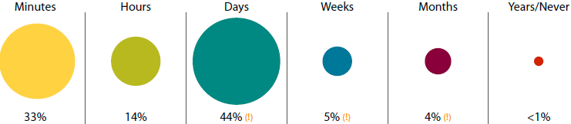
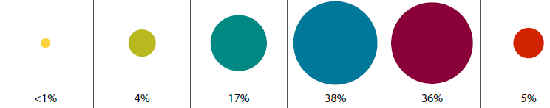

“Time-Distance Gap” for Internet Attacks
Point of Entry ⇨ Compromise
  ⇧ 50% attacks take days to months of reconnaissance for a successful breach
Compromise ⇨ Discovery
  ⇧ 70% of victims allow a breach to persist for weeks to months before detecting a compromise
Verizon – ‘11 Data Breach Investigations Report

Slide 4
Cognitive Positioning
Security as a Service
Expert Security
Basic Security
Firewalls • Email Security
Anti-Virus • VPN (SSL & IPsec)
Managed Security Services
Security Monitoring & Management
Vulnerability Management • IAM
Advanced Security
Network Behavior Analysis
Anomaly Detection
Web-Application Firewalls • IDS & IPS
Web Security, Content Filtering • SIEM
SIEM = Security Information & Event Management)
IDS & IPS = Intrusion Detection & Prevention System
AAA = Authentication, Authorization, & Accounting
IAM = Identity & Access Management
VPN = Virtual Private Network, SSL = Secure Sockets Layer

Slide 5






Modern Threats Require Higher Walls
Network Behavior Analysis
  Cost effective Expert Security for enterprises, telcos & governments
  Important security layer & a higher wall for modern-day protection
Security as a Service
Network
Behavior
Analysis
APT, Zero-Day, Exploit Kits
& Polymorphic malware…
IDS & IPS
Attack Patterns
malware, etc.
Web Security
email Security
Filtering, XXS
SQL Inj., etc.
Firewall
Virus,
Trojans,
Span, etc.
Footprint
reduction,
scripts, etc.

Slide 6


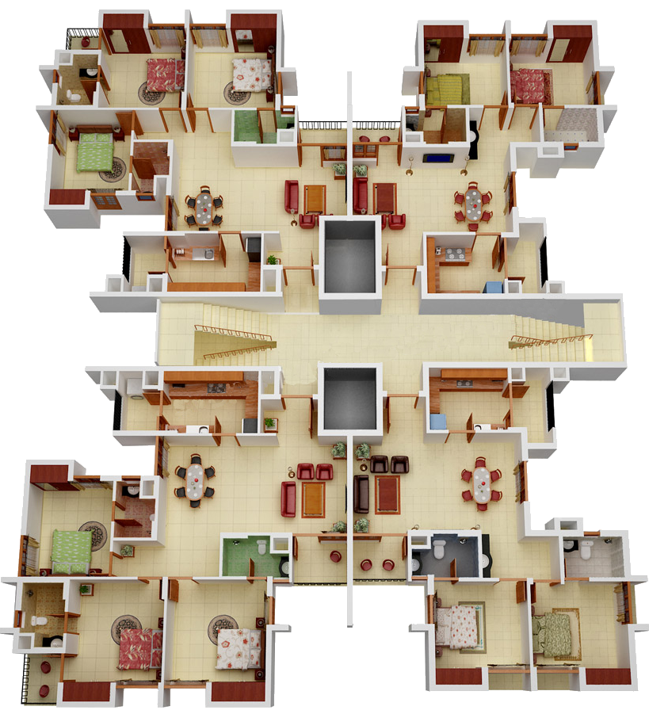


We “Turn the Lights On, in the Room”

Slide 7
Introducing - Cognitive Analyst platform
Cognitive Analyst
Cognitive₁₀
Cognitive_{Expert}
Cognitive₁
Cost Effective & Robust Network Behavior Analysis for Enterprise
High Throughput Traffic Volumes
- Telco, Mobile, ISP & NSP
High Resolution & Attack sensitivity
- custom for Governments

Slide 8

What We Mitigate
Corporate Governance
  Device or Network Misconfig
  Restricted Apps, Policy Violations
  Irregular Behavior & Misuse
Diagnostics Support
  Vulnerability & Pen-testing
  Forensics Analysis
  Incident & Response
Advanced Cyber-Attacks
  Trojans, Botnets, C2 & Exploit Kits
  Spyware & Info leaks
  Brute Force & Insider Attacks
  Denial of Service (DoS)
  Polymorphic Malware
Modern Sophisticated Attacks
  Advanced Persistent Threats
  Reconnaissance & Sabotage
  Zero-Day Attacks
Responsibilities of a
Security Administrator
Information Week - Strategic Security Survey '11

Slide 9




Analyze & Diagnose - Remediate
Remediate
Network
Attack
Treat
Monitor
Symptoms & Diagnose
Analyze
10%
70% Effort
20%

Slide 10
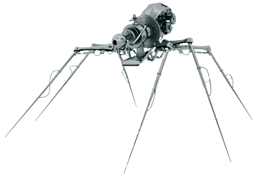
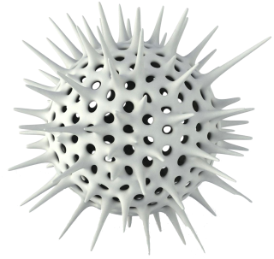


Introducing Modern Sophisticated Attacks
Advanced Persistent Threats
Zero Day Attacks
Polymorphic Malware
Exploit Kits

Slide 11
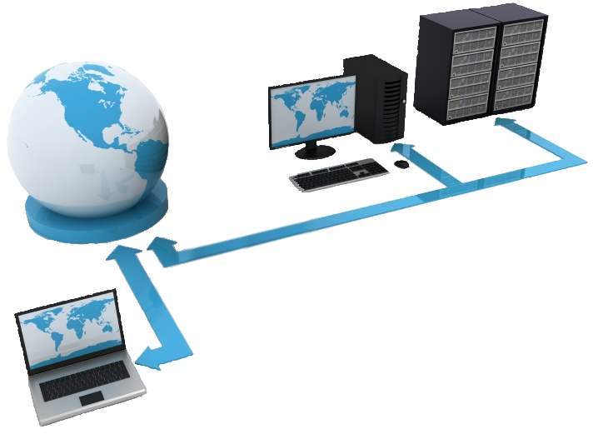





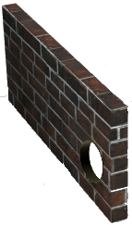
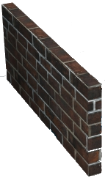

Signature vs. Non-Signature Detection
Virus
Polymorphic Malware
Virus
Advanced Persistent Threat
Virus
Zero Day Attack
Proxy
Internet
Cognitive
Analyst
Anomalous Behavior Detected
Anomalous Behavior Detected
Signature Match
Blocked
Anomalous Behavior Detected
Signature Match
Blocked
Signature Match
Blocked
No Match
-
Allowed
No Match
-
Allowed
No Match
-
Allowed

Slide 12


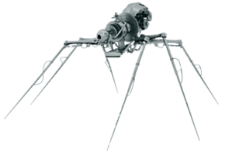
Anatomy of Modern Sophisticated Attacks
Modern Sophisticated Attacks
Heavy DNS
Use & Sophisticated Scans
Periodic Polling
- Command & Control
Unexpected new service or Outlier Client
Outbound Encrypted sessions (eg. SSH)
Peer 2 Peer Network Behavior
Unclassified Behavior - Unexpected
Anomaly

Slide 13


Cognitive Analyst - Differentiation
No Signatures!
  No Signature limitations
  Attackers will exploit:
    Delays in writing signatures
    Delay to install new signatures
    Clients ignoring updates due to resource constraints
Cost Competitive
  Cost effective Expert Security
Artificial Intelligence
  Strength of 8 Detection Algorithms
    Highly Accurate Attack detection
  Peer-Reviewed Algorithms
    Tested by the scientific community
  Long-Duration Trust Modeling
    Analyzing current behavior against past assessments
  Unique Self-configuration
    Challenge Agents ensures system is operational
  Hacker Circumvention Resistance
    Game Theory optimization ensures system behavior is not predicable
  State-of-the-art Auto-Tuning
    Minimal deployment resources needed
Signature

Slide 14
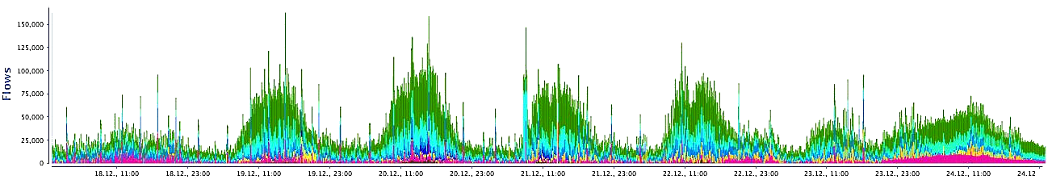
Firewall, IDS, & AV – Lacking Visibility
Traditional security layers have a narrow view of
data security as it is collected over time.
Saturday
Friday
Thursday
Wednesday
Tuesday
Monday
Network
Sunday
0
1
0
1
0
1
1
0
0
1
0
1
0
0
0
0
1
0
0
0
0
1
0
1
1
1
0
1
1
1
1
1

Slide 15
NBA – Long-Duration Threat Visibility
Network
Behavior
Analysis
NBA from COSE
compares near real-time
data with past security assessments
Trustfulness Assessment
Long-Duration Trust Modeling
Normal Behavior Baselining
Event Classification
Severity Assignment
Wednesday
Tuesday
Cognitive
Analyst
Monday
Network
Sunday
0
1
0
1
0
1
1
0
0
1
0
1
0
0
0
0
1
0
0
0
0
1
0
1
1
1
0
1
1
1
1
1

Slide 16




Cognitive Analyst - Event Classification
Cognitive Analyst classifies trustfulness of NetFlow data, then
Normal Behavior is separated from Abnormal Behavior.
Then further separated into…
Classified Events assessed into over 300 event categories,
& into 9 severity levels
Unclassified Behavior
which can not be
immediately classified
NetFlow

Slide 17
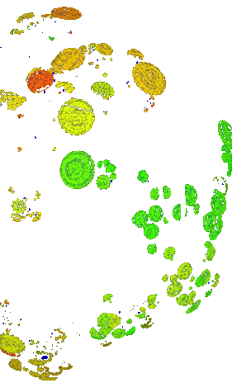
Cognitive Analyst - Trust Modeling
Comparing Near real-time data
to the past
  Historical threat data is incorporated to detect sophisticated attacks
Using the most sophisticated
self-learning techniques in the Security Industry today
  Using 8 independent
  Anomaly Detection Algorithms
Aggregating multiple threat sources into clusters
Severity 8
Unclassified
Normal

Slide 18
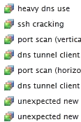
Attack Detection Accuracy - Using A.I.
Trustfulness
Assessment
Layer
Event Generation
Layer
Severity
Assignment Layer
Network Traffic
.
.
.
Contextual Severe
Unclassified Behavior
9
8
7
6
5
4
3
2
1
CTS = Cognitive Trust Score

Slide 19
Cognitive Analyst - First Hour of Operation
  Artificial Intelligence
    Continually tunes to the client’s environment
    Highly accurate by combining several advanced algorithms
  Auto-Learning Engine
    Self-Optimizing
  Scalable Architecture
    Decentralized & Distributed
    Parallel Processing for attack detection in high speed networks
00:00 (hh:mm) Start
00:05 Self-Initialization
00:30 Self-Configuration
01:00 Self-Optimization
System connected to network data source
| 00:05 2 Algorithms
| 01:00
Knowledge
Fusion - active
| 00:10 3 Algorithms
| 00:30
all Algorithms
Online

Slide 20
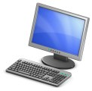
Cognitive Architecture
Net
Flow
&
IPFIX
Core Processing
Artificial Intelligence
Self-Monitoring
Hacker
Circumvention
Policies
& Models
Challenge
Agents
Game
Theory
Optimization
Security
Policy
Anomaly Detection &
Behavior Modeling
Knowledge Fusion
Ag₁
Al₁
Ag₂
Threat
Models
Al₂
Ag₃
Al₃
Ag₄
Al₄
Reconfig
Adaptation
Ag₅
Al₅
Ag₆
Al₆
Ag₇
Al₇
Ag_{n}
Al₈
Reporting & Dashboard
Al = algorithms
Syslog
XML
SIEM
email
SMS
Ag = agents

Slide 21






Cognitive Security – Products & Services
Clients
Ent
Tel
Gov
Pharma
Chemical
Mobile
Defence
Defence
Energy, Oil&Gas
ISP & NSP
Intelligence
Finance
Manufacturing
Hosting
Utilities
Pain
Downtime
Sabotage
Tarnished Image
Lost Productivity
Terrorism
Theft of Corporate Secrets
Fraud
Government Sponsored Attacks
Treatment
Detecting Modern Sophisticated Attacks
Attack Forensics
Advanced Threat Diagnostics
Security Monitoring Services
Services
Behavior Monitoring
Bronze
Silver
Gold
Platinum
Expert Services
Consulting
Training
Forensics
R&D
Software Development
Research
Products
Cognitive₁
Cognitive₁₀
Cognitive_{Expert}
Distribution
Appliance
VM or ISO Image
Software

Slide 22


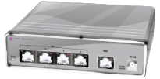

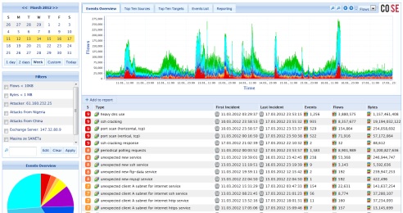

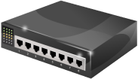



Cognitive Services
Expert Security Protection
Expert Security Protection
Security Monitoring
Advanced Threat Diagnostics
Behavior Correlation Analysis
Incident Reporting
Attack Forensics
Remedial Advisory
Experts in Network Behavior Analysis
Client
Management Dashboard
NetFlow
Sources
Cognitive Analyst
A.I. - Artificial Intelligence
Auto-Tuning
Self-Config
Real-time Analytics
Detection of Modern Sophisticated Attacks:
Malware, Zero-Day, Exploit Kits, APTs
Router
Switch
Cognitive
Analyst
Probe
Security
Security
Process
Technology
Knowledge
People
IT
Host

Slide 23


Cognitive Security - What We Offer
Security Innovation
  Delivering Forward-thinking Security Solutions
  Thought Leadership
R&D Expertise
  Cost-effective Research & Development resources
  Quick development turn-around
  Flexible integration with OEMs, MSSPs, & device manufacturers
Intuitive Management Interface
  Easy-to-Use Dashboard
  Granular attack detection analysis
Product Reliability
  5th Generation Network Behavior Analysis platform
Privacy Concerns
  Data anonymity is maintained

Slide 24
Download the Original Presentation Here:
http://gdusil.wordpress.com/2013/03/08/cognitive-secu…ntroduction-12/

Slide 26
Synopsis - Corporate Introduction ('12)
Corporate leaders face complex challenges in balancing security spending against the evolving risks that internet commerce presents. This has resulted in new and advanced levels of protection needed to facilitate these strategic objectives. Expert Security addresses the need to implement more robust and cost effective levels of expertise, and also helps to bridge the gap to higher, and more expensive - and often culturally adverse - outsourced solutions. As companies expand, their need for additional layers of protection it is paramount to ensure asset protection. Network Behavior Analysis are the building blocks of Expert Security, and offers a viable solution to modern sophisticated cyber-attacks. This presentation was prepared to outline our corporate overview and market positioning of Cognitive Security.

Slide 27
Tags
Network Behavior Analysis, NBA, Cyber Attacks, Forensics Analysis, Normal vs. Abnormal Behavior, Anomaly Detection, NetFlow, Incident Response, Security as a Service, SaaS, Managed Security Services, MSS, Monitoring & Management, Advanced Persistent Threats, APT, Zero-Day attacks, Zero Day attacks, polymorphic malware, Modern Sophisticated Attacks, MSA, Non-Signature Detection, Artificial Intelligence, A.I., AI, Security Innovation, Mobile security, Cognitive Security, Cognitive Analyst, Forensics analysis, Gabriel Dusil

