Slide 1




Corporate Overview
Gabriel Dusil
VP Marketing & Corporate Strategy
www.facebook.com/gdusil
cz.linkedin.com/in/gabrieldusil
gdusil.wordpress.com
gabriel.dusil@visualunity.com

Slide 2
Who is Visual Unity?
Visual Unity bridges the gap between linear broadcast, IT and IPTV to help clients reach and engage audiences on any screen. Since 1991, the team has been designing and delivering turnkey broadcast and complex multiscreen solutions worldwide – from HD outside Broadcast (OB) vehicles and major playout facilities to live internet streaming and Video on Demand services. Visual Unity’s award-winning vuMediaTM platform helps broadcasters and content owners control how their brand and assets are managed and monetized in the multiscreen environment. Highly scalable and flexible, vuMediaTM delivers a cutting-edge live viewing experience on the web or any mobile or connected device – all of which can be deployed into existing workflows and business processes.
Visual Unity is a global provider of video and digital media solutions, enabling our clients to deliver premium quality video content. Our clients can measure, analyze and optimize their libraries over time and achieve optimal business success. Our platform capabilities inspire our clients to deploy their assets across multiple devices, screens, and media formats. Visual Unity helps clients manage, deliver and monetize their digital content.
Please visit us at: www.visualunity.com
Na Hrebenech II 1718/8, Prague 4, 147 00, Czech Republic
T: +420 271 742 111 F: +420 271 742 112
info@visualunity.com

Slide 3
Corporate Overview
21
Award-winning Platform & Solutions
  Turnkey Broadcasting ⇨ Multiscreen
  ISO9001 since 2006
Multiscreen Systems Integrator
  45+ staff (12 in-house developers)
Internet Video Platform
Expertise with
broadcasters
Years of Video Experience
9
Geographic Regions
11½
Million USD ‘11 Revenue
15
Years of video & mobility experience

Slide 4

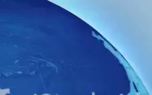



Product & Service Mix
What
We Do
  Network Operators • Media Companies • Enterprise
  Platform
  Solutions
  Service Provider
  Software Development
  Professional Services
What
We Deliver
  Broadcast Design
  Consulting
  Project Management
  Transcoding
  System Integration
vuMedia
vuNet
vuMultiscreen
vuEasy
vuMobile
For Whom
We Deliver

Slide 5







Awards & Achievements
Red Herring - Top 100
  Europe Winner & Global Finalist
TV Technology Star
Connected World TV
IBC Broadcast Engineering
CSI Awards
European Readers Choice

Slide 6
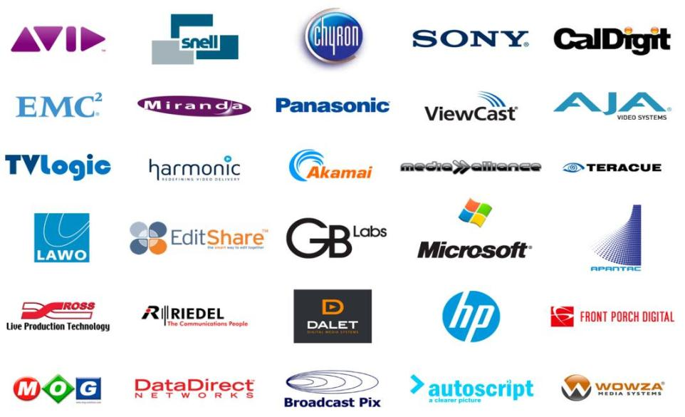
Our Partners
Notes:
MJO Note: his graphic was taken from the website - logos should be available on the shared drive. The list needs to be reviewed and updated, eg Omneon is now Harmonic.

Slide 7




Clients Worldwide

Slide 8



Corporate Locations
Corporate HQ
Planned Rep Office – 1st phase
Potential office – 2nd phase

Slide 9
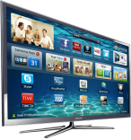

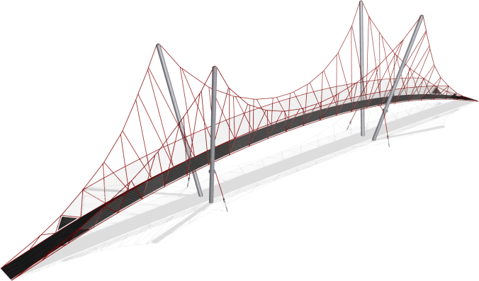




Multiscreen Solutions, Servicing…
Traditional Broadcasters
1950+ Broadcast
TV ⇨ Multiscreen
Multiscreen Providers
1997+
Online Video

Slide 10


Bridge to Connected Multimedia
vuMedia™…
  …Is a Solution
  …Is a Modular
  Architecture
  …Includes core
  competencies
  of Visual Unity
    People
    Process
    Knowledge
    Technology
vuMedia™…
  …Bridges traditional TV Broadcasting to Internet Video
  …Connects digital content workflow from Creation to Consumption
Multiscreen
Ingest Encode
Technology
People
Manage
vuMedia
Distribute
Knowledge
Process
Monetize
Digital Rights

Slide 12
Tags
Visual Unity, Gabriel Dusil, Broadcast, online advertising, System Integration, Online Video Platform, OVP, Online Video, Broadcast, Czech Republic, Internet Video, Online Video, Multiscreen System Integrator, Red Herring, TV Technology Star, Connected World TV, IBC Broadcast Engineering, CSI Awards, European Readers Choice, streaming service provider, vuMedia, vuEasy, vuManagement, vuStats, vuRights, CDN, Software developer, Software development

