Slide 1
Anatomy of Advanced Persistent Threats

Slide 2
Download the Original Presentation
Download the native PowerPoint slides here:
  http://gdusil.wordpress.com/2012/04/15/anatomy-of-advanced-persistent-threats/
Or, check out other articles on my blog:
  http://gdusil.wordpress.com

Slide 3


Threat Landscape - Paradigm Shift
Old threats were IT Oriented
  Fame & Politics
  Boredom & Personal Challenge
New threats focus on ROI
  Fraud & Theft
Criminals now take a strategic approach to cybercrime
  Companies now compensate by building higher walls
Battles may have been
won & lost on both sides…
  …But the war is far from over.

Slide 4

IT Security Challenges
People + Process + Technology = Business Challenges
Notes:
Behaviour between two entities is easily describable and predictable.
Introduction of the third body makes the dynamic much more complex – the infamous three-body problem!
This phenomenon is seen both in nature, people and technology
The pyramid with a triangular base is one of the most stable structures known to man
The trick is achieving that fragile but stable equilibrium between people, processes and technology
Tom Peters and Robert Waterman noted
...Without exception, the dominance and coherence of culture proved to be an essential quality of the excellent companies. Moreover, the stronger the culture and the more it was directed toward the market place, the less need was there for policy manuals, organisation charts, or detailed procedures and rules ...people ... know what they are supposed to do in most situations because the handful of guiding values is crystal clear
Procedures, therefore, should support the culture and not govern or influence it.

Slide 5
Definitions
Vulnerability
A bug, glitch, hole, or flaw in a network, application or database
Threat
Attack developed to take advantage of a vulnerability
Exploit Kits
Attack on a selection of vulnerabilities to control a network, device, or asset
Patch
Attack against an unknown vulnerability, with no known security fix
Advanced Persistent Threat • Methodical, long-term covert attacks, using many tools to steal info
Zero-Day Attack
Software designed to fix a vulnerability and otherwise plug security holes

Slide 6






Anatomy of APT Attacks
Blended
Threats
Include embedded URLs that link to an infected Web page
Employ social engineering to encourage click-through.
Infected
Websites
Victim visits legitimate site infected by malware (eg. Cross Site Scripting, or iFrame compromise)
Malware
Tools
Back-door downloaders, key loggers, scanners & PW stealers
Polymorphic design to escape AV detection
Infected
PC (bots)
Once inside the, infiltrating or compromising data is easy
Command&
Control (C2)
Remote servers operated by attacker control victim PCs
Activity occurs outside of the normal hours, to evade detection
Management
Console
Interface used to control all aspects of the APT process
Enables attackers to install new malware & measure success
Some DDoS attacks can originate from internal workstations

Slide 7
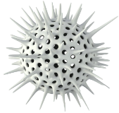
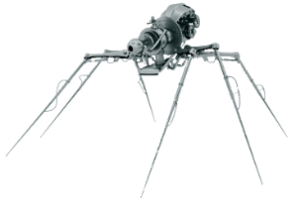
Anatomy of Advanced Persistent Threats
Advanced Persistent Threats
Heavy DNS
Use & Sophisticated Scans
Periodic Polling
- Command & Control
Unexpected new service or Outlier Client
Outbound Encrypted sessions (eg. SSH)
Peer 2 Peer Network Behavior
Unclassified Behavior - Unexpected
Anomaly

Slide 8



Application Security “Imbalance”
Web Browsers
  IE, Firefox, Opera,
  Safari, Plugins
Applications
  Adobe Flash,
  Codecs,
  QuickTime
Rich Complex
Environments
  Java, Flash,
  Silverlight,
  .NET & J2EE
8. Web
7. App
Presentation
5. Session
4. Transport
3. Network
2. Data
1. Physical
TCP, SIP
TCP, UDP
IP
802.11, FDDI, ATM
1000Base-T, E1
SSL, TLS
HTTP, SMTP, FTP
80%
Apps
10% App
90%
Network
20%
Network
% of
Security
Attacks
% of
Security
Spending
Notes:
Top attack target is the web application layer – not the web server (IIS, Apache, etc.) but the web applications
And why are they targeting web applications? They’re targeting site visitors!
8

Slide 9
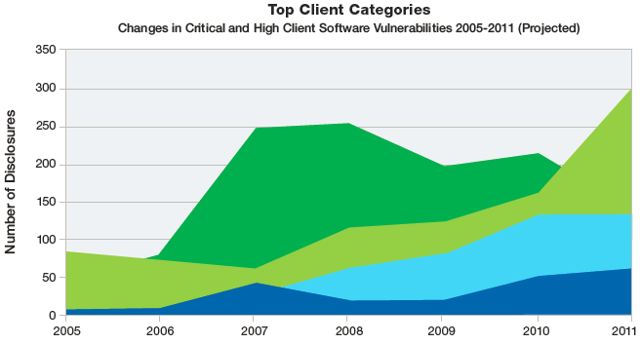
Top Vulnerabilities by Category
IBM - X-Force (Mid-year Trend & Risk Report '11

Slide 10
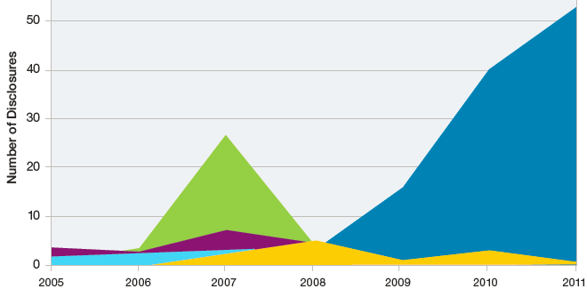
Vulnerabilities Affecting Multimedia Software
IBM - X-Force (Mid-year Trend & Risk Report '11

Slide 11
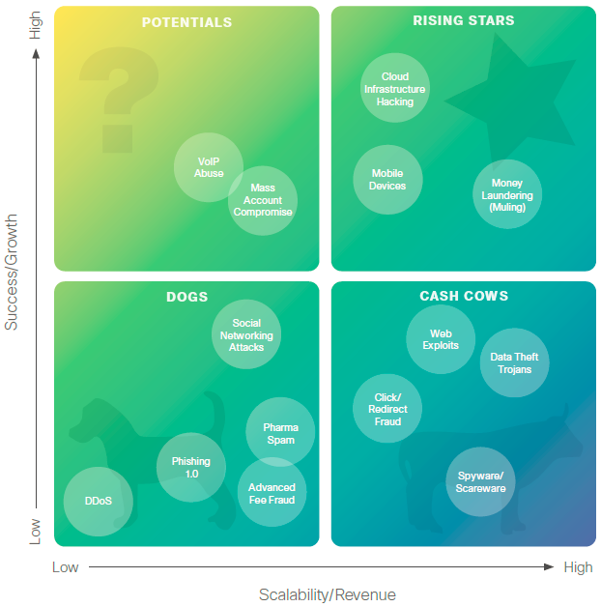
Cisco - Cybercrime Techniques ‘11
“The Zeus Trojan…,
….will continue to receive
significant investment
from cybercriminals
in 2011.”
“The aptly named
Zeus,… …targeting
everything from bank
accounts to government
networks, has become
extremely sophisticated
and is much more.”
Cisco - Annual Security Report '11

Slide 12
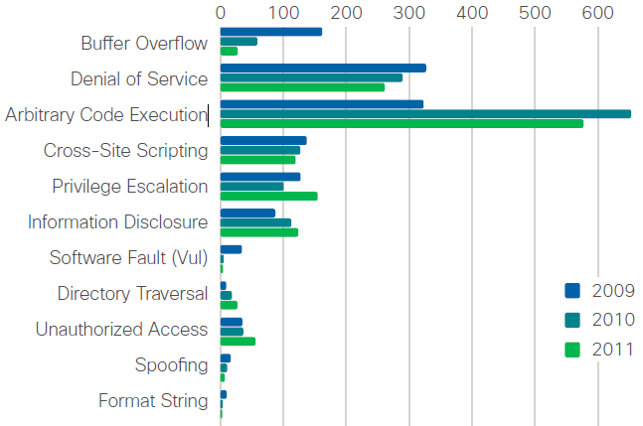


From Buffer Overflows to Code Executions
“Going into 2012,
security experts
are watching
vulnerabilities in
industrial control
systems &
supervisory
control & data
acquisition
systems, also
known as
ICS/SCADA.”
Cisco - Annual Security Report '11

Slide 13
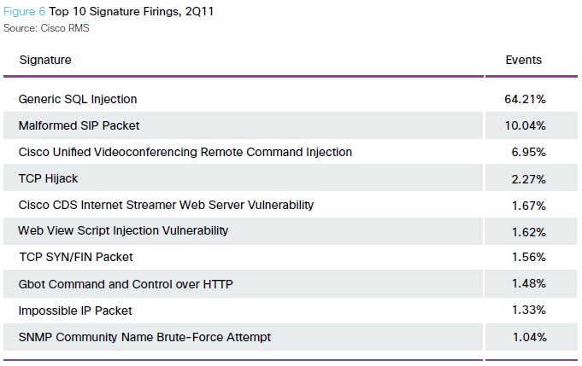
Signature Detection – Not Good Enough
Cisco - Annual Security Report '11

Slide 14
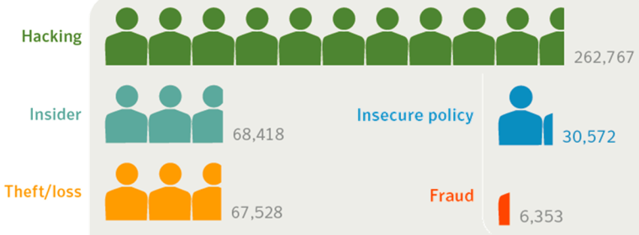

Targeted Attack Types
  “[Hacking] Breaches… …can be especially damaging for enterprises because they may contain sensitive data on clients as well as employees that even an average attacker can sell on the underground economy.”
Source: OSF DataLoss DB,
Symantec – Internet Security Threat Report ‘11.Apr

Slide 15
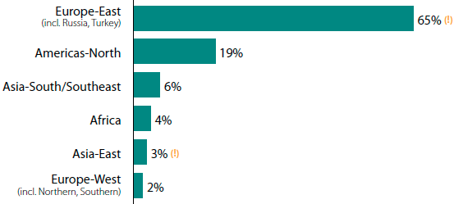
Origin of External Hackers
*Verizon – ‘11 Data Breach Investigations Report

Slide 16
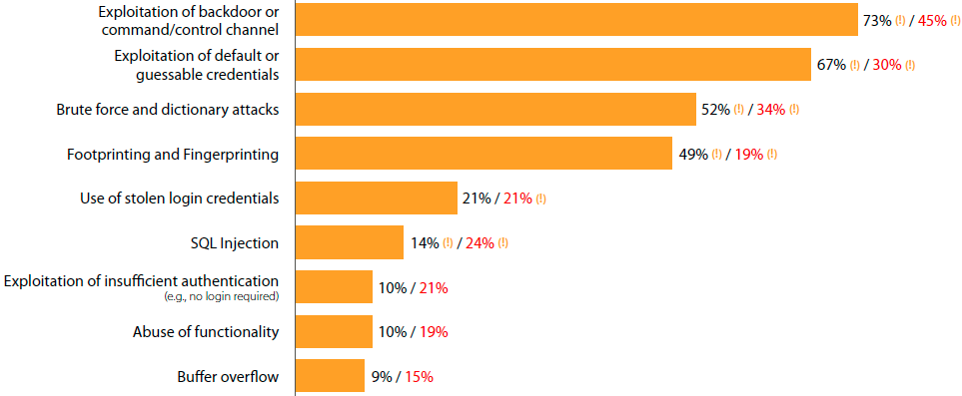
Types of Hacking
% breaches / % records
footprinting and fingerprinting) - automated scans for open ports & services
Verizon – ‘11 Data Breach Investigations Report

Slide 17
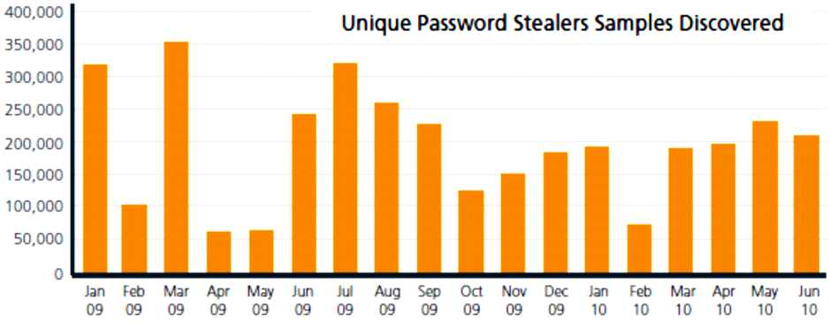
Password-stealing Trojans
Primarily targets are bank accounts
McAfee Threats Report, Q2 ‘10

Slide 18
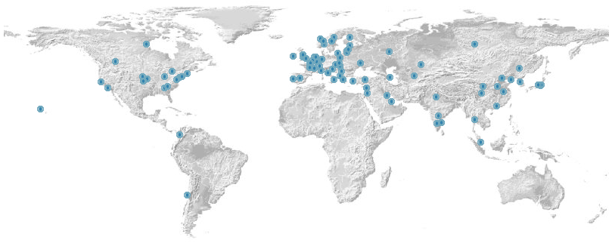
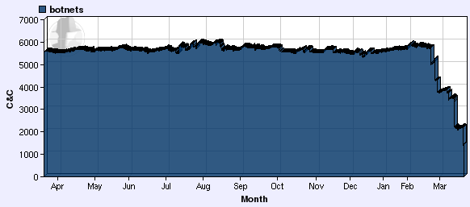

Botnet Statistics
Up to 6000 different botnet Command & Control (C&C) servers are running every day
  Each botnet C&C controls an average of 20,000 compromised bots
  Some C&C servers manage between 10’s & 100,000’s of bots
Symantec reported an average of 52.771 new active bot-infected computers per day
Arbor Networks Atlas - http://atlas.arbor.net/summary/botnets
ShadowServer Botnet Charts - www.shadowserver.org/wiki/pmwiki.php?n=
Stats.BotnetCharts

Slide 19
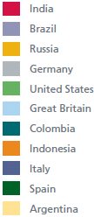
Overall Botnet Distribution by Country
Friday is the busiest day for
new threats to appear
May 13 - June 4, 2010
  Increased Zeus &
  other botnet activity
McAfee Threats Report, Q1 ‘11

Slide 20
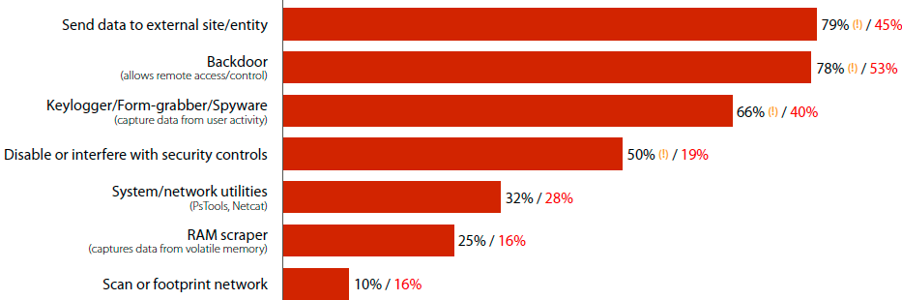
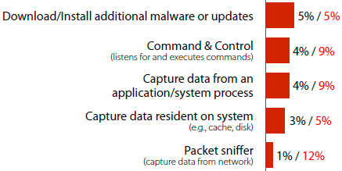
Malware Functionality
% breaches / % records
Verizon – ‘11 Data Breach Investigations Report

Slide 21
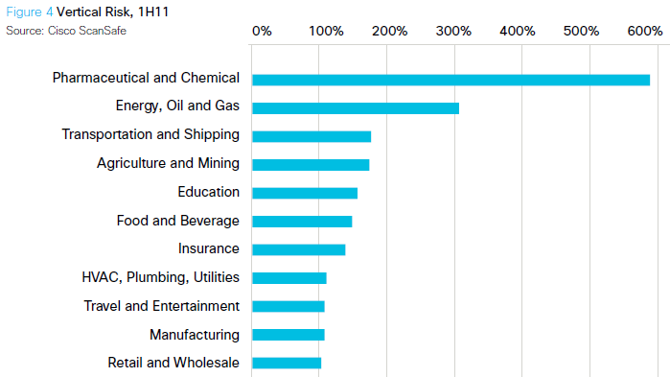

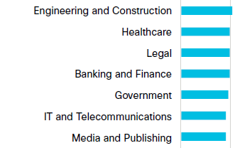
APT Threats by Vertical market
Gartner estimates that the global market for dedicated NBA revenue will be approximately $80 million in 2010 and will grow to approximately $87 million in 2011
  Gartner
Collecting “everything” is typically considered overkill. Threat Analysis at line speeds is expensive & unrealistic – NetFlow analysis can scale to line speeds, & detect attacks
  Cisco
“…attacks have moved from defacement and general annoyance to one-time attacks designed to steal as much data as possible.”
  HP
HP – Cyber Security Risks Report (11.Sep)
Gartner - Network Behavior Analysis Market, Nov ’10
Cisco - Global Threat Report 2Q11

Slide 22
APT Threats by Vertical market
Cisco - Global Threat Report 2Q11

Slide 23
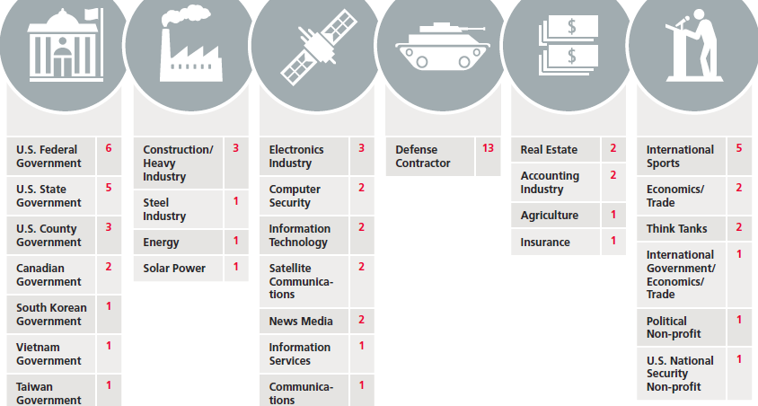
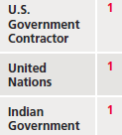
APT by Vertical Market
McAfee – Revealed, Operation Shady RAT

Slide 24
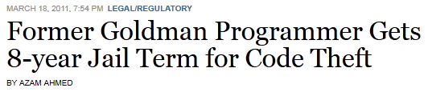
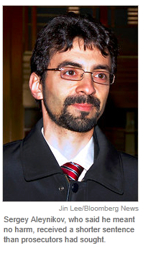
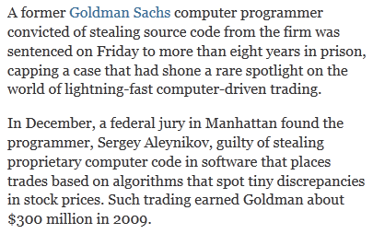
Theft – Intellectual Property
http://dealbook.nytimes.com/2011/03/18/ex-goldman-programmer-sentenced-to-8-years-for-theft-of-trading-code/

Slide 25
APT - Targets
✓ Defense
✓ CERT/CSIRT
✓ Intelligence
✓ Utilities
✓ ISP - Internet Service Providers
✓ NSP - Network Service Providers
✓ Mobile & Telco Operators
✓ Banking,
Finance, & Insurance
✓ Pharma,
Petrochemical
Energy, &
Transport
Government
Telcos
Enterprise

Slide 26
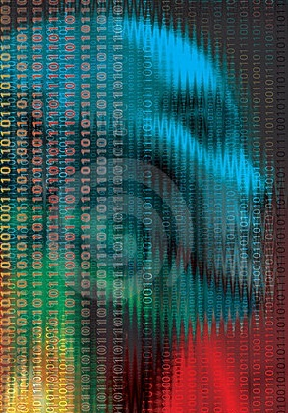
Telco – Business Pains & Needs
Challenges
  Integrate with SIEM
  Provide a way for automated blocking
  Handling of high bandwidth traffic
  Mapping IP addresses to subscribers
  Processing of incidents
  5x7 and 24x7 support
  Handling links with minimum latency
  No additional point-of-failure
  No modifications of the existing infrastructure
  Integrate into the existing reporting

Slide 27
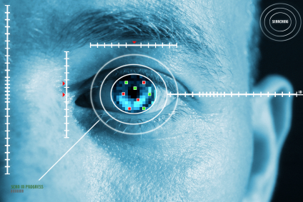
Telco - Threats
Protect critical network infrastructure
  Legacy network
  Traffic going to the Internet
  Internal VOIP traffic
Protect Cable & GPRS subscribers
  Botnets
  DNS attacks
  Zero-day attacks
  Low-profile attacks
  SYN flood & ICPM attacks
  Service misuse
Protection against
APT, zero-day attacks, botnets and polymorphic malware

Slide 28

Pharmaceutical – Business Pains & Needs
Protection of design secrets
  Throughout the R&D process
  High-end databases from theft
Databases contain development & testing of new compounds & medicines.
  Theft of Intellectual Property
  Secrets lost to competitors or foreign governments
Security is needed to protect Corporate Assets
  Sales Force Automation, Channel Management, CRM systems, Internet Marketing
C-T.P.A.T - Customs & Trade Partnership Against Terrorism,
http://www.cbp.gov/xp/cgov/import/commercial_enforcement/ctpat/

Slide 29

Pharmaceutical – Business Pains & Needs
A Global Industry
  Exposed to security risks from competitors or government sponsored attacks
Supply Chain Security
  R&D ⇨ chemicals ⇨ production ⇨ sales channels
  Cross-Country & Cross-Company
  Indian & Chinese emergence
  Chemicals used for terrorism
Mandatory retention of data
  Protection from APT attacks
  Unauthorized access from both internal and external agents
REACH - Registration, Evaluation, Authorization and Restriction of Chemicals is a European Union law, regulation 2006/1907 of 18 December 2006. - REACH covers the production and use of chemical substances

Slide 30
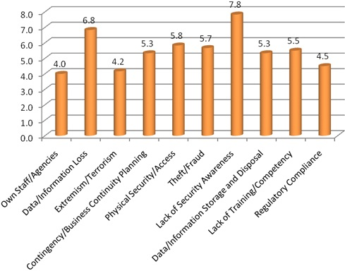
Pharmaceutical – Threats
Cybersquatting
  Registration of domain
  names containing a brand,
  slogan or trademark to
  which the registrant has
  no rights
Understanding the
topology across
the Supply Chain
can assist security
experts in
identifying potential
weak spots
UKSPA - What are the top security threats facing the research sector? -http://www.ukspa.org.uk/news/content/2562/what_are_the_top_security_threats_facing_the_research_sector

Slide 31


Preventative Solutions for APT Attacks
Behavioral Analysis
Cyber-Attack Detection
Security Monitoring
Maximize QoS
Incident Response
Attack Validation
IP or AS blocking
Blocking Policies
Inform Subscriber
Risk Analysis
Attack Location ID
IP = Internet Protocol, AS = Autonomous System, QoS = Quality of Service, SRMB = Security Risk Minimal Blocking

Slide 32
APT – Preventative Strategies
Using NetFlow to support incident response
Take an analytical approach to detecting APTs.
Use location IDs so alerts are more “human-readable,”
Baseline, to detect anomalous events.
Collaborate & share knowledge.
Combining the above approaches can help security teams more quickly identify and remediate intrusions and help avoid potential losses.
Cisco - Global Threat Report 2Q11
Notes:
Conclusion
Cybercriminals are launching more targeted, sustained, and hard-to-detect attacks. But organizations are not defenseless against these intrusions. While there is no magic bullet, many approaches to monitoring, detection, and incident response are readily available—and often free. As discussed in this report, security professionals should consider embracing strategies such as:
• Using NetFlow to support incident response by identifying zero-day malware that has bypassed typical security controls; exposing compromised machines; verifying that connections destined for areas within the enterprise network are expected in accordance with company network and security policies; evaluating firewall access control lists; and detecting covert channels and/or web-based uploads.
• Taking an analytical approach to detecting APTs and deploying well-understood computer security incident responses. These include the ability to produce, collect, and query logs; some form of deep packet inspection to cover key network “choke points”; the ability to quickly query network connections or flows through NetFlow or similar services; the development of trust-based, intelligence-sharing relationships with other organizations; and malware analysis.
• Assigning IDS location variables to make alerts more “human-readable,” so that security teams can instantly identify and escalate an incident without needing to first decipher the alert.
• Baselining to detect anomalous events. Approaches include charting infected host count per detection vector, establishing thresholds and trending, or recording the number of IP addresses found per run of each malware report and then looking for deviations from what is expected.
• Collaborating and sharing knowledge. Develop trust-based relationships with other organizations to share intelligence on events. This is a long process that you will have to purposely resource and tend. A great start would be joining an organization like FIRST.org.
Regardless of the motivation of attackers—whether it’s to steal data, prove a point, or grab a laugh—breaches are costly and the number of incidents continues to increase. Combined, the above approaches can help security teams more quickly identify and remediate intrusions on their own networks, and help avoid potential losses.

Slide 34
Synopsis - Breaking Down the Advanced Persistent Threat
“Advanced Persistent Threats”, or APTs, refers low-level attacks used collectively to launch a targeted & prolonged attack. The goal is to gain maximum control into the target organization. APTs pose serious concerns to a security management team, especially as APT toolkits become commercially and globally available. Today’s threats involve polymorphic malware and other techniques that are designed to evade traditional security measures. Best-in-class security solutions now require controls that do not rely on signature-based detection, since APTs are “signature-aware”, and designed to bypass traditional security layers. New methods are needed to combat these new threats such as Behavioral Analysis. Network Behavior Analysis proactively detects and blocks suspicious behavior before significant damage can be done by the perpetrator. This presentation provides some valuable statistics in the growing threat of APTs.
.

Slide 35
Tags - Breaking Down the Advanced Persistent Threat
Network Behavior Analysis, NBA, Cyber Attacks, Forensics Analysis, Normal vs. Abnormal Behavior, Anomaly Detection, NetFlow, Incident Response, Security as a Service, SaaS, Managed Security Services, MSS, Monitoring & Management, Advanced Persistent Threats, APT, Zero-Day attacks, Zero Day attacks, polymorphic malware, Modern Sophisticated Attacks, MSA, Non-Signature Detection, Artificial Intelligence, A.I., AI, Security Innovation, Mobile security, Cognitive Security, Cognitive Analyst, Forensics analysis, Gabriel Dusil

