Slide 1
A Compliance Framework for Credit Card Security
Gabriel Dusil
SecureWorks Inc.
Director Partnerships, EMEA
www.facebook.com/gdusil
cz.linkedin.com/in/gabrieldusil
gdusil.wordpress.com
dusilg@gmail.com

Slide 2
Download the Original Presentation
- A Compliance Framework for Payment Card Security
Download the native PowerPoint slides here:
  http://gdusil.wordpress.com/2010/09/18/a-compliance-framework-for-payment-card-security
Or, check out other articles on my blog:
  http://gdusil.wordpress.com

Slide 3

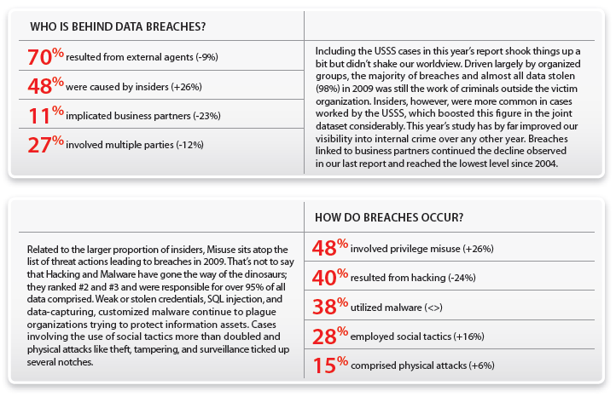
Breach Sources & Methods
    Source - Verizon “Data Breach Investigations Report ’10”

Slide 4


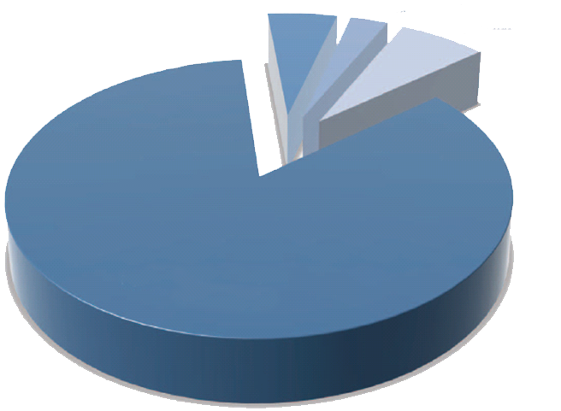
Types of Stolen Data
Intellectual Property
3%
Non-Payment
Card Info
5%
Sensitive Company
Data
7%
Payment Card Information
85%
7Safe – UK Security Breach
Investigations Report ‘10

Slide 5
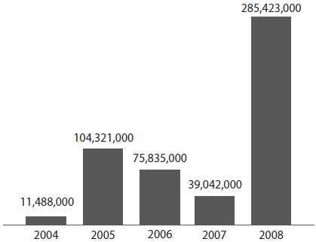
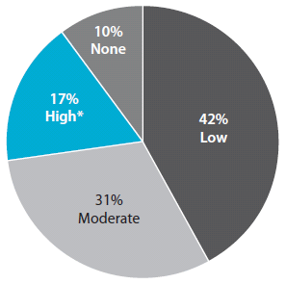
Security Breaches by Difficulty
Stealing records
should require
expert security
knowledge…
… But 80% of existing attacks required little or no
knowledge
Security Breaches by # of records
    Source - Verizon “Data Breach Investigations Report ’09”

Slide 6
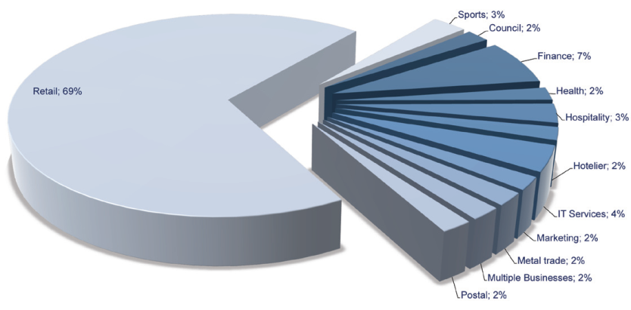
UK Breaches – Retail Exposure
7Safe – UK Security Breach
Investigations Report ‘10

Slide 7
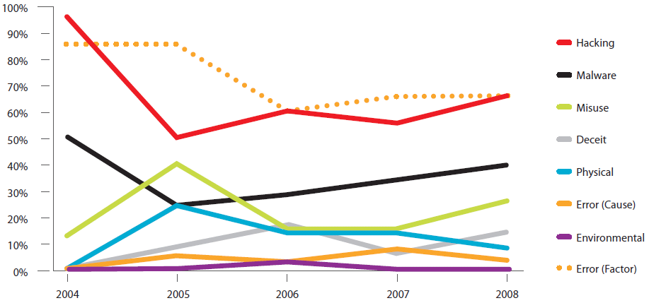
Data Breach Trends
How do breaches occur?
  67% aided by significant errors
  64% resulted from hacking
  38% utilized malware
  22% privilege misuse
  9% physical attacks
    Source - Verizon “Data Breach Investigations Report ’09”

Slide 8
Market Rates - Identity & Data Theft
  Value of selling stolen credit card data has dropped from $6 per record in 2008 to less than $0.50 per record in 2009
Item | Price
Credit Card (with CVV) | $0.50 - $6
Identity (SSN, DoB, bank account, credit card, …) | $14 - $18
Online banking account with $9,900 balance | $300
Compromised Computer | $6 - $20
Phishing Web site hosting – per site | $3 - $5
Verified PayPal account with balance | $50 - $500
Skype Account | $12
World of War craft Account | $10
    Source: SecureWorks

Slide 9

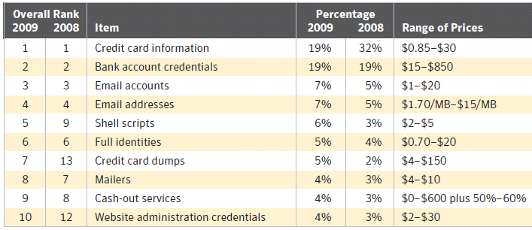
Rates - Advertised by Criminals
    Symantec Internet Security
    Threat Report – Apr ’10, EMEA

Slide 10

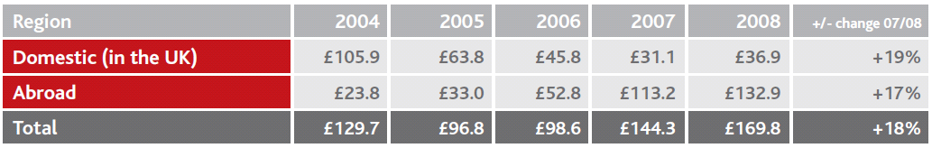
Fraud – UK vs. Int’l
Counterfeit card fraud losses in the UK & abroad
  All figures in £ millions
    UK Payments Administration - “Fraud Facts ‘09”

Slide 11
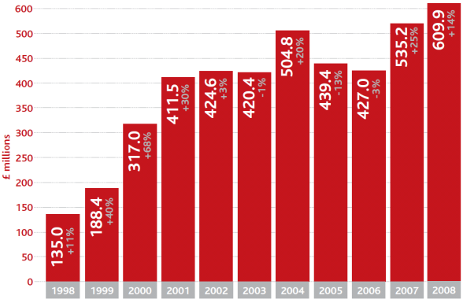
Card Fraud - UK
Card fraud
steadily
Increasing
  Figures in grey
  show percentage
  change on
  previous year’s
  total
    UK Payments Administration - “Fraud Facts ‘09”

Slide 12
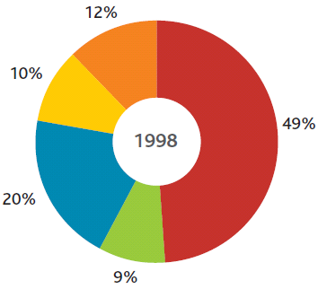
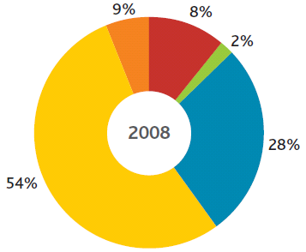
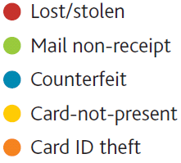
Types of Card Fraud
Card-not-present is the current weak link
    UK Payments Administration - “Fraud Facts ‘09”
    Card fraud losses split by type as % of total losses

Slide 13
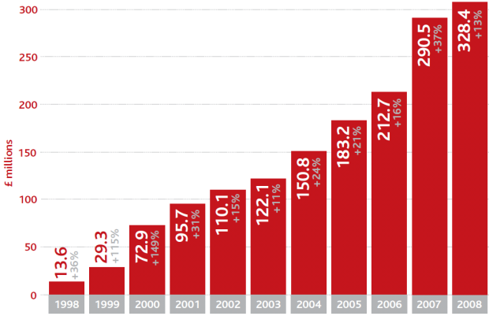
Card-Not-Present fraud
Businesses accepting
Card-not-present
transactions are
unable to check the
card’s physical
security features to
determine whether
it is genuine
  Without a signature
  or a PIN there is less
  certainty that the
  client is the genuine
  cardholder
    UK Payments Administration - “Fraud Facts ‘09”
    Card-not-present fraud losses on UK-issued cards

Slide 14

Downtime from IT Failures
Best Practices have the lowest downtime
    Itpolicycompliance.com - Leading Causes of Regulatory Compliance Deficiencies - “Managing Spend on Info Security & Audit for Better Results, Feb ’09”

Slide 15
Annual Financial Loss
Best Practices have the lowest Financial Losses
    Itpolicycompliance.com - Leading Causes of Regulatory Compliance Deficiencies - “Managing Spend on Info Security & Audit for Better Results, Feb ’09”

Slide 16

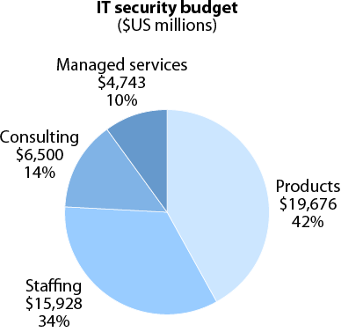
IT Security Budget - High-Level
    Forrester - “Market Overview:
    IT Security In 2009” (09.Apr)

Slide 17

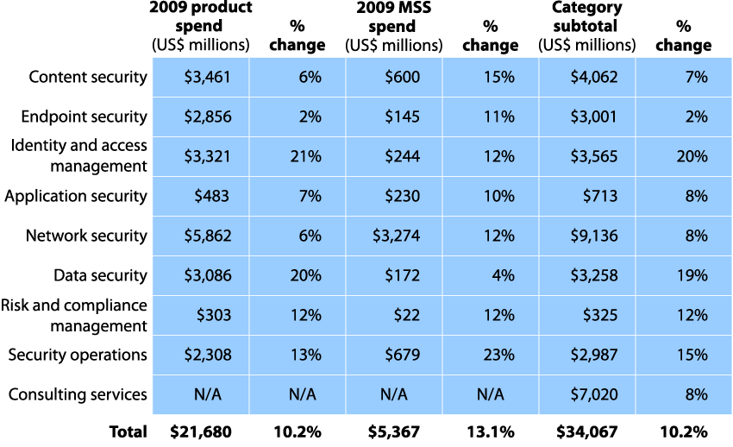
Estimated IT Security Spending
    Forrester - “Market Overview:
    IT Security In 2009” (09.Apr)

Slide 18

PCI DSS Evolution
Compliance Means…
  Everyone that
  processes, stores,
  or transmits
  must comply
  Payment apps
  must be
  reviewed
  for PA-DSS
  compliance
PCI DSS v2.0
2010
2008
PA-DSS released
New SAQs released
PCI v1.2
2006
PCI security standards
Council formed and PCI
DSS version 1.1 released
2005
Payment Application Best practices Program announced
2004
2001
Programs combined into Payment Card Industry (PCI), Data Security Standards (DSS)
12 core requirements
Scanning requirements for public-facing systems
Visa (‘01) &
MasterCard (‘03) Separate programs

Slide 19
PCI - State of Play
PCI is a model that is likely to be emulated
  Created by representative standards body
  Is prescriptive in recommended controls
  Enforced at industry level by monetary fines
  Refined continuously based on breech information
If you have significant efforts in ISO27001, NIST, COBIT, SOX
  PCI will not be difficult
  Will require preparation because of unique, specific requirements
Notes:
Colleagues said, Why are you speaking about PCI in the Kingdom? Credit cards are very popular and PCI has not had the impact there that is has in the States.
Here’s why.
1st:Because payment cards, even credit cards, issuance is growing quickly.
This is for reasons you are familiar with - western banking practice being somewhat more common, issuance of cards that align better with Islamic principles, etc.
So, PCI will affect some percentage of organizations naturally as a part of this growth.
2nd: And more importantly, I think the clever Security manager, CIA, CSO will study PCI as a model.
Why?
-Talk to bullets 3 and 4.

Slide 20
PCI - State of Play
An increasing concern for merchants
  Perhaps the major security initiative driver in the USA
  Growing quickly in Europe and the rest of EMEA
  Clever security and risk managers will study PCI as a reference model
Everyone should expect increased IT security regulations
  Industry
    Self-regulate before government forces it
    Maintain reputation
  Government
    If industry doesn’t self-regulate governments will
    Encourage commerce
    Increase trust, decrease fraud
Notes:
Colleagues said, Why are you speaking about PCI in the Kingdom? Credit cards are very popular and PCI has not had the impact there that is has in the States.
Here’s why.
1st:Because payment cards, even credit cards, issuance is growing quickly.
This is for reasons you are familiar with - western banking practice being somewhat more common, issuance of cards that align better with Islamic principles, etc.
So, PCI will affect some percentage of organizations naturally as a part of this growth.
2nd: And more importantly, I think the clever Security manager, CIA, CSO will study PCI as a model.
Why?
-Talk to bullets 3 and 4.

Slide 21
PCI DSS – Protection of Card Holder Data
Manufacturers
PCI PED
Software Developers
PCI PA-DSS
Merchant & SP
PCI DSS
Standards applied to payment devices, payment applications, systems that transmit/ store/ process cardholder data and the users.
The PCI Standard is one of the most detailed and stringent regulations affecting businesses today.

Slide 22
PCI Counsel & Payment Brand
PCI Counsel
Payment Brand
  Issues new standards & management standards life cycle
  Manage the qualification and approval for ASV/ QSA/ PA-QSAs & PED Labs.
  Create awareness and adoption of standards
  Participation and Feedback to enhance payment security
  Each Payment Brand develops and maintains its own PCI DSS compliance program, which includes
  Tracking & Enforcement
  Penalties, Fees & Deadlines
  Validation Process
  Definition of Merchants & Service Provider (SP)
  Responsible for forensics & account compromises
Notes:
PCI Counsel and Payment Brand main objectives
Acquirer is responsible for Merchant compliance
- Their responsibility that Merchant understand PCI DSS compliance requirements and track compliance efforts
- Manage merchant communication
Acquirer works with merchants until full compliance has been validated
- Merchants are not compliant until all requirements have been met and validated
- Acquirer is responsible of providing merchant compliance status to payment brand
- Acquirer incur liability for non-compliance (which they usually pass to the merchants)

Slide 23
PCI Levels
Level | Visa Europe | MasterCard SDP
1 | Over 6 million Visa transactions (all channels ) or compromised merchant | Over 6 million MasterCard transactions or identified as level 1 by other brand or being compromised
2 | 1 to 6 million Visa transactions annually | 1-6 million transactions or identified as level 2 by other brand
3 | 20k to 1 million Visa e-com transactions annually | 20k to 1 million MasterCard e-com transactions annually
4 | Less than 20k visa e-com transactions & all other up to 1million transactions | All other MasterCard Merchants
Notes:
PCI Counsel and Payment Brand main objectives
Acquirer is responsible for Merchant compliance
- Their responsibility that Merchant understand PCI DSS compliance requirements and track compliance efforts
- Manage merchant communication
Acquirer works with merchants until full compliance has been validated
- Merchants are not compliant until all requirements have been met and validated
- Acquirer is responsible of providing merchant compliance status to payment brand
- Acquirer incur liability for non-compliance (which they usually pass to the merchants)

Slide 24
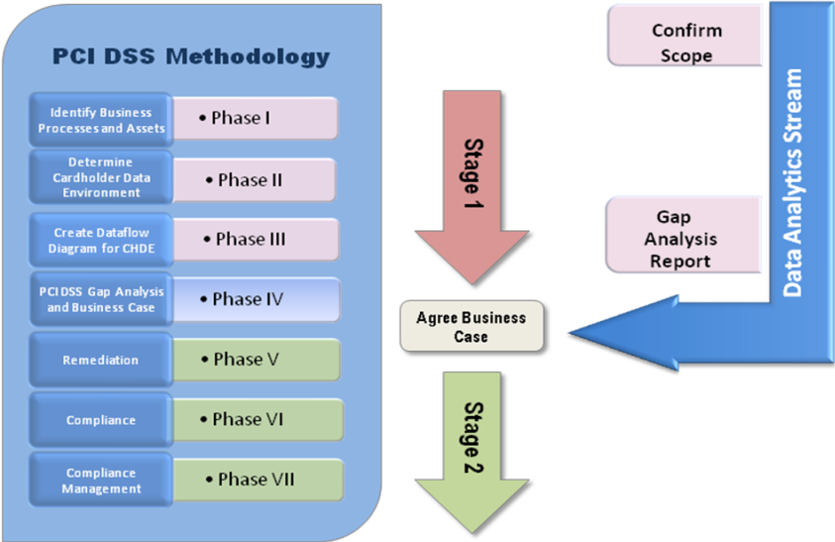
Path to Compliance

Slide 25
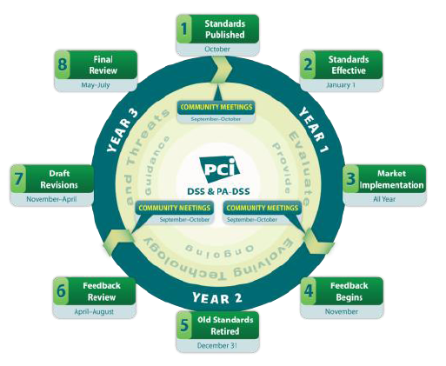
New Three Year Lifecycle
Notes:
Colleagues said, Why are you speaking about PCI in the Kingdom? Credit cards are very popular and PCI has not had the impact there that is has in the States.
Here’s why.
1st:Because payment cards, even credit cards, issuance is growing quickly.
This is for reasons you are familiar with - western banking practice being somewhat more common, issuance of cards that align better with Islamic principles, etc.
So, PCI will affect some percentage of organizations naturally as a part of this growth.
2nd: And more importantly, I think the clever Security manager, CIA, CSO will study PCI as a model.
Why?
-Talk to bullets 3 and 4.

Slide 26

PCI Foundation – 12 Requirements
PCI Requirements | Legend: Managed Service Monitored Service ✓ Additional Services | Managed FW | Managed IDS/IPS | Managed WAF | Security Monitoring | SIM on Demand | Log Monitoring | Log Retention | Vulnerability Man | Managed St. Auth | Managed Directory | Threat Intelligence | Consulting Service
1. Install & maintain FW config to protect cardholder data. |  | ✓ |  |  | ✓ | ✓ |  |  |  |  |  |  | ✓
2. Do not use vendor-supplied defaults for passwords |  |  |  |  |  |  |  |  | ✓ | ✓ |  |  | ✓
3. Protect stored cardholder data |  | ✓ | ✓ | ✓^{DB} |  |  |  |  |  |  |  |  | ✓
4. Encrypt cardholder data across open networks. |  | ✓ |  |  | ✓
5. Use & regularly update anti-virus programs. |  |  | ✓ |  | ✓ | ✓ |  |  | ✓
6. Develop and maintain secure systems & applications. |  |  |  | ✓ |  |  |  |  | ✓ |  |  | ✓ | ✓
7. Restrict access to cardholder data by need-to-know. |  |  |  |  | ✓ | ✓ |  |  |  | ✓ |  |  | ✓
8. Assign a unique ID to each person with PC access. |  |  |  |  | ✓ | ✓ |  |  |  | ✓ |  |  | ✓
9. Restrict physical access to cardholder data. |  |  |  |  | ✓ | ✓ |  |  |  | ✓ |  |  | ✓
10. Monitor access to net resources & cardholder data. |  |  |  |  | ✓ | ✓ | ✓ | ✓
11. Regularly test security systems & processes |  |  | ✓ |  | ✓ | ✓ |  |  | ✓ |  |  |  | ✓
12. Maintain security policy for employees & contractors. |  |  |  |  | ✓ |  |  |  | ✓ |  |  |  | ✓

Slide 27
PCI DSS - Lifecycle Process
New Version released
Months
0-9
Feedback Period
Months 10-12
Feedback Review & Decision
Months 13-20
New Release Final Review
Months 21-24
New Version Released
Month 24
Communication & implementation
Evaluate immediate Feedback as needed
The new version is effective immediately
Open formal feedback process
Feedback
Forms
PCI DSS
Lifecycle
Process
Community Meeting
Community Meeting
Issue new version
Provide summary of changes
Communicate compiled feedback
Impact Analysis
Propose Changes
Determine Action Plan
Issue revision for review
Notes:
https://www.pcisecuritystandards.org/pdfs/OS_PCI_Lifecycle.pdf
http://www.mastercard.com/us/sdp/assets/pdf/SDP%20Program%20Revisions%20FAQ.pdf
http://www.visacemea.com/ac/pdf/Account_Information_Security1.pdf

Slide 28
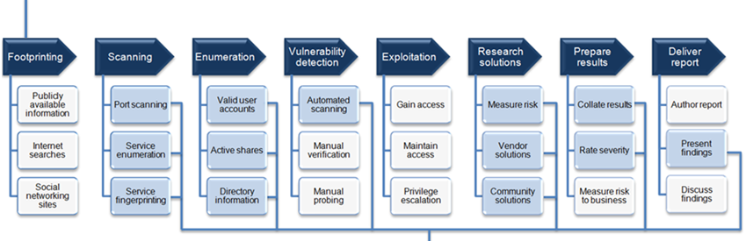
Pen Testing vs. Vulnerability Scanning
Penetration Testing
Vulnerability Scanning
Notes:
Show that vulnerability scanning is a subset of a full penetration testing, don’t hang on this slide too long as the next one covers it too

Slide 29
Vulnerability Management Process
Threat Assessment
Define & Implement Policy
Identify Assets
Threat Intelligence
Prioritise Remediation
Inventory
Continuous Vigilance
Req. 12.1.2
Regular scanning
Alerting systems
Req. 12.1
Exploitable vulnerabilities
Know your CDE
Req. 6.2
Hosts, apps & devices
Notes:
VM is a cyclical process

Slide 30

Compensating Control Allowance
Meets the intent and rigor of the
original PCI DSS requirement
Provide a similar level of defense
as the original PCI DSS requirement
  Control sufficiently offsets the risk
  that the original PCI DSS requirement
  was designed to defend against.
Should be “above & beyond” other
PCI DSS requirements
  Simply being in compliance with other
  PCI DSS requirements is not enough
Be aware of the additional risks by
not adhering to PCI DSS requirements

Slide 31
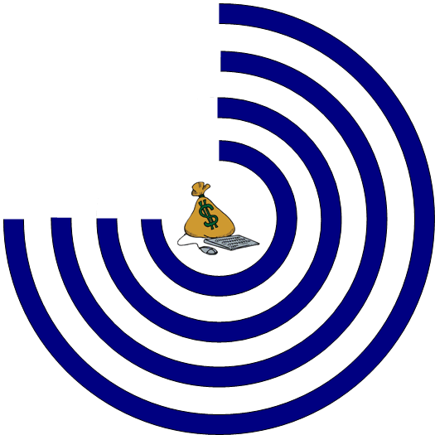
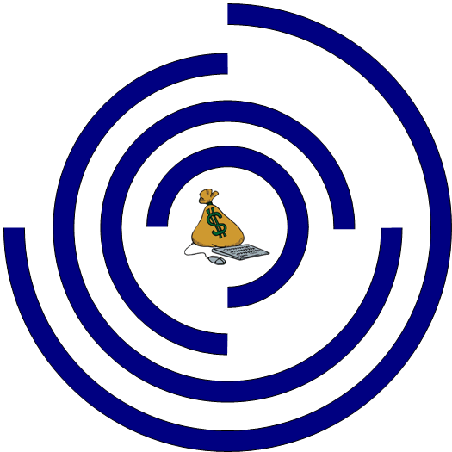
Compensating Controls – Considerations
Perform a Risk Analysis
  Look at a layered solution to provide adequate compensating controls with database monitoring and leak prevention.
Primary Layers
  App Layer Firewall
  Database Security
    Database Security
    is one of the least understood
    categories
    of security.
    If done correctly, database security
    is a legitimate compensating
    control.
Notes:
Primary Layers:
Internal application layer firewall
Database security – Securing your database is one of the least understood emerging categories of security. There are network-based gateways (from folks like Guardium Inc. and Imperva Inc.) and host-based monitoring options (Application Security Inc., Lumigent Technologies Inc.) that purport to monitor database transactions and apply a policy, determining which transactions are allowed based on a myriad of attributes (requestor, application, data type, data content, etc.).
If done correctly, database security is a legitimate compensating control. The database host must be protected because if that machine is directly compromised, data protection is nearly impossible. But short of encrypting all sensitive data at rest, a database security offering can provide appropriate protection. Grade: B+ (Your auditor will grumble a bit, but likely let you skate by.)
Additional layers:
Additional network segmentation
Network access control (NAC) – Network access control has been portrayed by an increasingly desperate network security market (growth is slowing and innovation is scarce) as the cure to everything, including PCI DSS. The reality is quite different; at first glance, post-connection NAC can ensure only authorized parties access front-end applications and only proper resources access back-end databases. Based on the way most applications are architected, NAC isn't helping with client data protection. Why? Because there are few servers that are authorized to access the database, and those few servers need to be able to do anything.
Leak prevention – Data or information leak prevention offerings take a "no blood, no foul" approach to protecting client data. The data can be at risk, but these offerings stop the data from leaking out at the perimeter. By training the leak prevention product to recognize client data and intellectual property, a line of last defense is established where a leak prevention gateway will ensure sensitive information stays put.
Theoretically, the concept holds water. If you can stop sensitive data from leaving your network, then you are meeting the spirit of the PCI DSS. Leak prevention technology should be used as another layer to verify protection if other defenses falter, since nothing is 100% secure.
Email encryption – Since lots of client data leaks via email, the idea of encrypting email with sensitive data makes sense. Unfortunately, there are lots of other ways for data to leak out, so at best email encryption is a partial solution. I don't envision the auditor being grumpy about email encryption deployment, but if that's all you've done from a compensating control standpoint, you'll be sucking auditor exhaust.

Slide 32
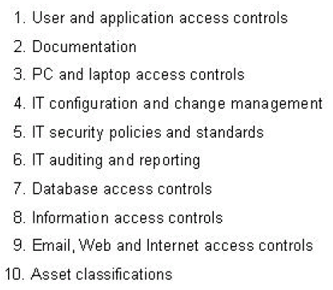
Compensating Controls – Considerations
Additional Layers
  Access control
    A valuable defense against unauthorized access.
  Leak prevention
    If you can stop sensitive data from leaving your network, then you are meeting the spirit of the PCI DSS
  Email encryption
    Encrypting email makes sense. Unfortunately, there are lots of other ways for data to leak out
  Additional network segmentation
Leading Causes of Regulatory Compliance Deficiencies
“Managing Spend on Info Security & Audit for Better Results, February ’09”
Notes:
Primary Layers:
Internal application layer firewall
Database security – Securing your database is one of the least understood emerging categories of security. There are network-based gateways (from folks like Guardium Inc. and Imperva Inc.) and host-based monitoring options (Application Security Inc., Lumigent Technologies Inc.) that purport to monitor database transactions and apply a policy, determining which transactions are allowed based on a myriad of attributes (requestor, application, data type, data content, etc.).
If done correctly, database security is a legitimate compensating control. The database host must be protected because if that machine is directly compromised, data protection is nearly impossible. But short of encrypting all sensitive data at rest, a database security offering can provide appropriate protection. Grade: B+ (Your auditor will grumble a bit, but likely let you skate by.)
Additional layers:
Additional network segmentation
Network access control (NAC) – Network access control has been portrayed by an increasingly desperate network security market (growth is slowing and innovation is scarce) as the cure to everything, including PCI DSS. The reality is quite different; at first glance, post-connection NAC can ensure only authorized parties access front-end applications and only proper resources access back-end databases. Based on the way most applications are architected, NAC isn't helping with client data protection. Why? Because there are few servers that are authorized to access the database, and those few servers need to be able to do anything.
Leak prevention – Data or information leak prevention offerings take a "no blood, no foul" approach to protecting client data. The data can be at risk, but these offerings stop the data from leaking out at the perimeter. By training the leak prevention product to recognize client data and intellectual property, a line of last defense is established where a leak prevention gateway will ensure sensitive information stays put.
Theoretically, the concept holds water. If you can stop sensitive data from leaving your network, then you are meeting the spirit of the PCI DSS. Leak prevention technology should be used as another layer to verify protection if other defenses falter, since nothing is 100% secure.
Email encryption – Since lots of client data leaks via email, the idea of encrypting email with sensitive data makes sense. Unfortunately, there are lots of other ways for data to leak out, so at best email encryption is a partial solution. I don't envision the auditor being grumpy about email encryption deployment, but if that's all you've done from a compensating control standpoint, you'll be sucking auditor exhaust.

Slide 33
Top PCI Misconceptions
Being PCI Compliant ≠ Being Secure
“One vendor and product will make us compliant”
“I use a PA-DSS certified applications. Therefore I'm compliant”
“Outsourcing card processing makes us compliant”
“We don’t take enough credit cards to be compliant”
“Since I don't store credit card information, I don't have to be PCI compliant”
“PCI is vague, with room for interpretation”
“PCI is too hard”
“I use PayPal/Authorize.NET therefore I don't have to be PCI complaint
“PCI compliance ends with a successful assessment”
PA-DSS = Payment Application Data Security Standard
ASV = Authorized Scanning Vendor

Slide 34
Top 10 PCI Pitfalls
No project sponsor/board sponsor or ownership
Lack of budget and prioritization
Misunderstanding of the requirements
Incomplete data flows leading to areas being missed
Incorrect scoping
Misinterpretation of the standard
Technical errors
Misunderstanding the intent of the controls
Prescriptively following the standard, rather than taking a risk-approach
Working with advisors who don’t understand payments or security

Slide 35


Slide 36
Synopsis - A Compliance Framework for Credit Card Security
  As the saying goes, “if you don't know where you're going, you're certainly not going to get where you need to be”. This is certainly applicable to the efforts of many security practitioners aligning their strategies and enterprise infrastructures to comply with PCI DSS (Payment Card Industry Data Security Standard). As outlined in this presentation, the payment industry is faced with an increase in data breaches. This highlights the need to maintain a robust data security standard that protects the consumer, and their personal data. Though PCI DSS compliance, stake-holders can create an environment that lends itself to a high benchmark in security best-practices, and minimizes the tendency of implementing reactionary solutions.

Slide 37
Tags - A Compliance Framework for Credit Card Security
  Gabriel Dusil, SecureWorks, PCI, Payment Card Industry, PCI DSS, Compensating Controls, Application Layer Firewall, Web Application Firewall, WAF, Risk Analysis, Vulnerability Management, Penetration Testing, Pen Testing, Data Breach Trends, UK Payments Administration, Itpolicycompliance.com, 7Safe, Managed Security Services, MSS, SaaS, Security as a Service, Cloud Security, APACS, Forrester

